Slide 1
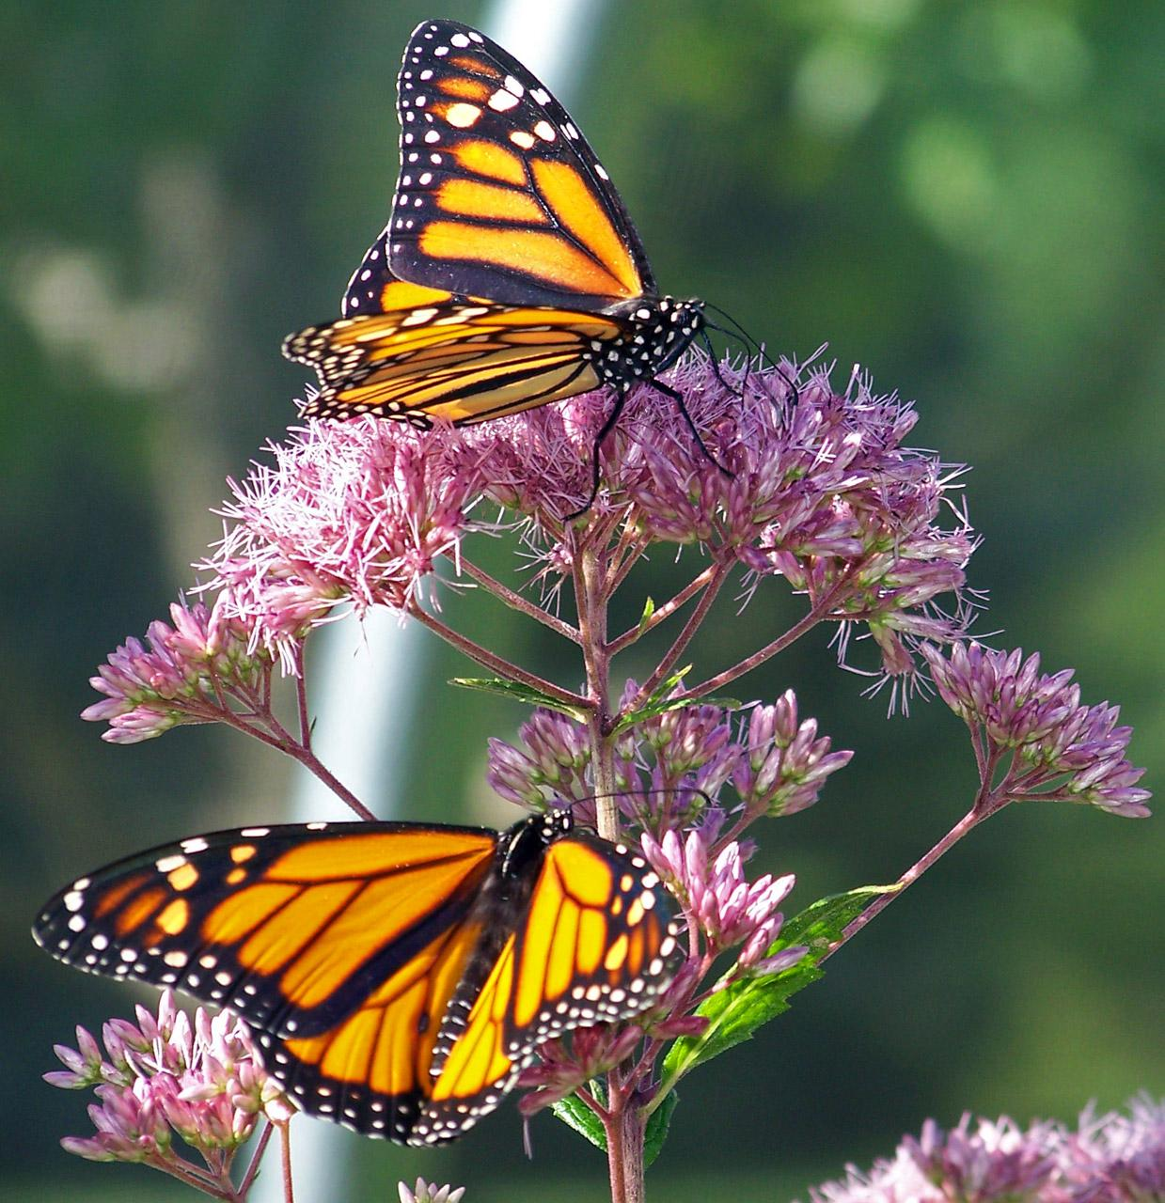
Mattos Science Magnet Docent Program
Second Grade
Lesson 6. Habitat Enhancement for Pollinators Students plant their milkweed plants around the school to provide additional habitat for monarch butterflies and other animals.
Math Science Nucleus © 2024

Slide 2
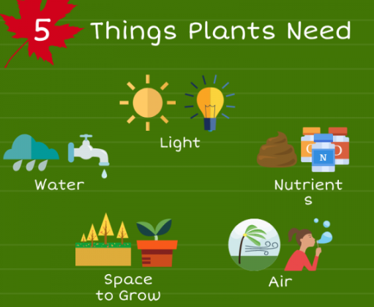
Tie in long term project
longer days, more light and warmer temperatures
Increase growth
? Move milkweed that is in mowing path
? Remove weeds around raised beds
? Plant any new native plants (limited due to water)

Slide 3
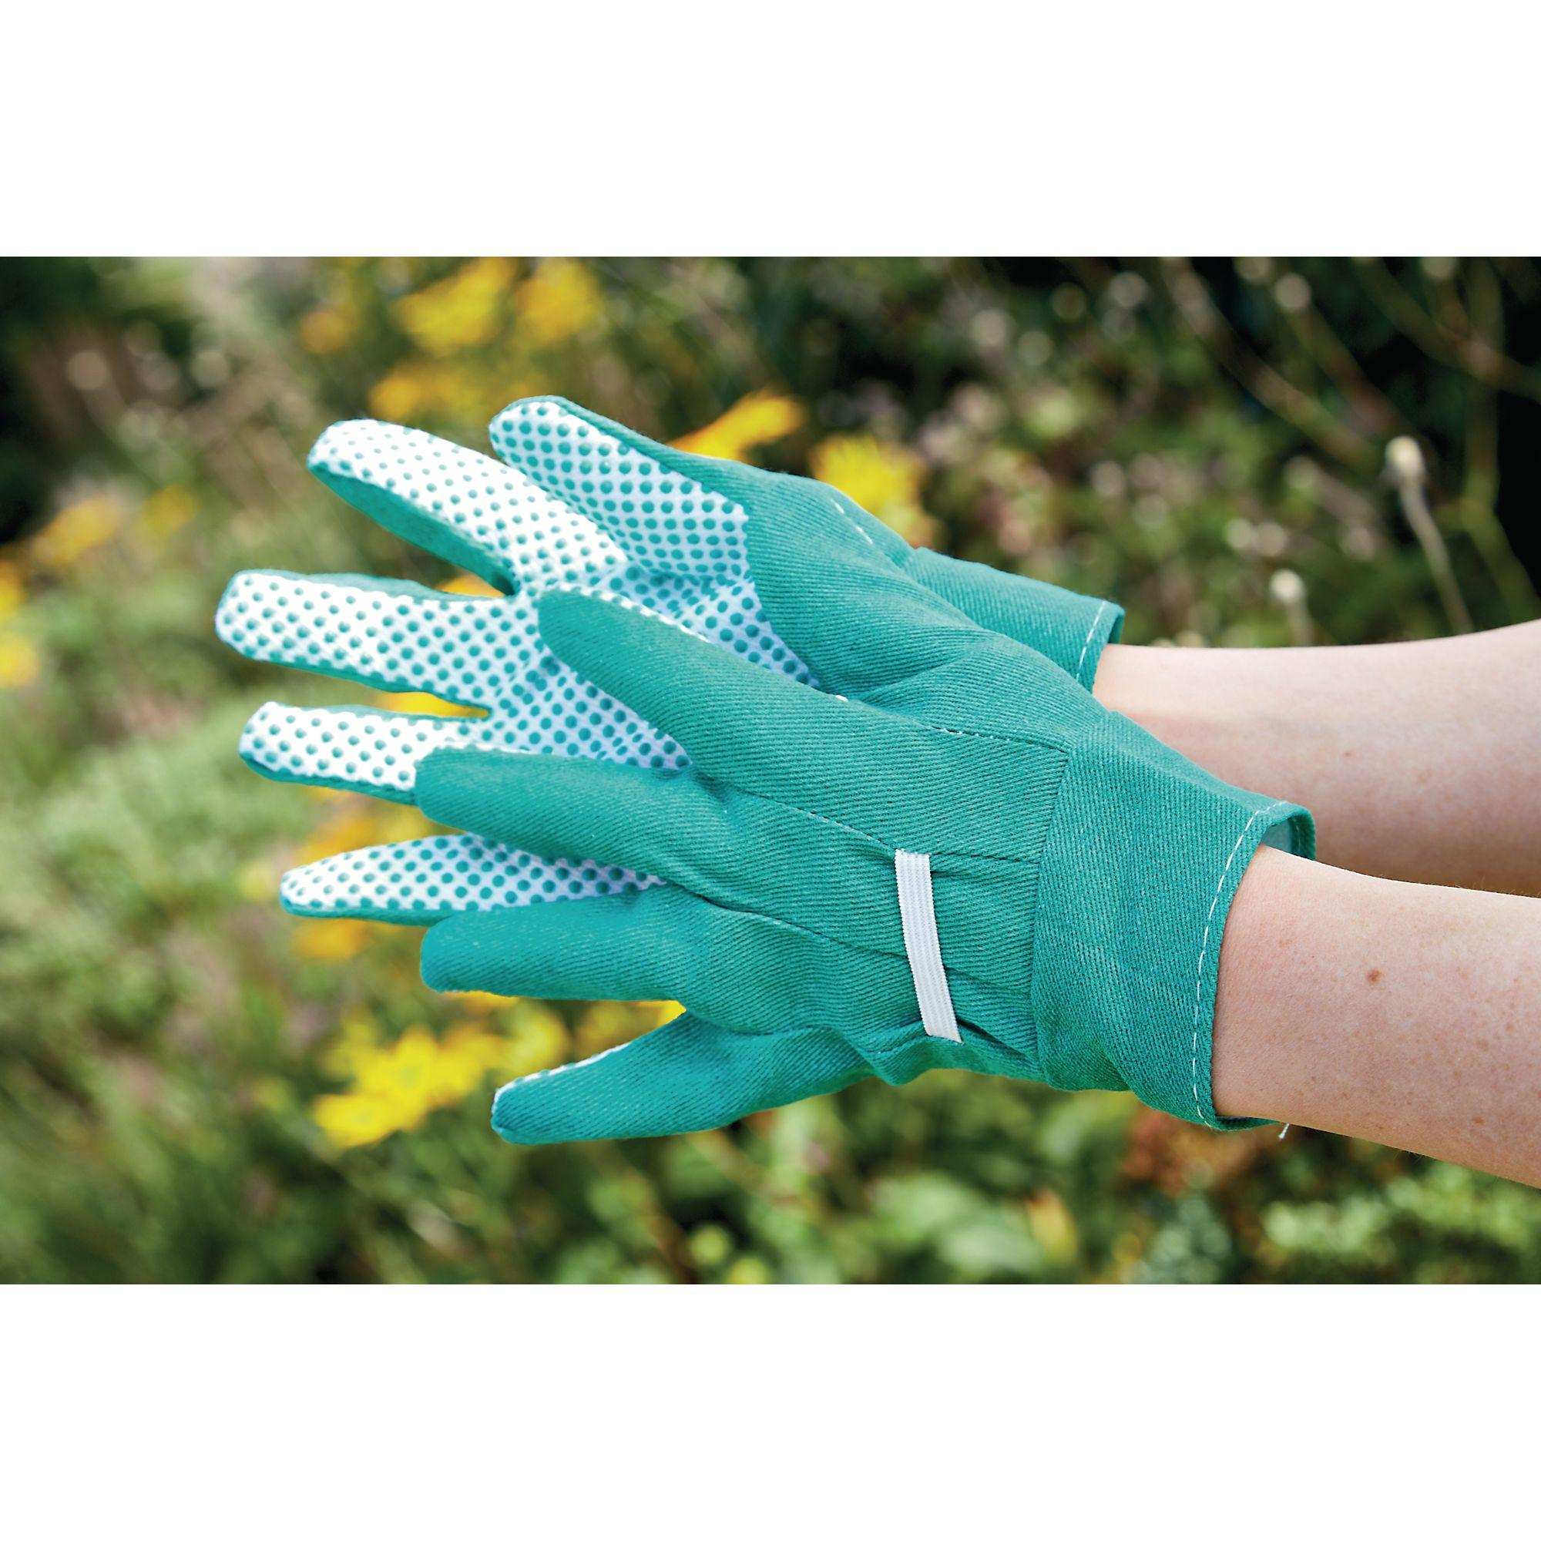
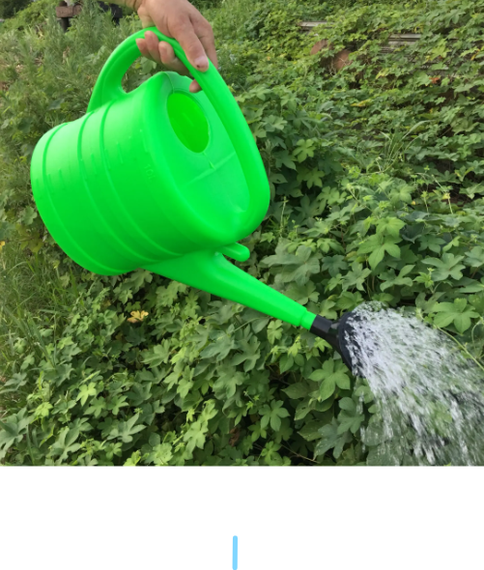
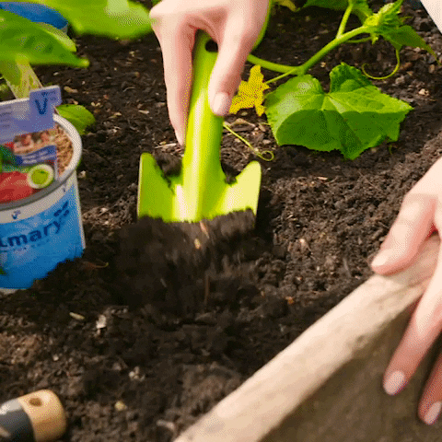
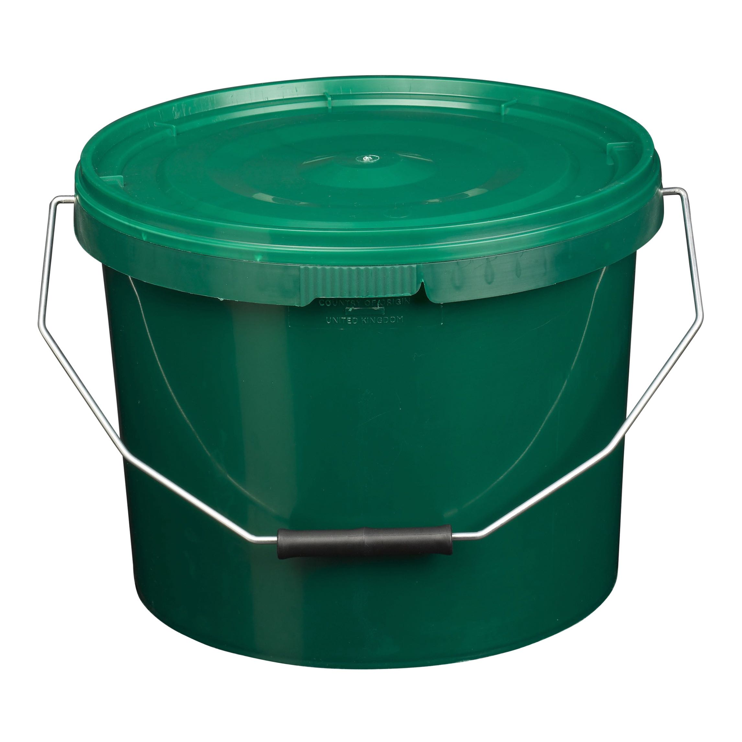
Tools of the garden
Garden work gloves
Watering can
Garden hand trowel
Old bucket or plant pots for trash (weeds)

Slide 4
How to plant a potted plant (step by step)
Get soil ready (clear weeds)
Select what you are planting
Dig hole that you think fits pot
Try pot in hole, Does it fit? Remove potted plant and make it bigger or smaller
Put fingers over pot and turn plant over
6. Top of the plant is even with dirt (planted at same depth it was growing)
Push dirt down between pot and plant
Lightly press soil all around
water
Video or pictures coming soon
How to dig with trowel
Straight down…
How to weed with trowel
What if I find a worm?

Slide 5
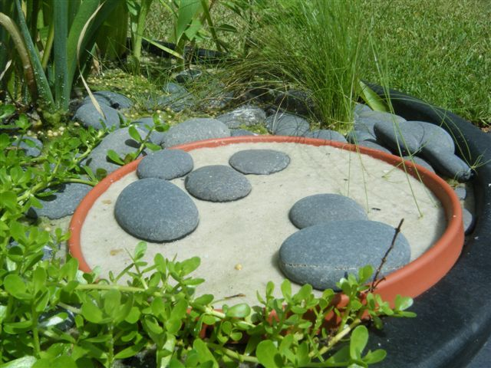
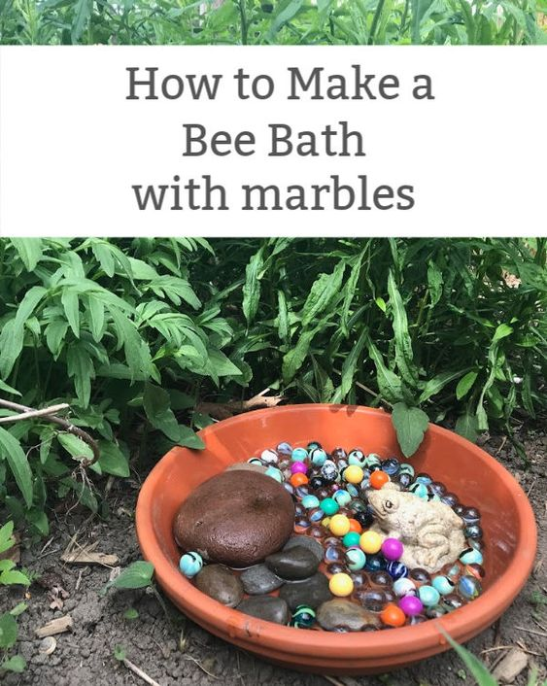
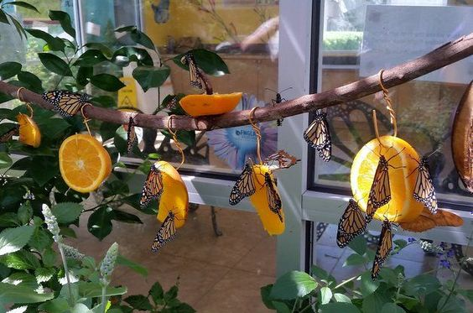
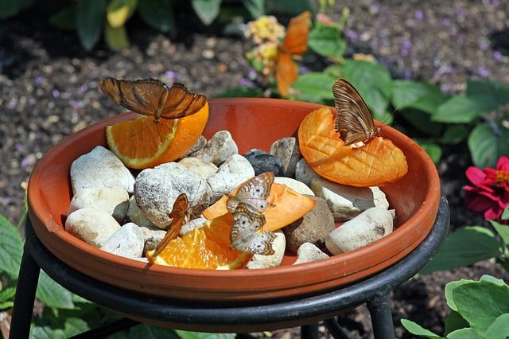
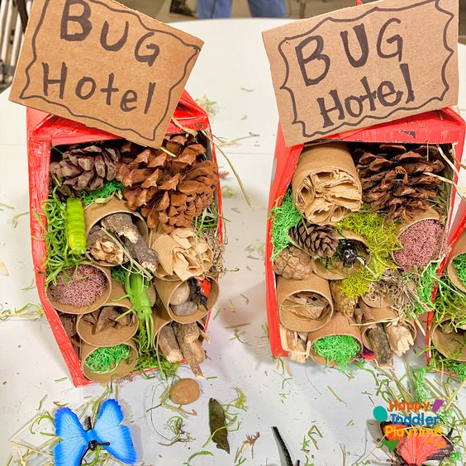
Projects that improve habitat for pollinators
Butterflies need a place to puddle
Use sticks and hollow stems for hiding places for ladybugs and other insects
If no flowers with nectar, put out bananas and oranges

