Slide 1
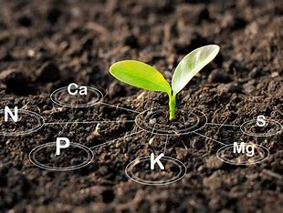
Mattos Science Magnet Docent Program
Second grade Lesson 5. Nutrients in Soil Students learn that nutrients in the soil are important for plants to survive.
Math Science Nucleus © 2024

Slide 2
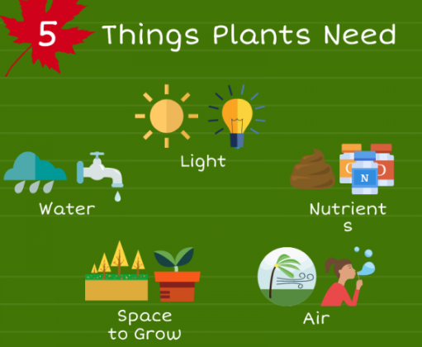
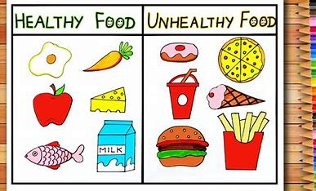
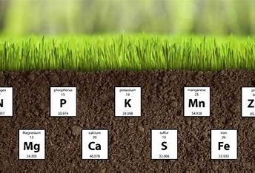
Need to live?

Slide 3
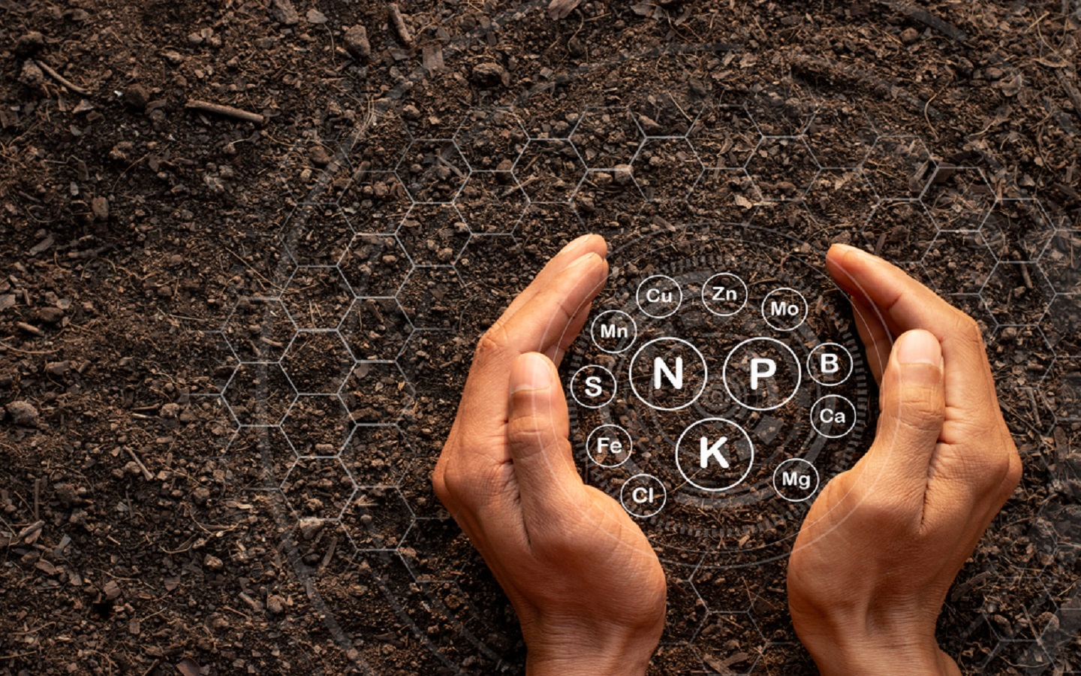
What are these letters?
Can you find them on the Periodic Table?
These are nutrients (like our vitamins) that plants need tobe healthy.

Slide 4
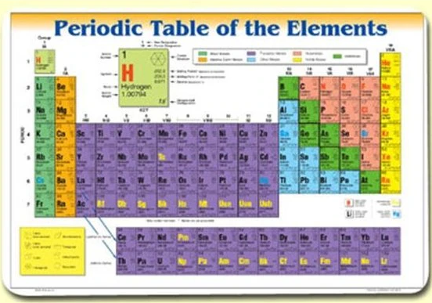
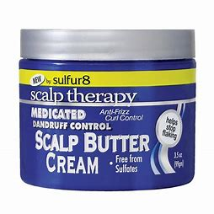
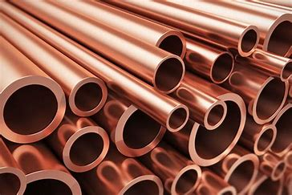
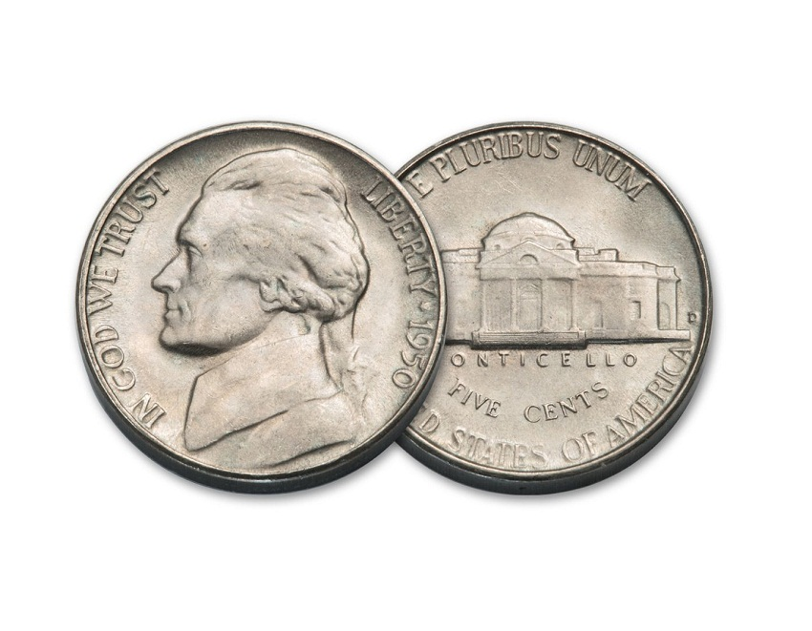
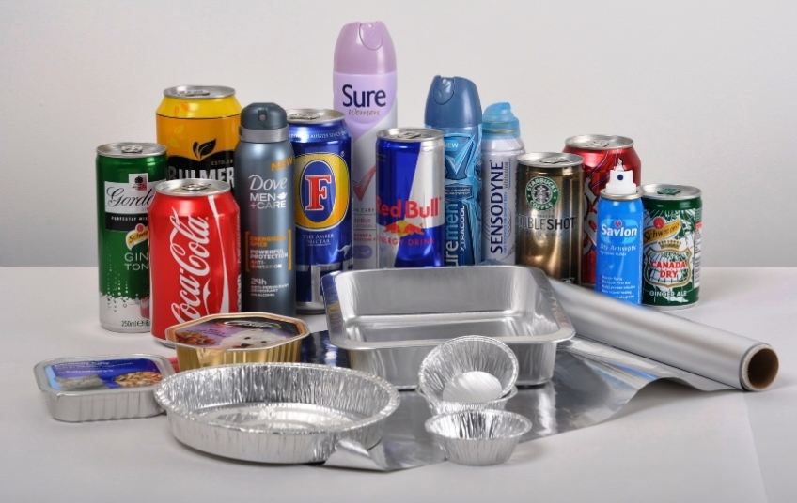
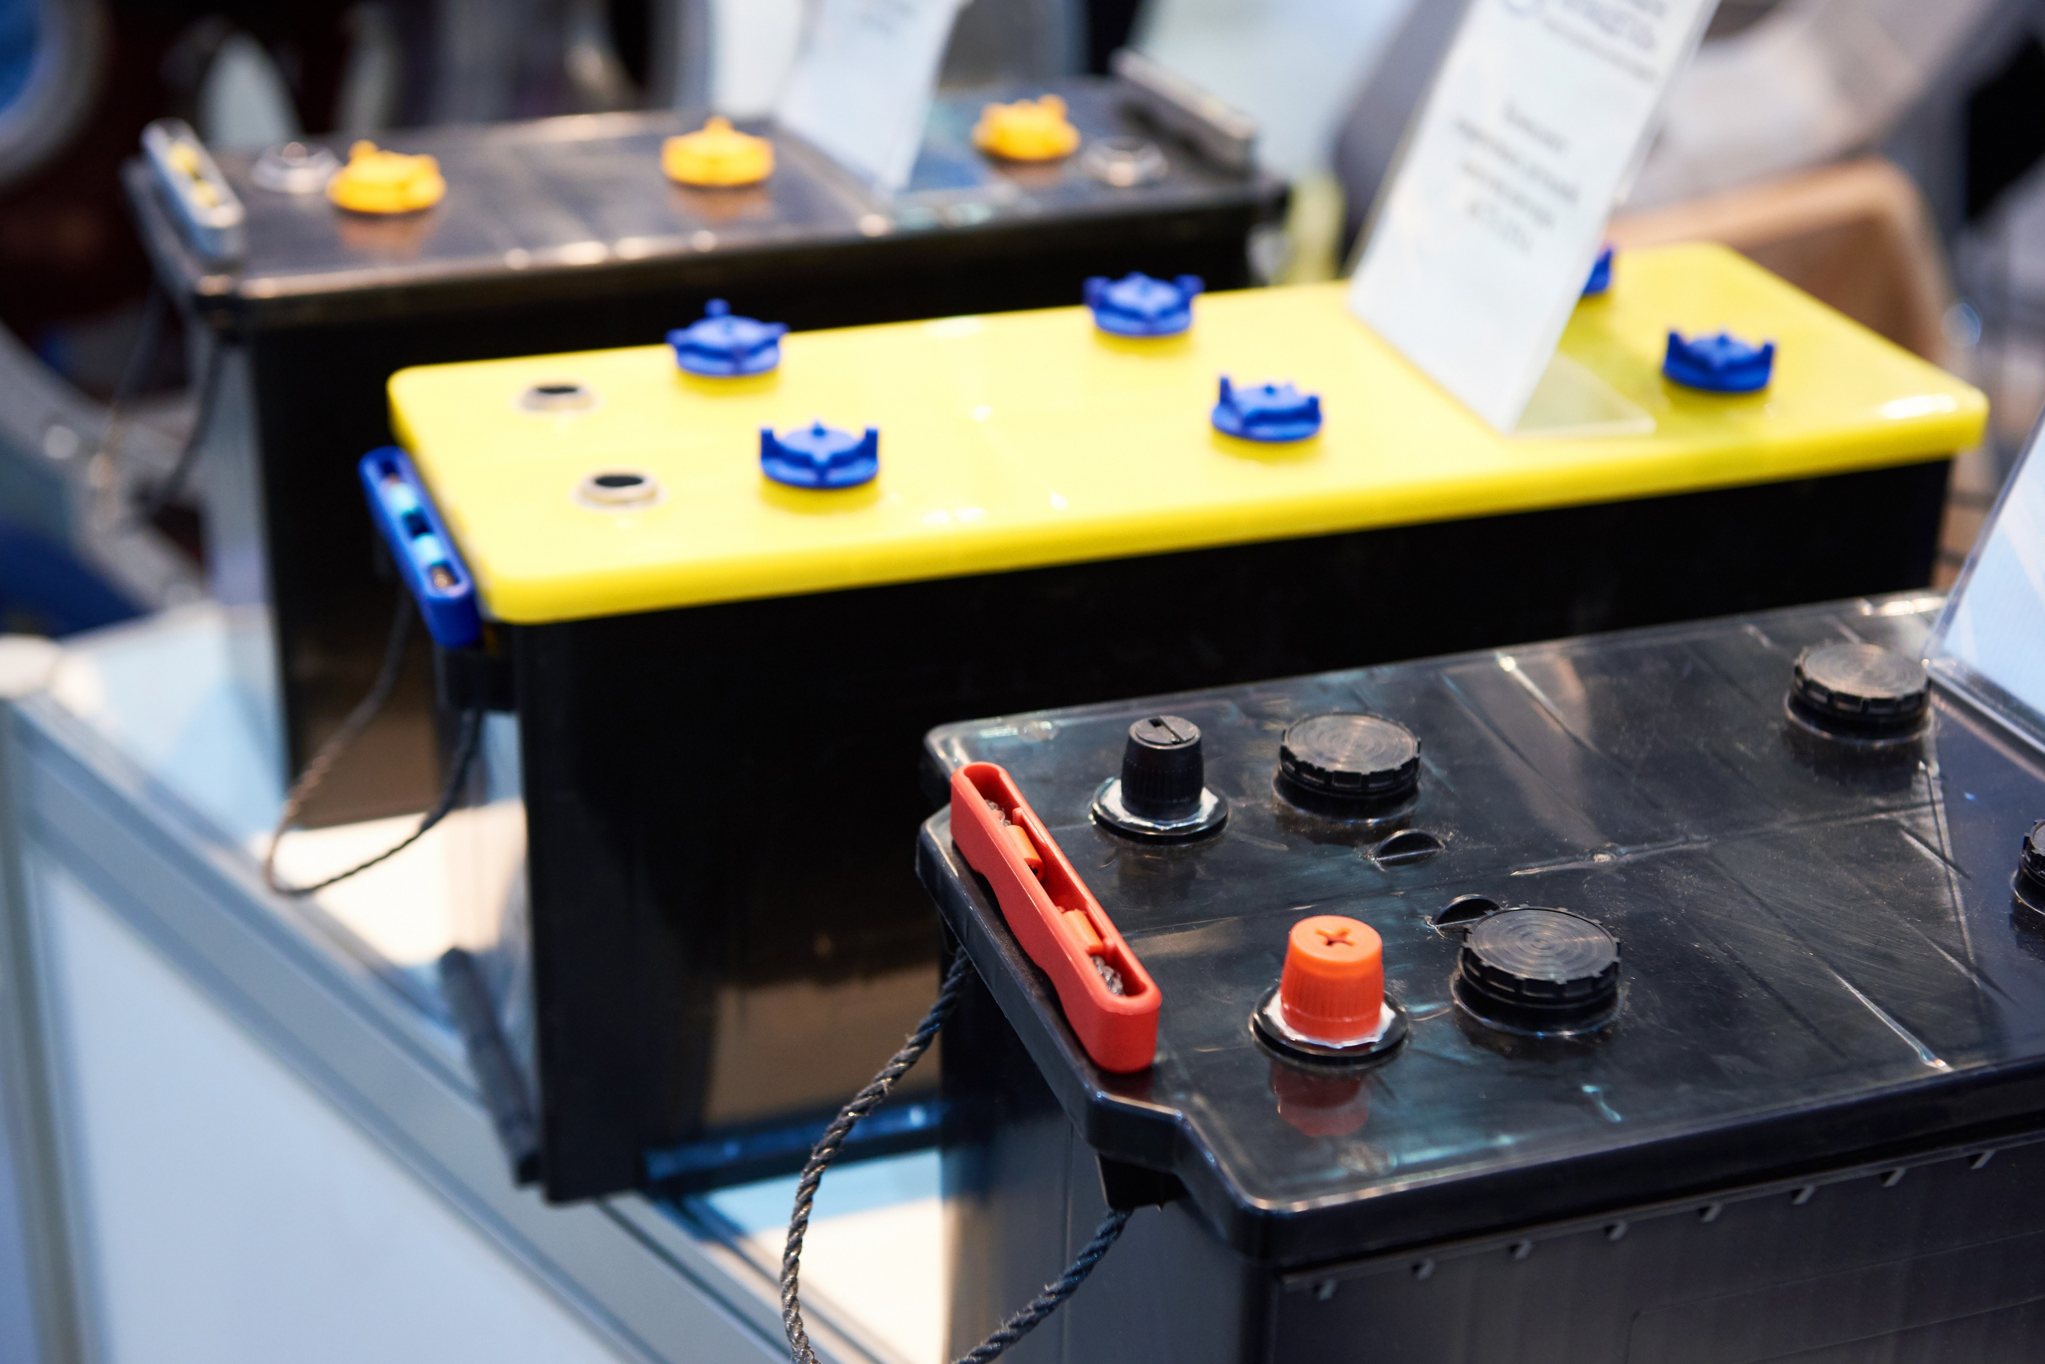
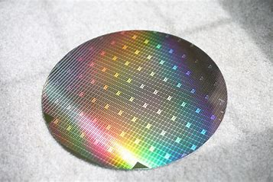
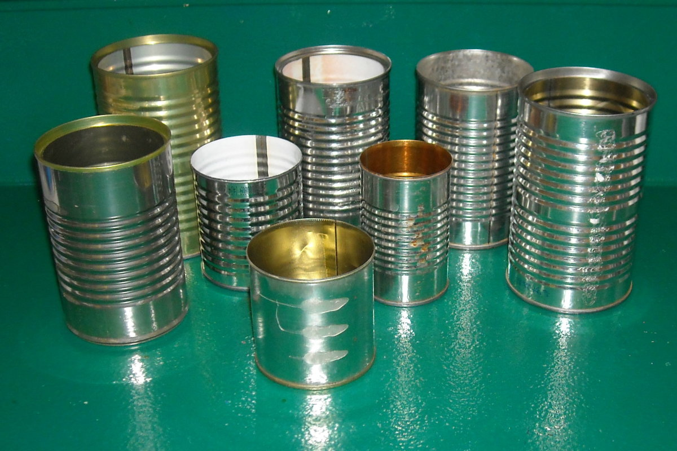
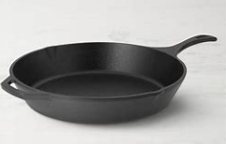
Activity Explore elements of the Periodic Table
Copper
Nickel
Lead
Silicon
Carbon
Sulfur
Aluminum
Iron
Zinc
Tin

Slide 5
Activity Explore elements of the Periodic Table
copper
nickel
sulfur
Copper
Nickel
Lead
Silicon
Carbon
Sulfur
Aluminum
Iron
Zinc
Tin
aluminum
Lead in batteries
Carbon
(graphite)
Zinc roof
silicon
iron
Tin cans

Slide 6
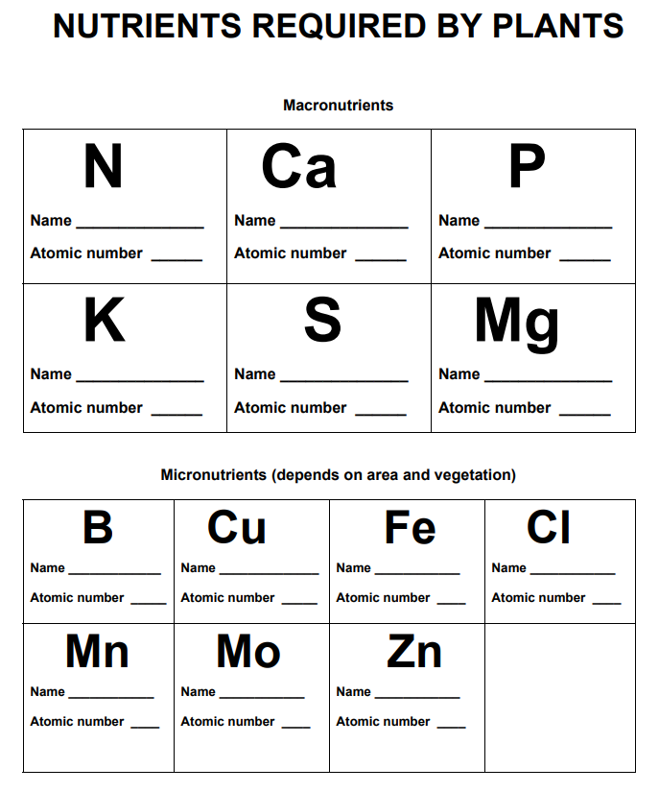
Activity Nutrients required by plants
Use the worksheet to find the name and atomic number. Write it in the space. Cut them apart and place on periodic table

Slide 7
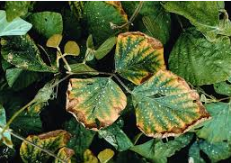
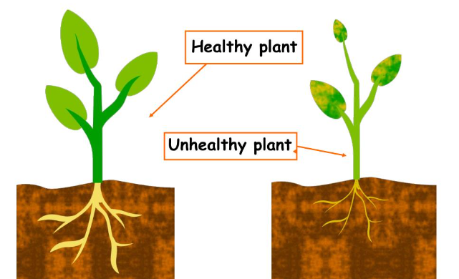
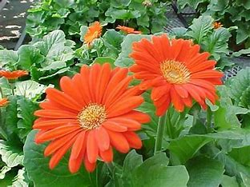
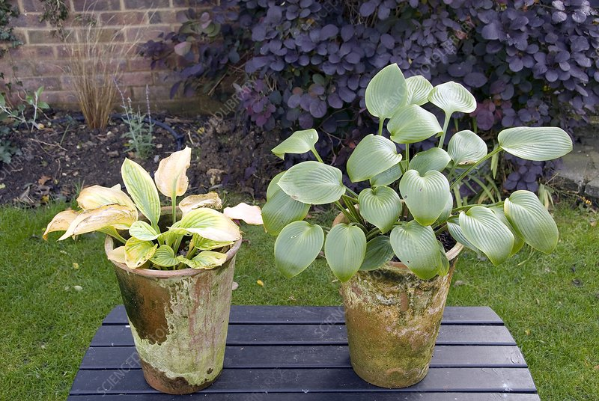
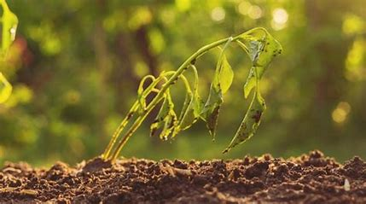
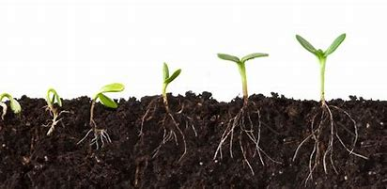
Healthy or Not?

Slide 8
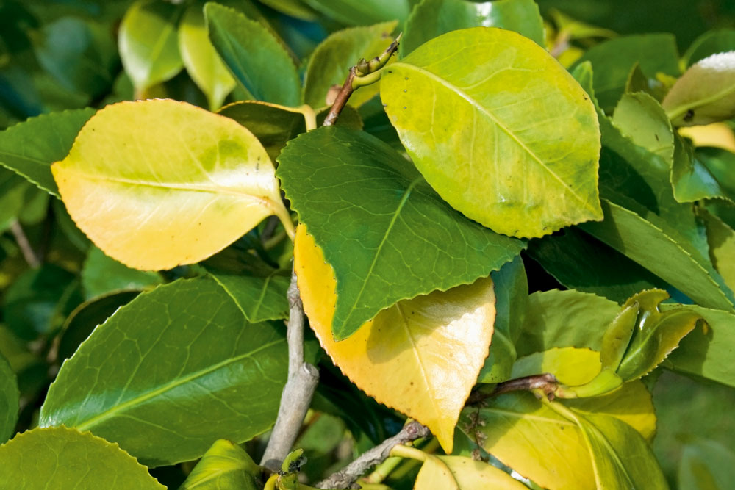
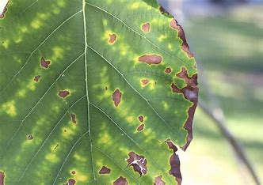
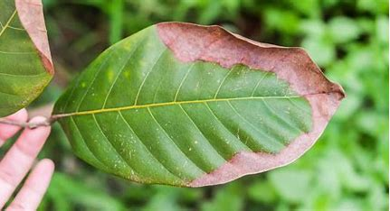
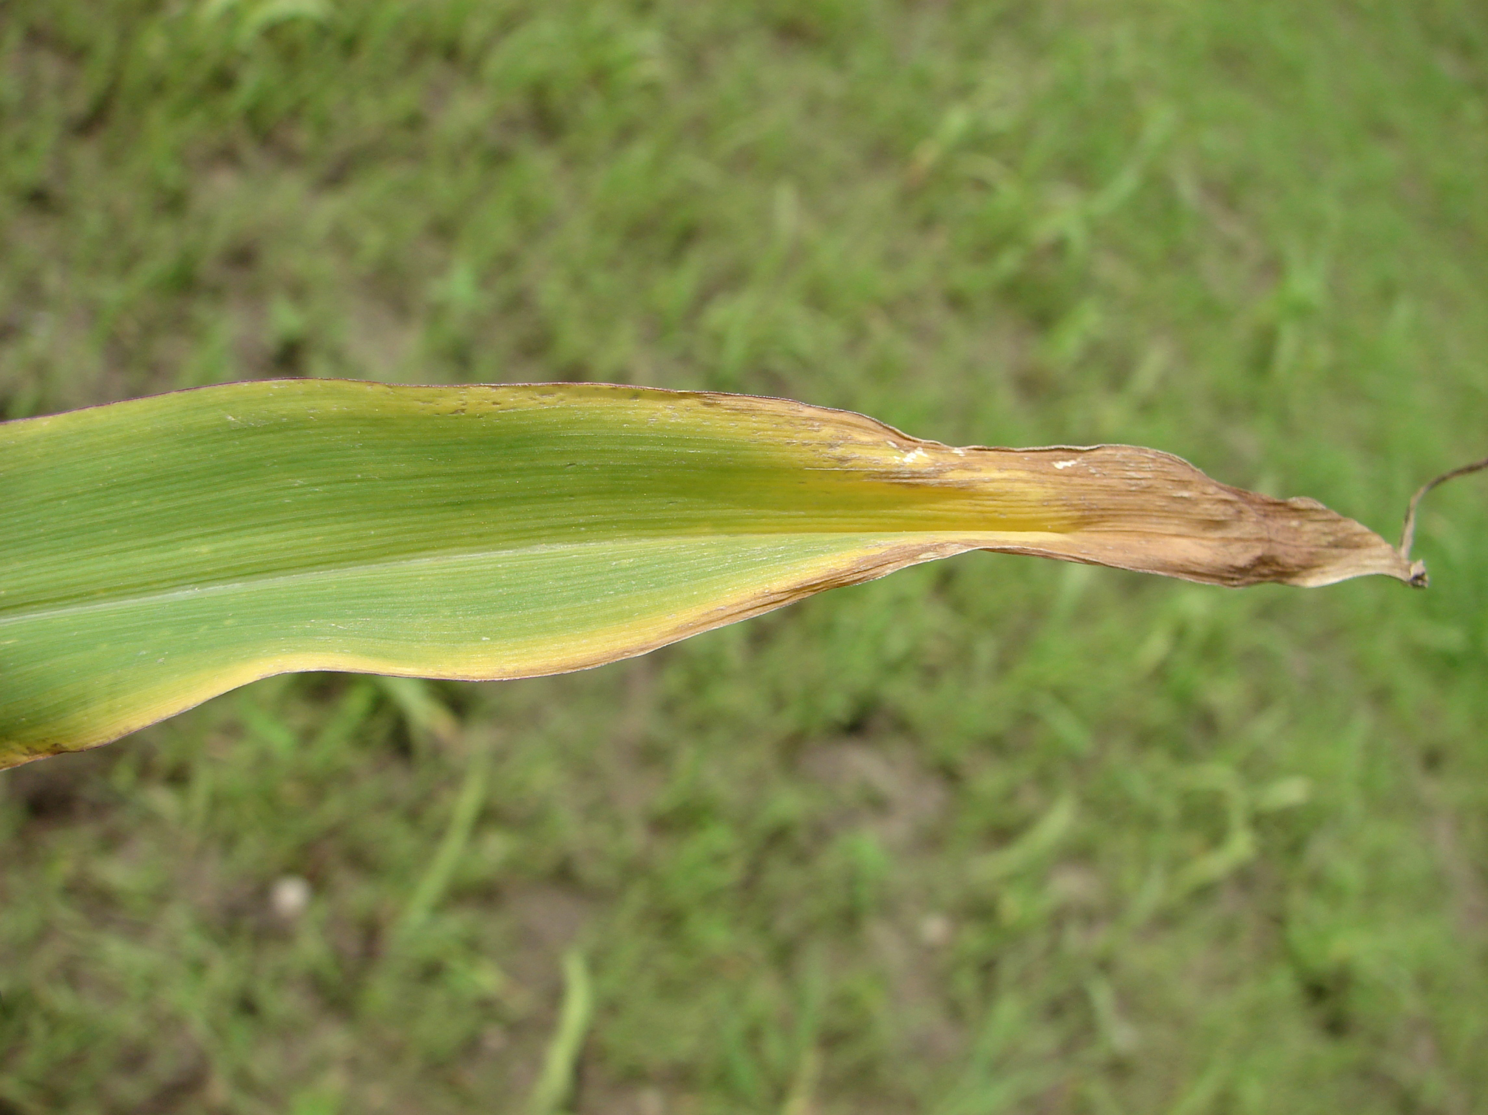
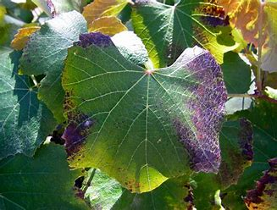
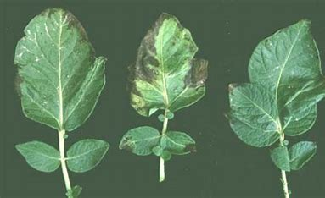
Activity Identifying Plant Nutrient Deficiencies
Learn by reading books, talking with friends that garden, practice observing
Color print and laminate in groups match to 3 sheets?
n
p
n
p
k
k

Slide 9
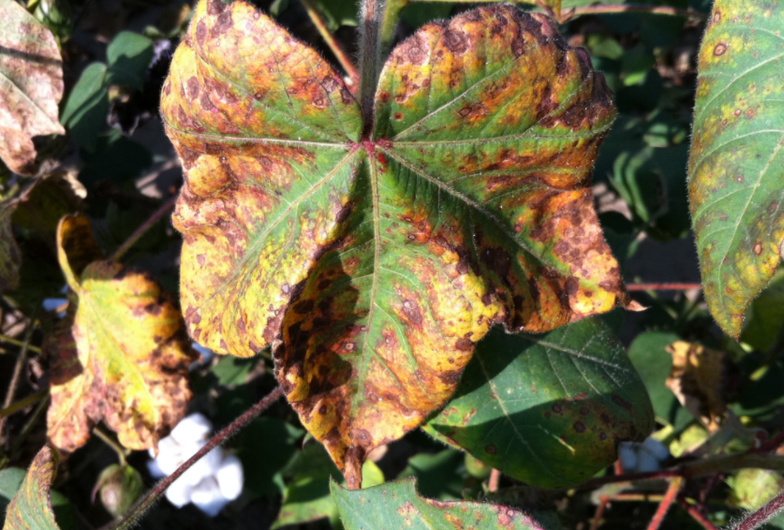
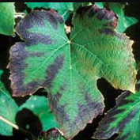
Low Potassium (K)
symptoms include brown scorching and curling of leaf tips, yellowing between leaf veins and purple spots. Reduced growth, root development, and seed and fruit.

Slide 10
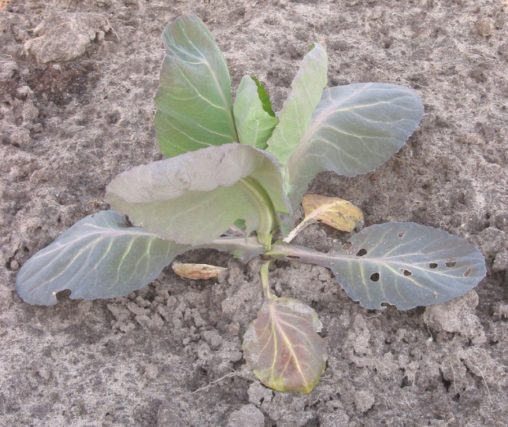
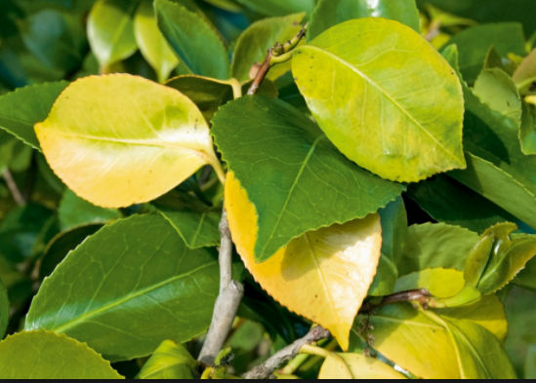
Low Nitrogen (N)
Symptoms include poor plant growth, and leaves that are pale green or yellow because they are unable to make sufficient chlorophyll.

Slide 11
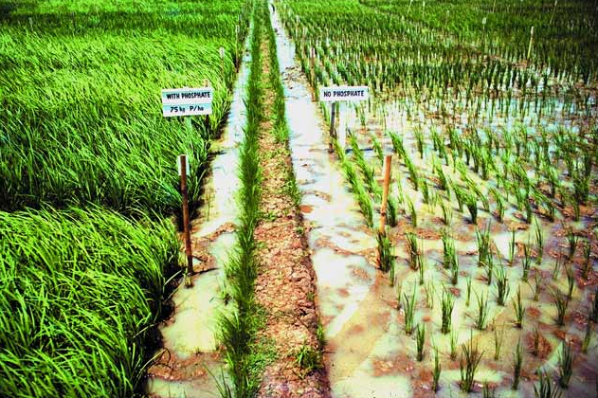
Low Phosphorus (P)
Plants deficient in phosphorus don’t grow well (so are smaller). Leaves may have an abnormal dark-green or a reddish-purple color.

Slide 12
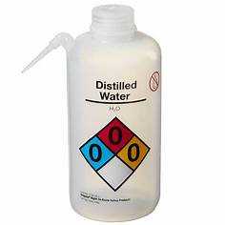
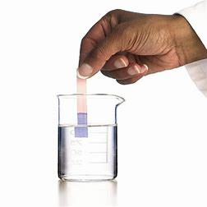
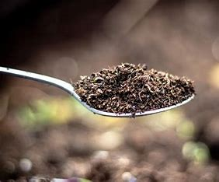
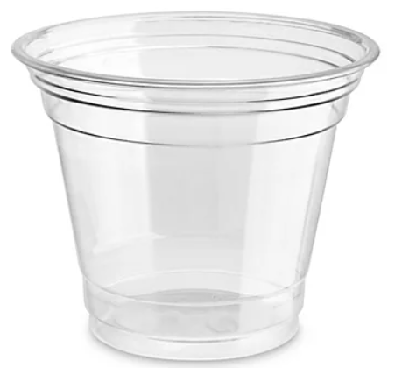
Activity: Be a Soil Scientist!
Garden soil
+
+
stir
Dip litmus paper
Compost

