Slide 1
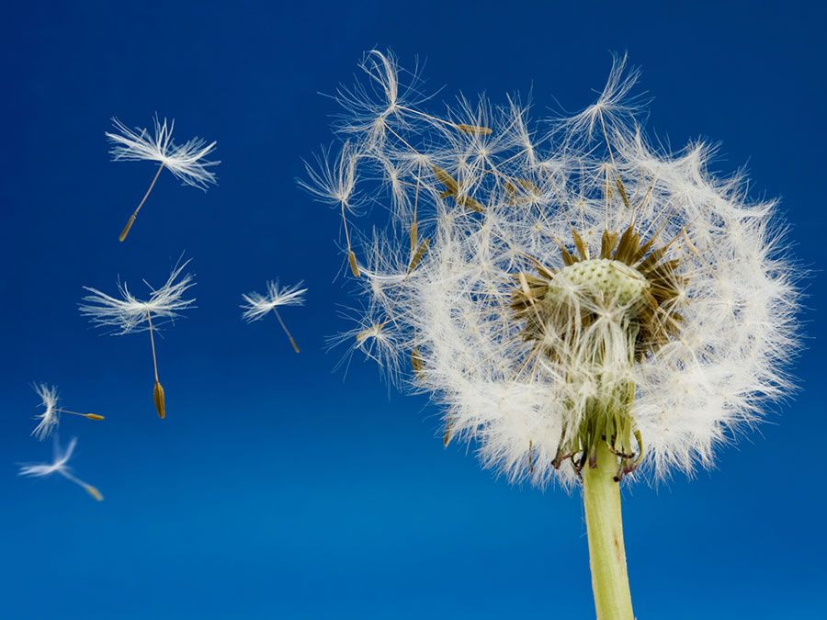
Mattos Science Magnet Docent Program
Second grade
Lesson 3: Seed Parts and Dispersal
Comparing different seeds and exploring strategies plants use to spread or disperse their seeds.
Math Science Nucleus © 2024

Slide 2
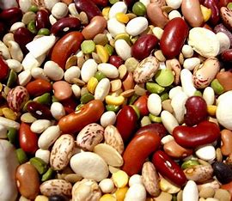
Life cycle plants Kb
Activity: Compare different types of seeds
Explore parts of dried seeds
Smallest?
Largest?
How many different colors (seed coat)?
How many different shapes?

Slide 3
Reference Life cycle plants 1Alab
Activity: Parts of a Seed
Seed coat
Dry seed
Wet seed

Slide 4
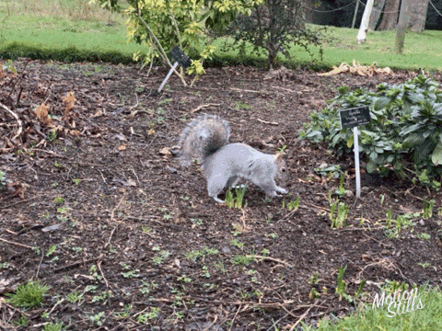
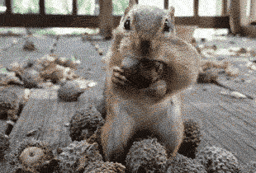
Animals moving seeds
Animals find a seed. Take it to their home or hide it for later. If they forget, it may start to grow.

Slide 5
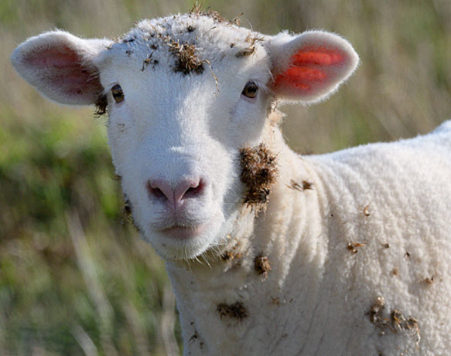
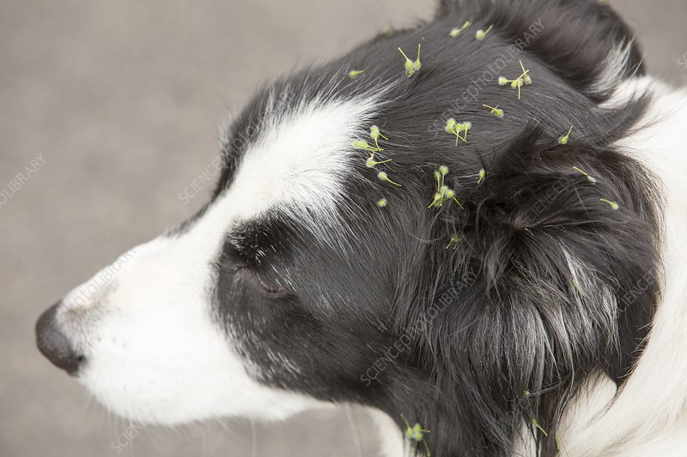
Animals moving seeds.
The seeds stick to fur or feathers and drop off in a new location.
Large sticky seeds that tangle in fur… Cockleburrs
Small sticky seeds like Velcro…
Hitchhikers

Slide 6
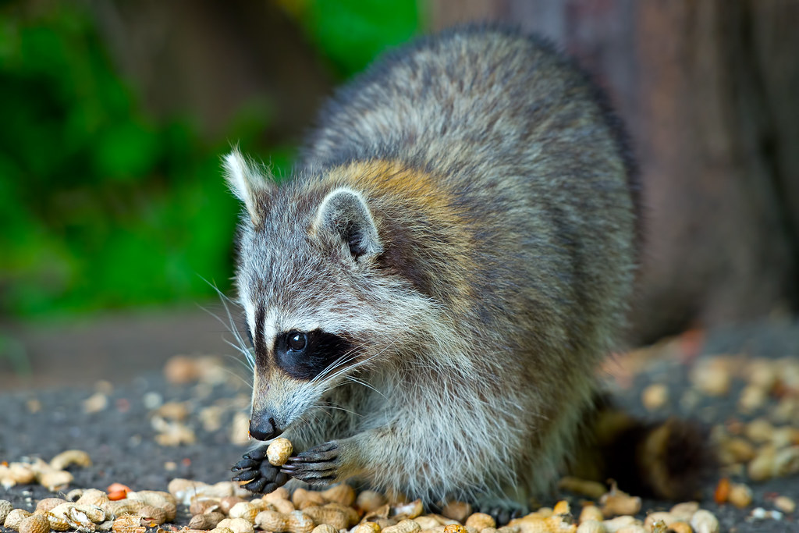
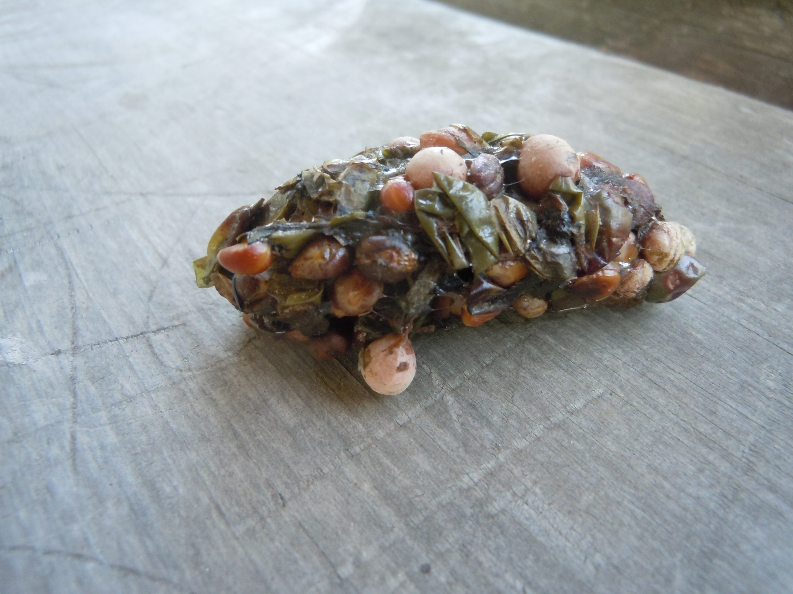
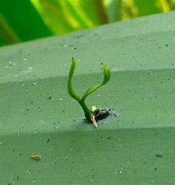
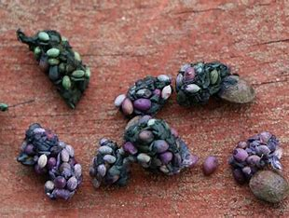
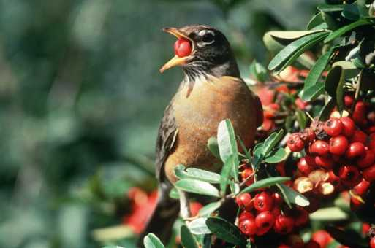
Moving through animal gut
Animal eats fruit/nuts and the seeds. Goes through gut, removes seed coat. When its pooped out, the seed is ready to grow!

Slide 7
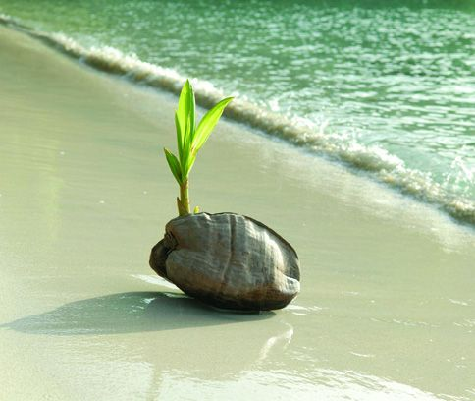
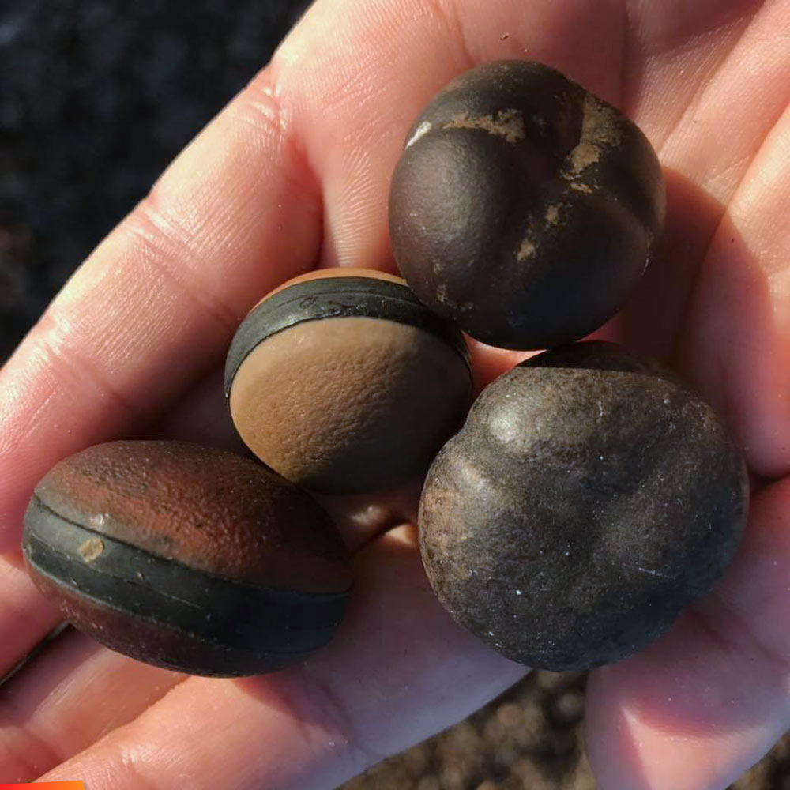
Seeds float in water and travel far distances
coconuts

Slide 8
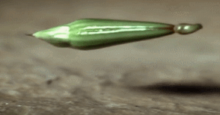
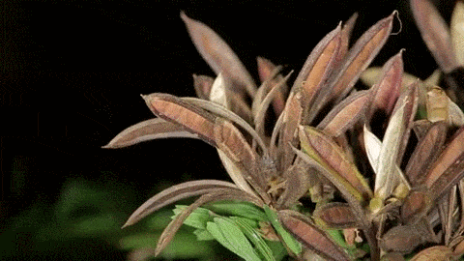
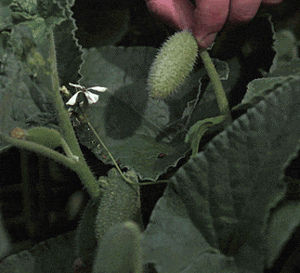
Seed Pods popping open!

Slide 9
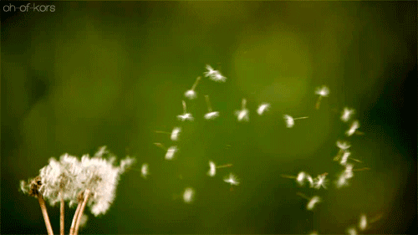
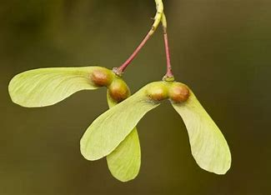
Wind can move seeds!
The seeds look like helicopters and parachutes.

Slide 10
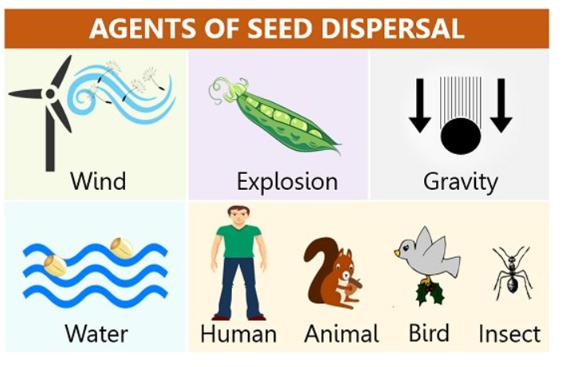
Activity: How seeds move!
Many plants have roots in the ground. They can’t move, but the seeds can move!
Pick a seed. How does it move to a better location to grow?

Slide 11
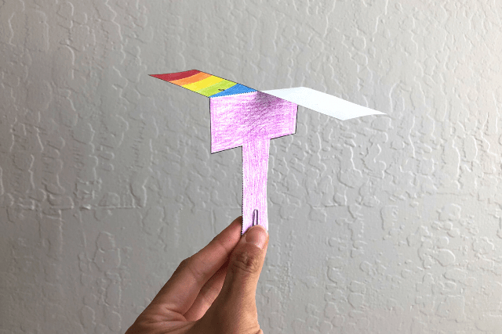
Activity: Make a model of a maple seed.
It has wings, and spins like a helicopter.

Slide 12
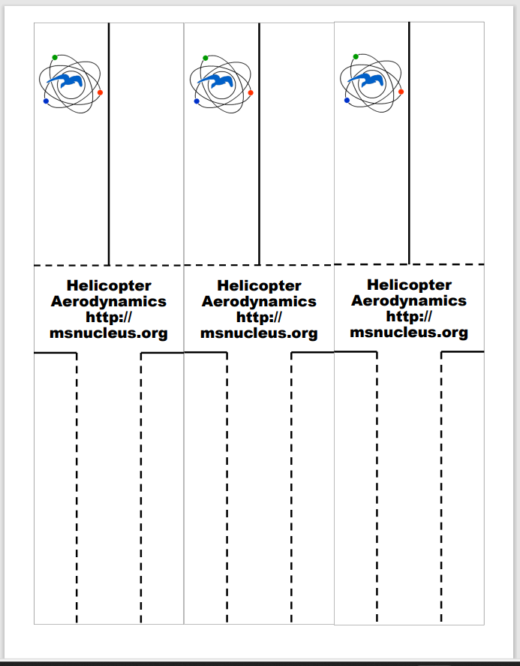
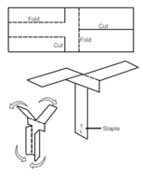
Fold dotted lines
Cut solid lines
Fold 2 sides in and secure with a paper clip on base.

