Slide 1
Mattos Science Magnet Docent Program
Second Grade Lesson 1. Classification of Plants
Math Science Nucleus © 2024
Notes:
Introductions to All the Parent Docents
Reminders: Please raise your hands to give an answer or ask a question
The study of plants is called botany or plant biology. Today we are all going to start to learn how to be plant biologists. We are going to learn how to classify different types of plants. The kind of plant that we are going to focus on is trees.

Slide 2
What is a Plant
Makes their own food (photosynthesis)
Needs light
Needs water
Needs nutrients

Slide 3
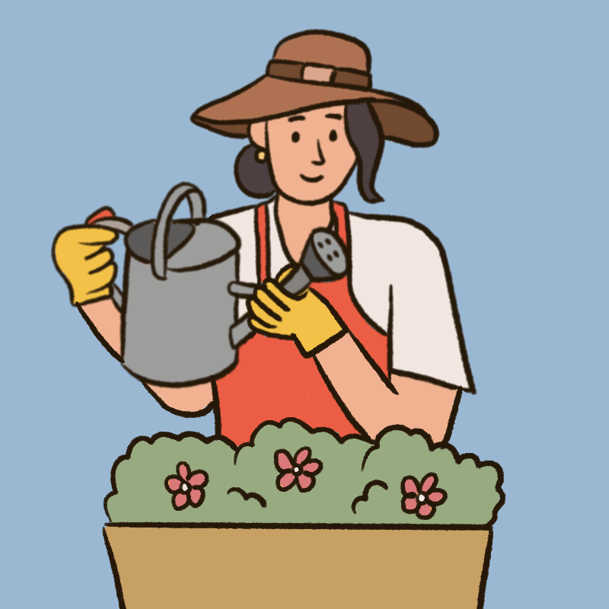
There are many types of plants
Plants are found on land and water
Trees are plants with woody tissue.
Small plants are herbaceous.
Some plants have leaves.
Some plants have flowers and pollen to make seeds.
We group plants on where they grow and identifying characteristics

Slide 4
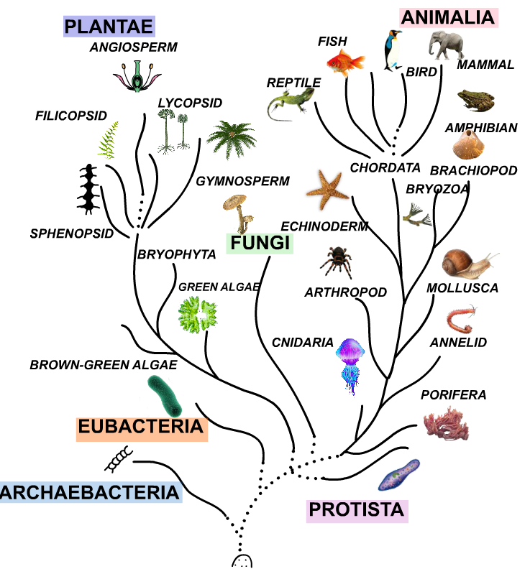
Plant Kingdom
Green Algae
Bryophyta
Sphenopsid
Filicopsid
Lycopsid
Gymnosperm
Angiosperm (flowering)

Slide 5
Notes:
There are two different types of tree, broad-leaf and needle-leaf. An example of each is shown on the slide.

Slide 6
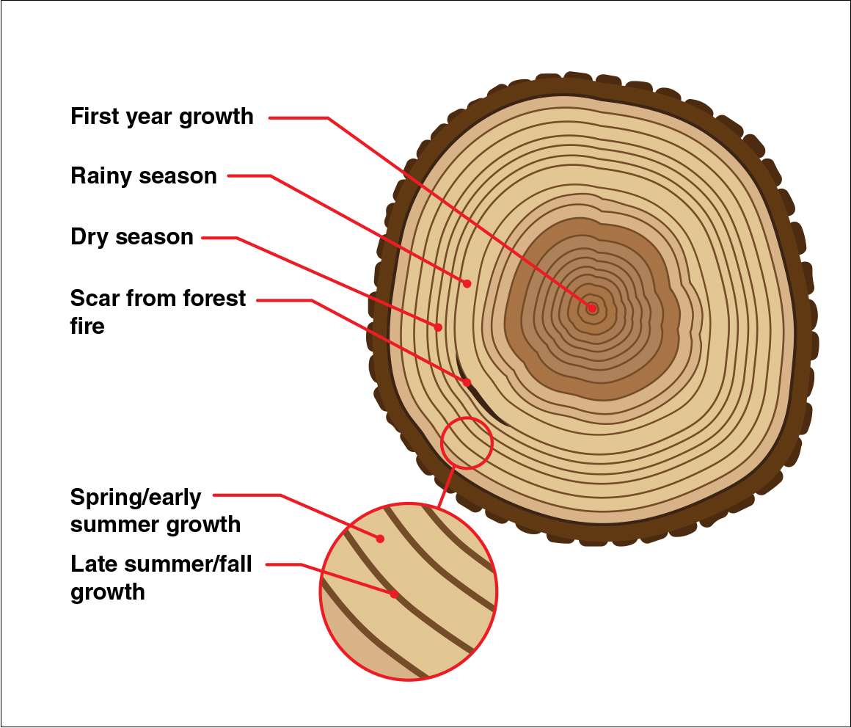
Activity
To know the age of a tree, count the rings. Each ring represents a year.
Count the age of some tree sections. The tree is made of woody tissue.
Notes:
trees grow at different rates depending on what season it is. In the spring and early summer, trees grow more quickly and make wide, light-colored bands. When the conditions for growing are really good – like when there is a lot of rain — the band is extra wide. The rest of the time, trees grow more slowly and make thinner, darker colored-bands. This means that you can look at the inside of a tree — called the cross section — and learn how old a tree is. Each dark band means a winter is passed. So if you count those bands, you can know the age of the tree
Pass out tree cookies and ask them to estimate the age of the tree.

Slide 7
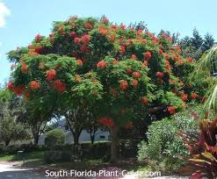
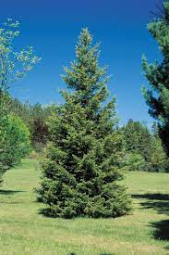
broadleaf are angiosperms
needleleaf are gymnosperms
Notes:
There are scientific words for each of the types. A broad-leaf tree is called an angiosperm. A needle-leaf tree is called an gymnosperm.

Slide 8
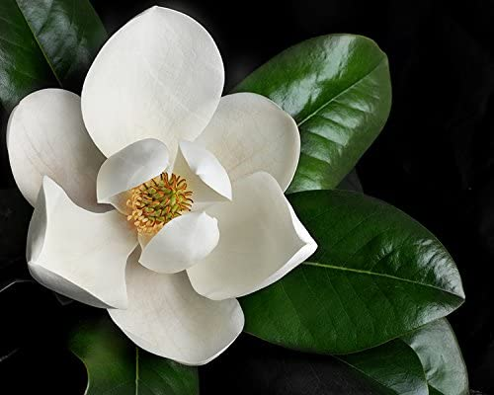
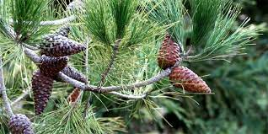
angiosperms use flowers for seeds
gymnosperms have cones for seeds
Notes:
The female part of the plant will produce the seed. In an angiosperm the seed is protected, usually with a fruit. The gymnosperm will not have any protection and they come out of the cone.
Both types of trees produce pollen. Does anyone know what pollen is?
Maybe you have heard about pollen as something people are allergic to? Pollen is produced by the male part of a tree. The yellow pollen in baggies are from pine trees. They produce so much that if it rains when pollen is produced many puddles will have a yellow look because of all the pollen.

Slide 9
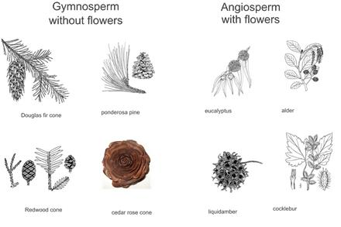
Activity–
Match the samples with their drawing
Sort the living samples into needle and broadleaf
Notes:
Now let’s practice what we learned about angiosperms and gymnosperms to sort some from trees in our neighborhood. Work with your group to sort the plants at your table. The parent docents will come around to ask you what observations you made to help you sort the leaves.

Slide 10
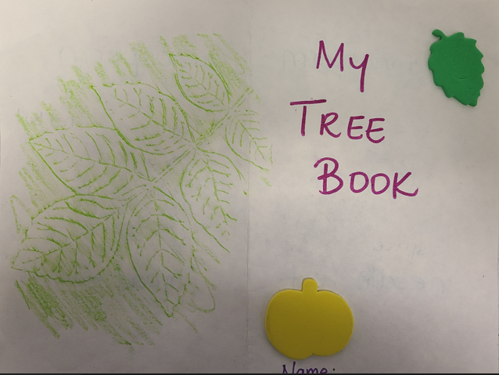
Activity
Notes:
Now that you’ve learned about angiosperms and gymnosperms, let’s make your own book about tree classification. You could take it home to teach your grown ups or brothers and sisters about the two different types of trees.
Pick a sample of each, make a cover, and label them on the inside. I will leave this slide up to help with the spelling. The parent docents will pass out tape so you can tape your samples in your booklets.

Slide 11
On your way home or school playground classify plants
Is it a tree? Does it have broad leaves or needle leave?
Is it without woody tissue (herbaceous)?
Does it have flowers?
You will see that there are many types of plants. A botanist is a scientist that studies plants.

