Slide 1
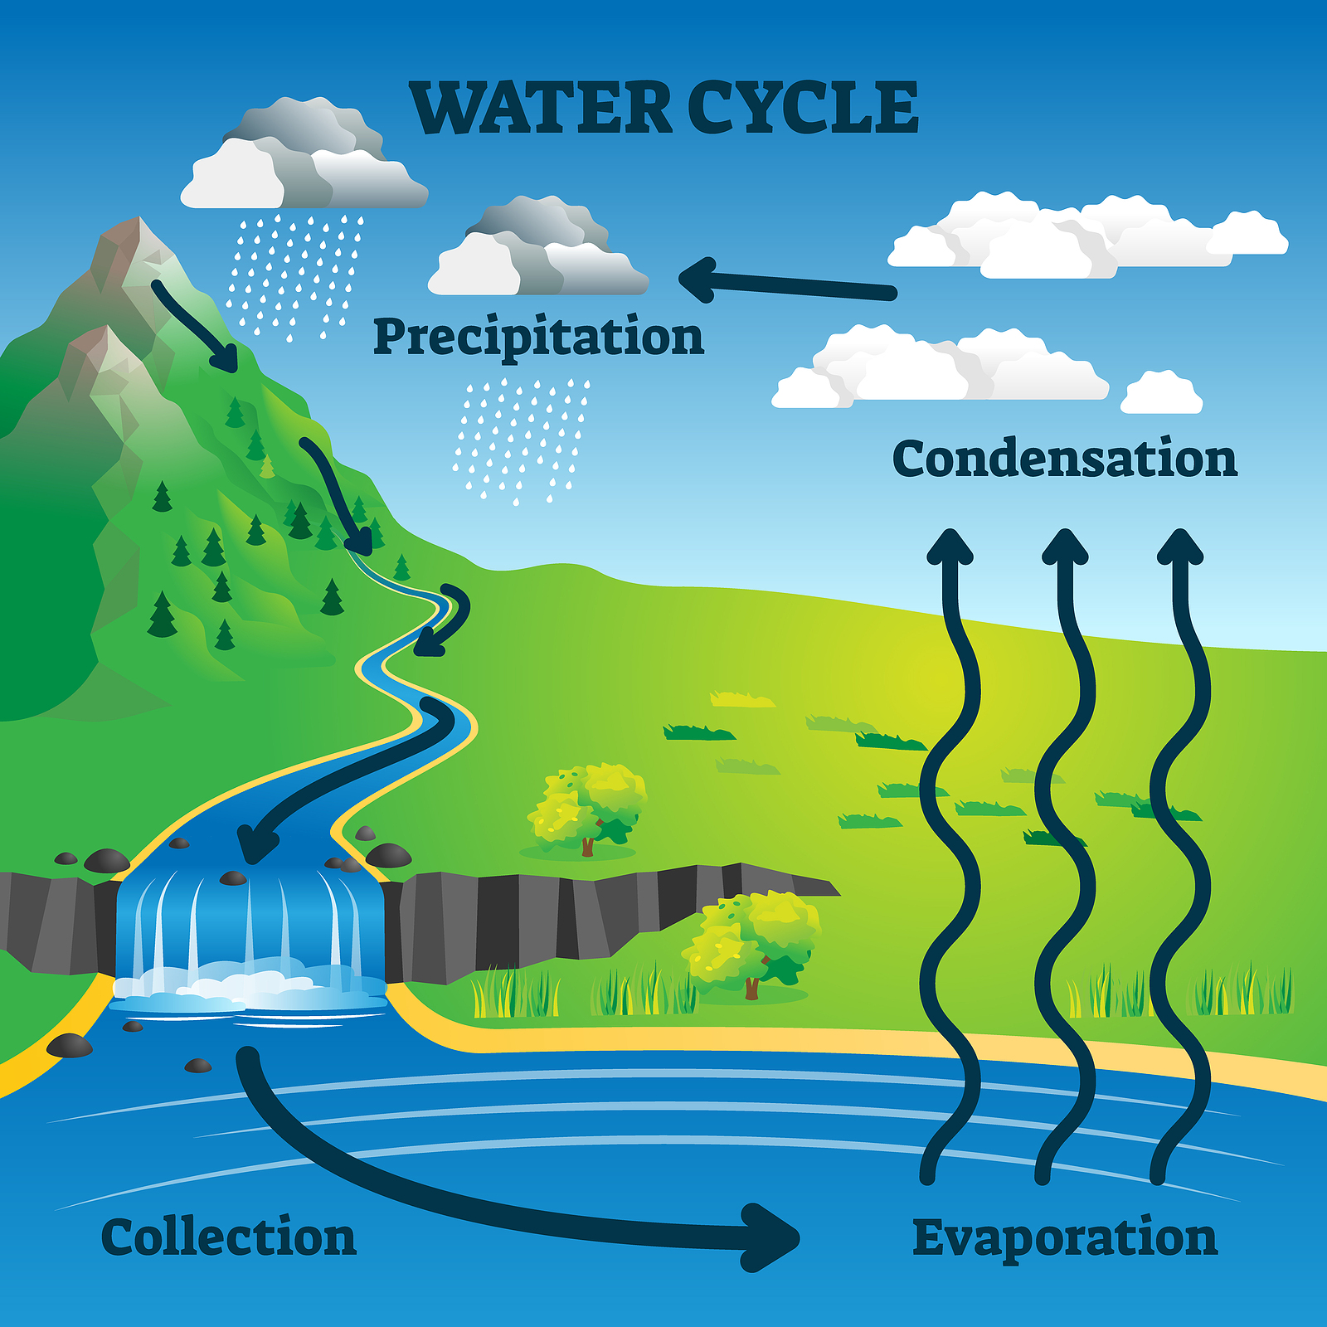
Mattos Science Magnet Docent Program
Kindergarten, Lesson 6. Weather
Learning the elements of weather and the Water Cycle
Math Science Nucleus © 2024

Slide 2
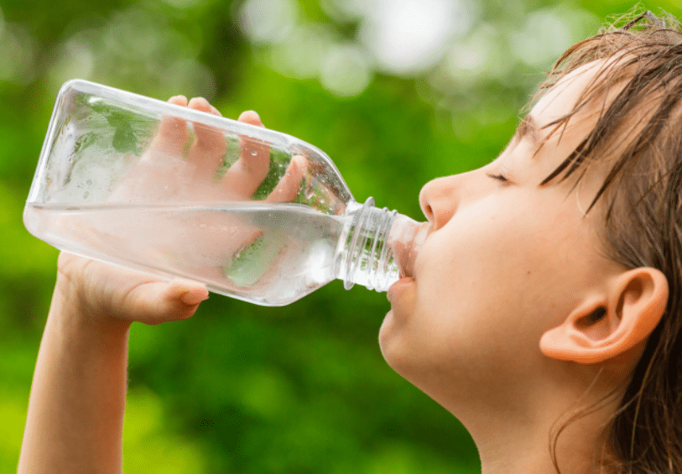
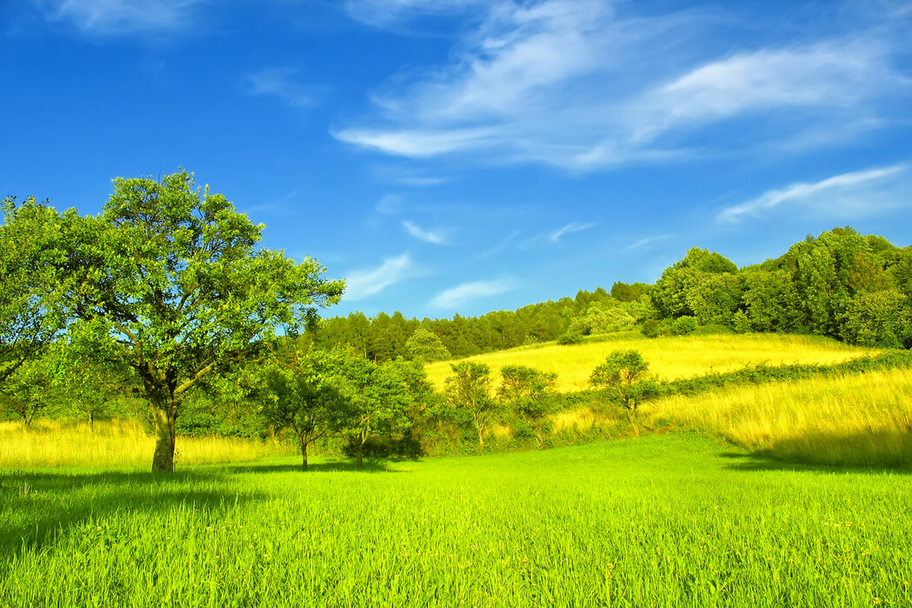
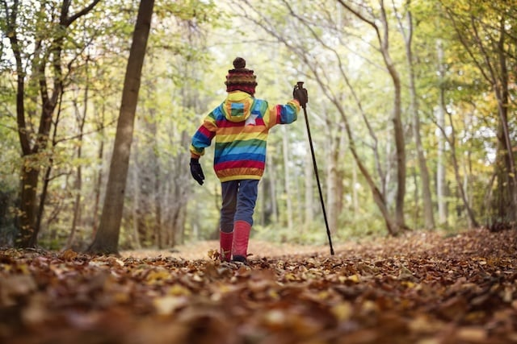
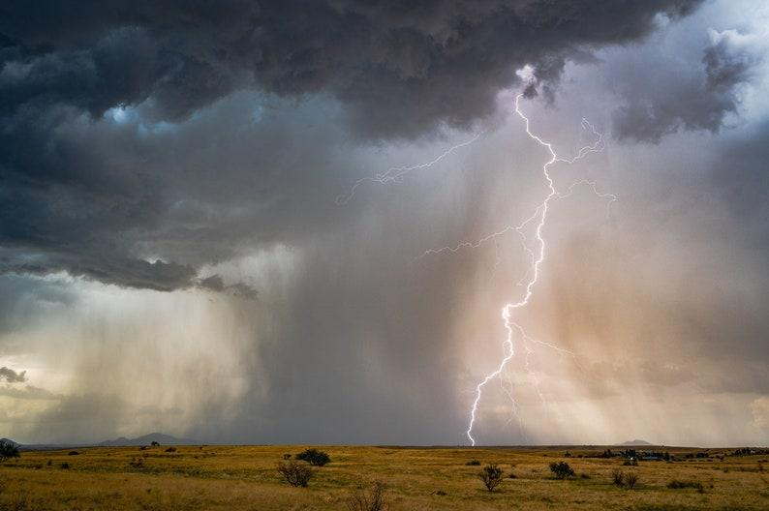
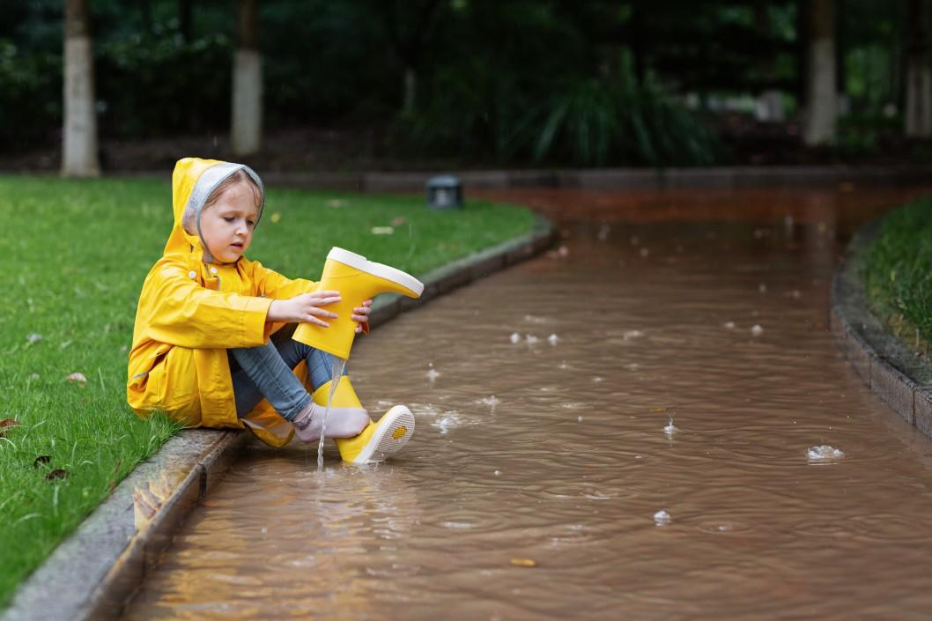
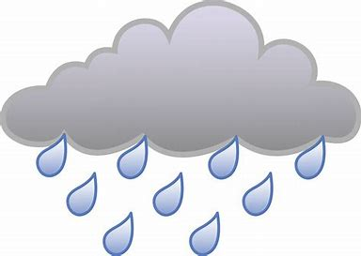
Different types of weather
sunny
Hot or cold?
stormy
rainy
rainy

Slide 3
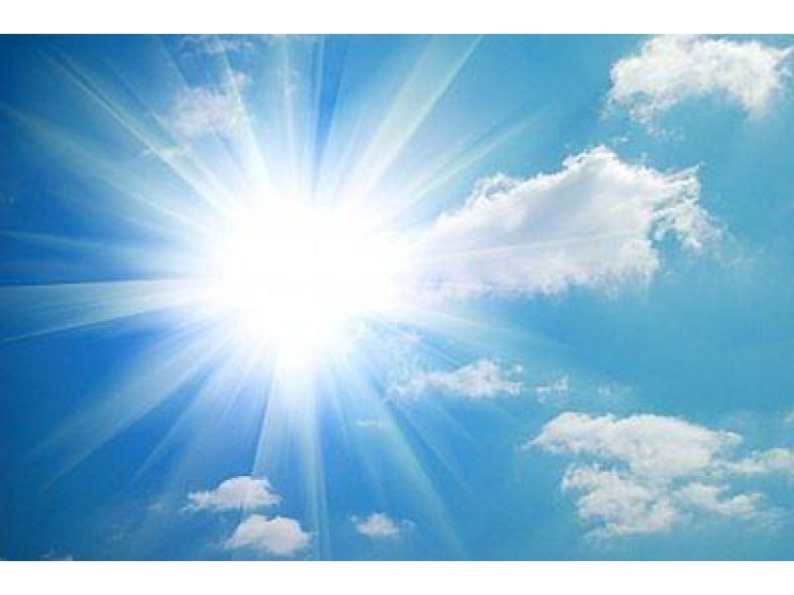
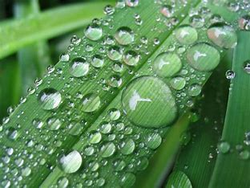
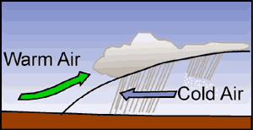
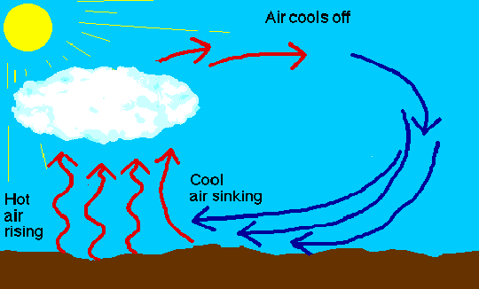
What makes the Weather?
Temperature
The Sun warms our atmosphere. All materials do not warm and cool the same way
Moisture
The amount of water in the air.
This could be rain, snow, hail, and dew.
Air pressure
low=rainy high=sunny
Wind
Moving air

Slide 4
Water travels in a cycle - song
(sung to tune of She’ll be coming round the mountain)
Water Travels in a cycle yes It does
Water Travels in a cycle yes It does
It flows up as Evaporation (wiggle fingers)
Forms clouds as condensation (hold arms over head like a cloud)
rains down as precipitation, yes it does

Slide 6
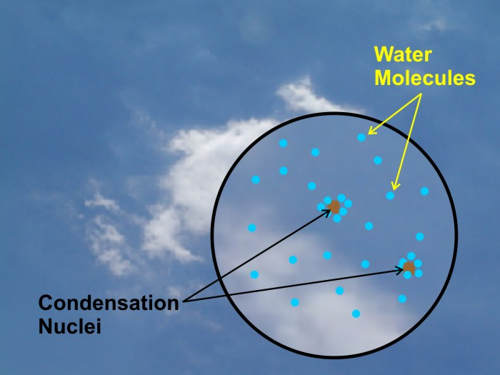

Slide 8
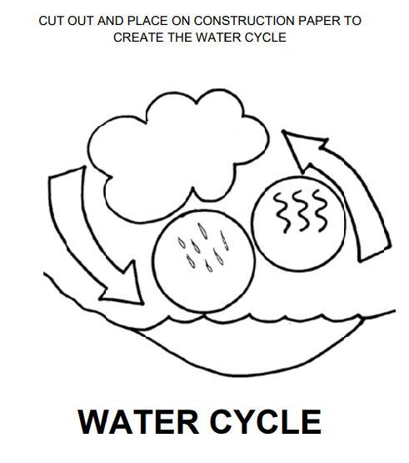
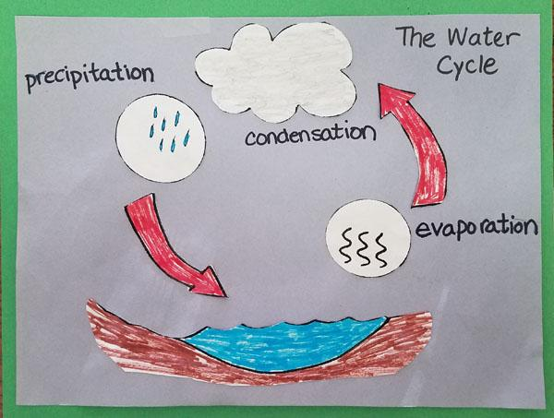
Activity -- Make your own Water Cycle

Slide 9
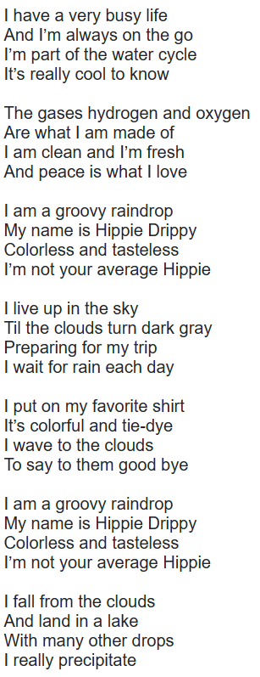
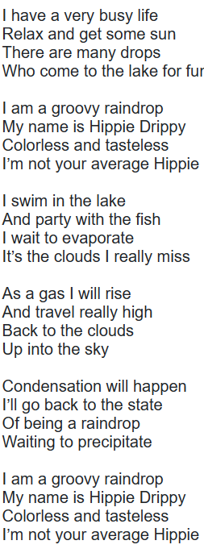
Lyrics for Hippy Drippy (water cycle)
Activity
Students can use a drippy drop to move thru the water cycle. This can be used with completed water cycle activity and the storybook Hippy Drippy or read through lyrics

