Slide 1
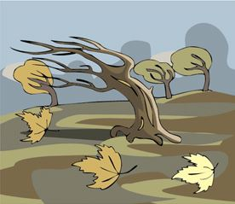
Mattos Science Magnet Docent Program
Kindergarten Lesson 5. WIND Observing wind and determining the direction of wind
Math Science Nucleus © 2024

Slide 2
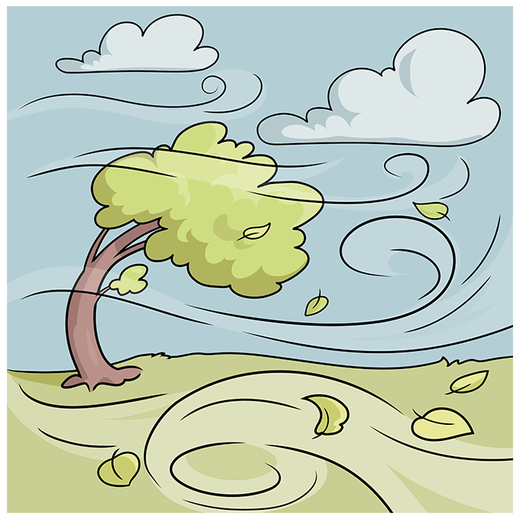
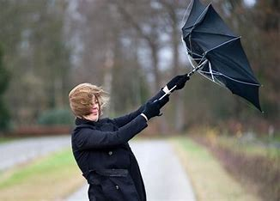
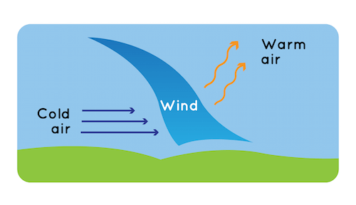
What is wind?
Wind is moving air
What makes the wind?
Different materials warm/cool at different rates

Slide 3
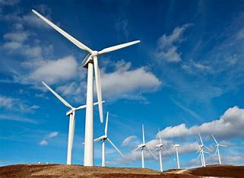
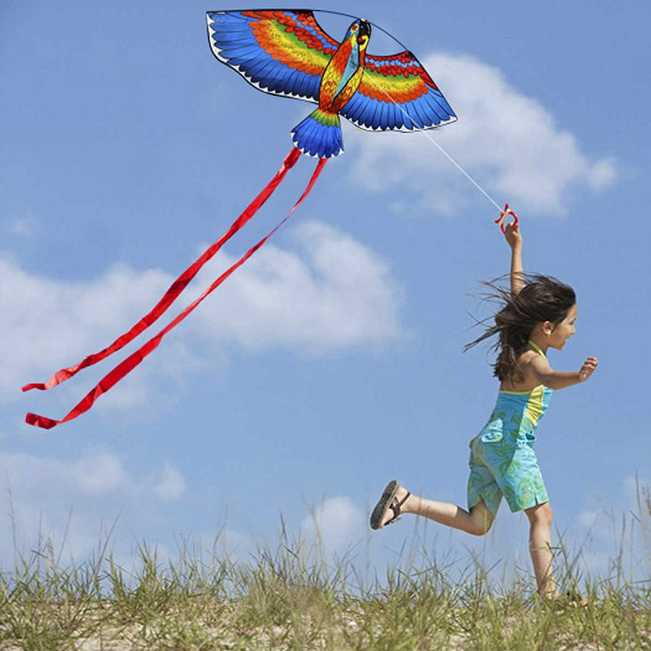
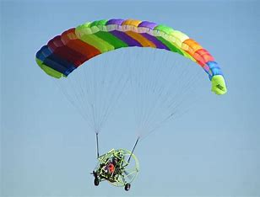
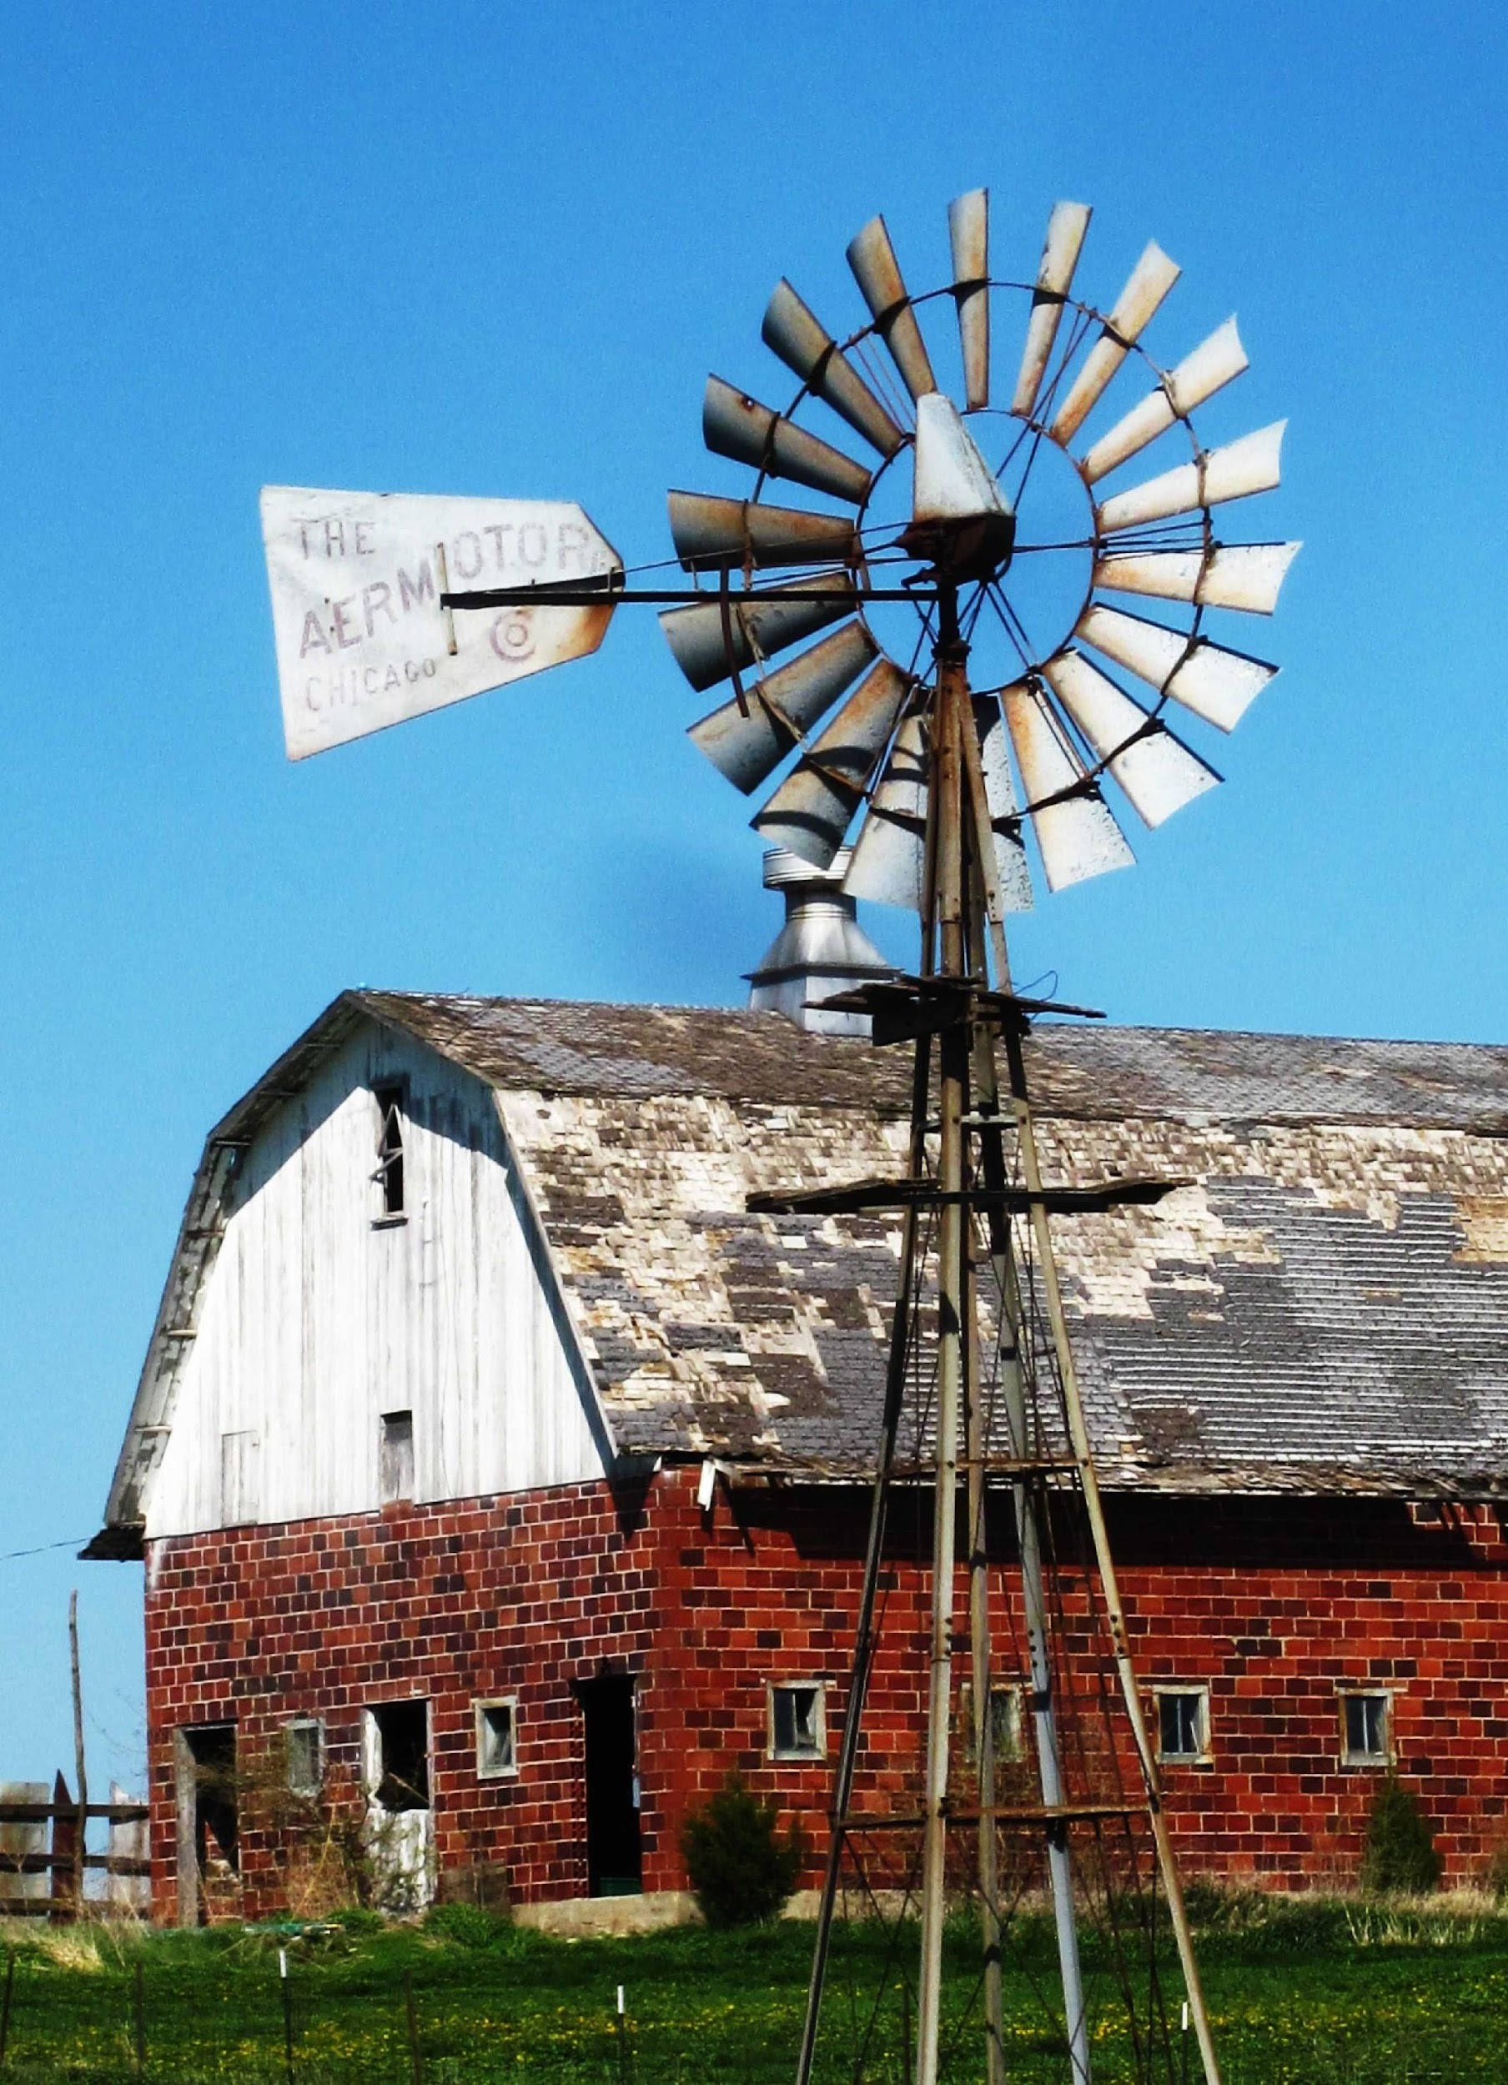
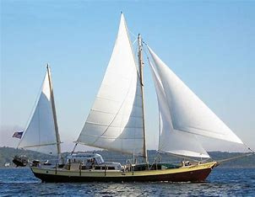
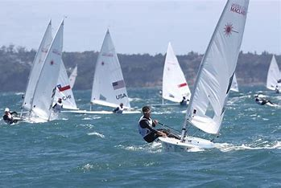
How do we use wind?
Wind can be used to generate electricity, grinding grain or pumping water
Travel
Fun, recreation, races

Slide 4
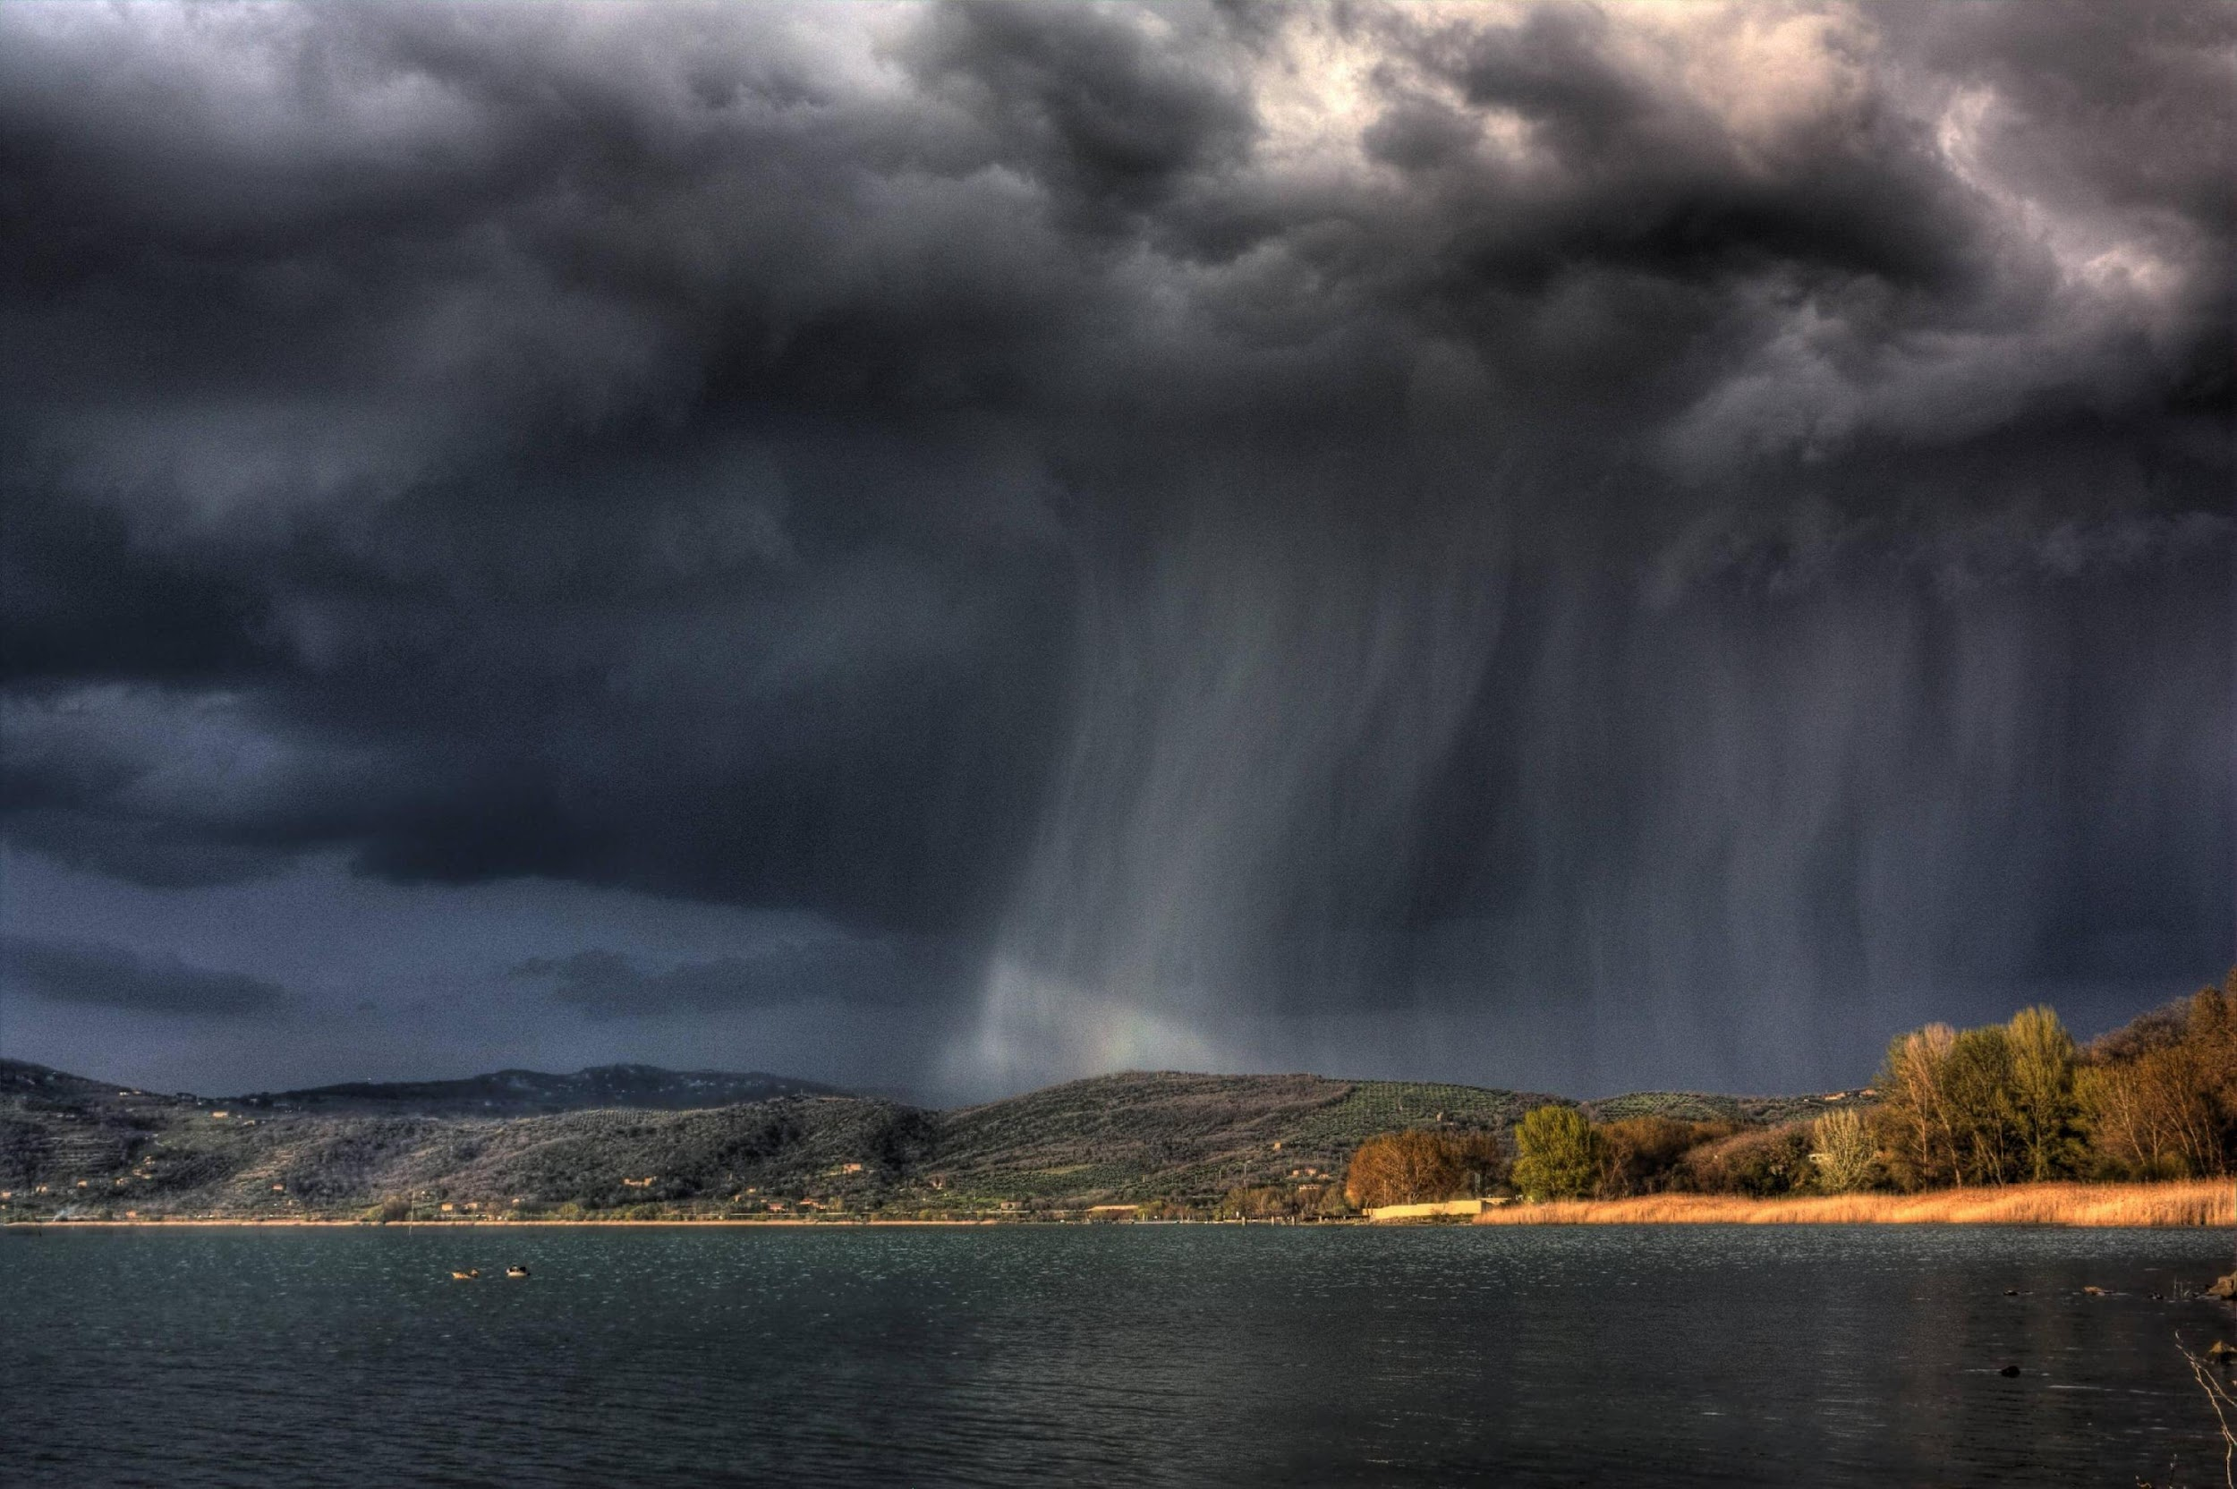
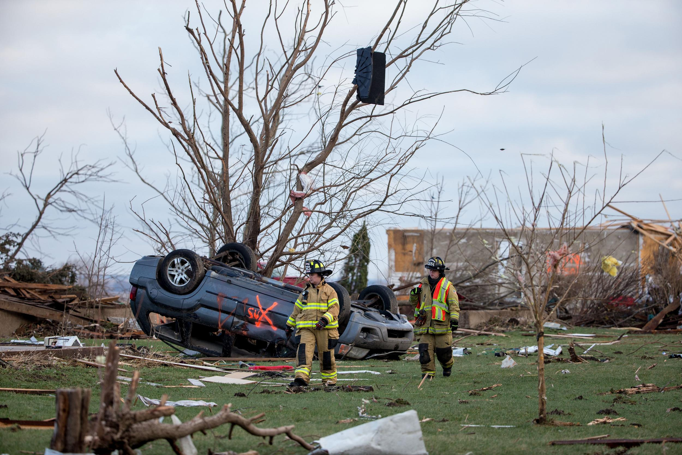
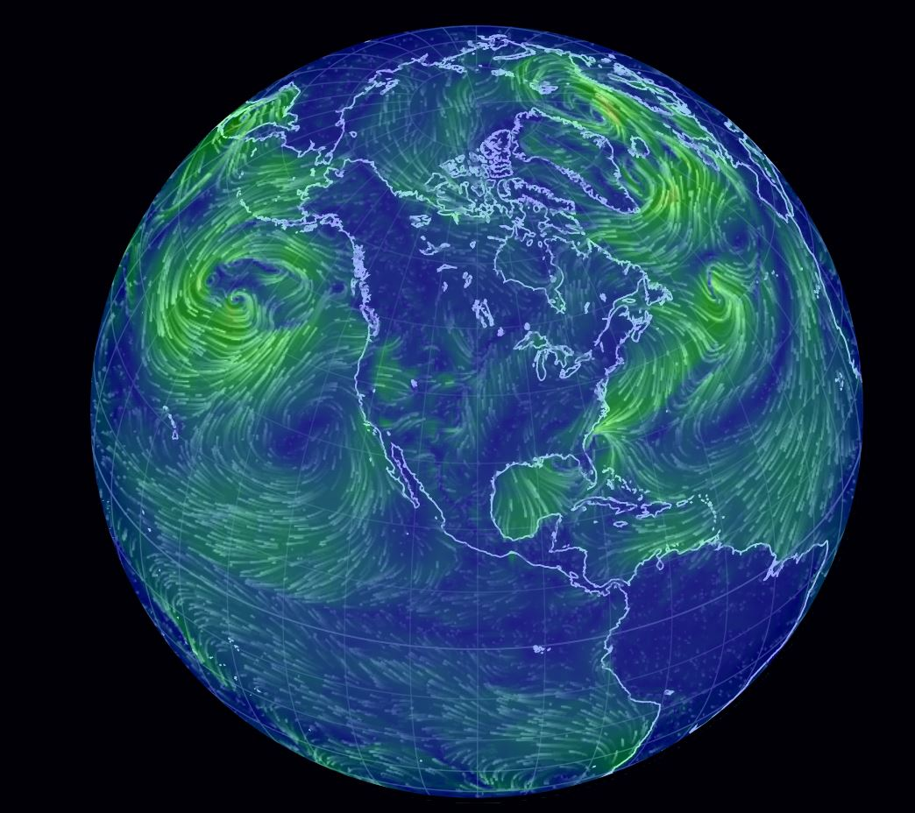
Wind brings us changing weather
Winds can bring rain, cold, warm weather
Strong winds can cause damage (tornado, hurricane)
We study clouds and temperature changes
Local winds and global winds are important

Slide 5
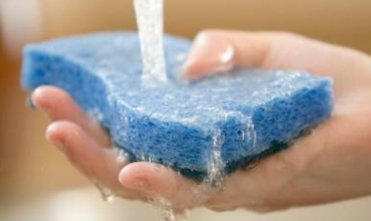
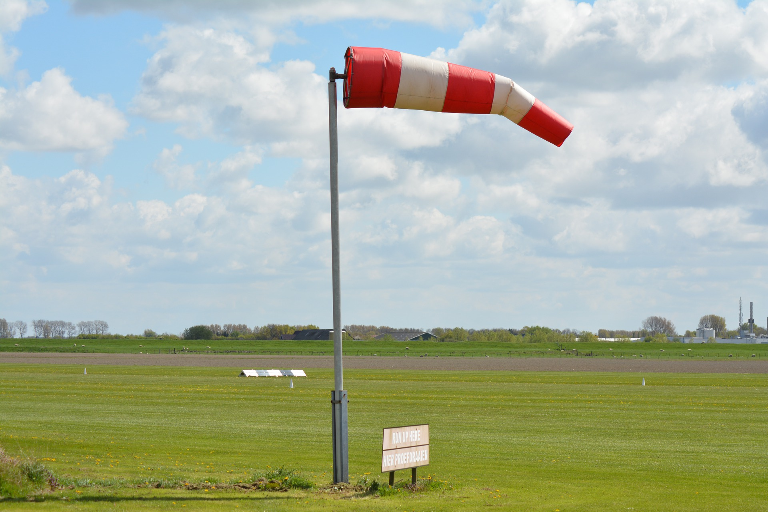
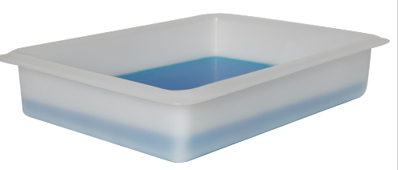
Activities to figure out wind direction
Activity 1 - Finger Test for Wind Direction
1. Stand as still as possible.
2. Wet the ball of your index finger and point it upwards.
Which side of your finger feels the coolest?
Whichever direction the cool side of your finger is facing (north, south, east, west), that's the direction the wind is coming from.
Works like a weather vane or wind sock

Slide 6
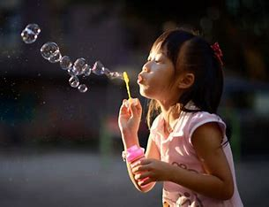
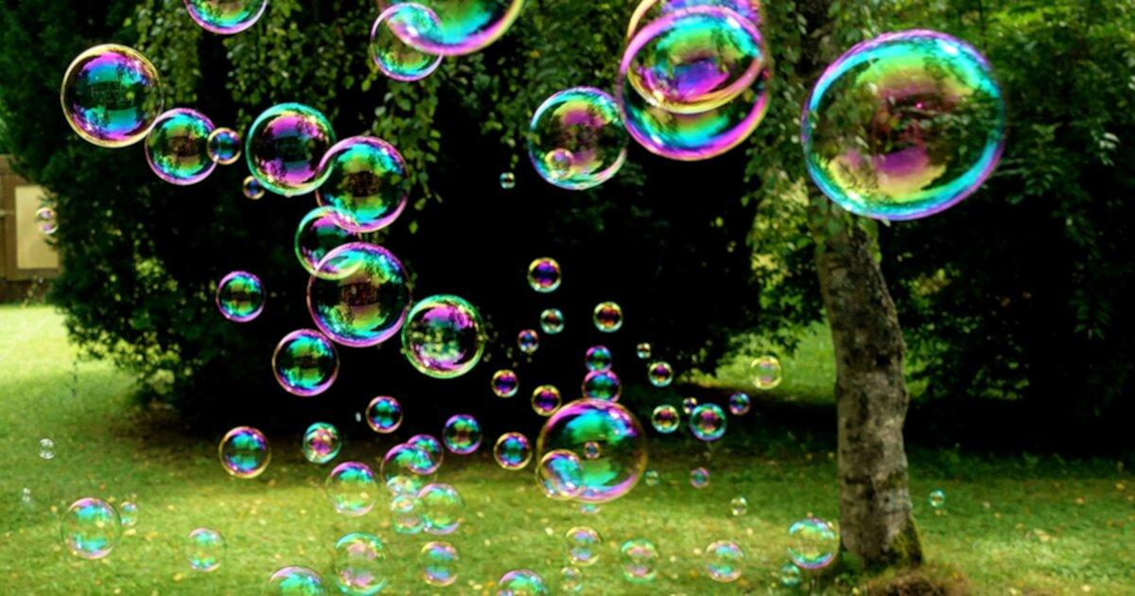
Activity 2 - Bubbles
Blow bubbles. Where do they go?
Hold bubble wand up, can the wind blow a bubble?
Is air/wind moving at same speed and direction?

Slide 7
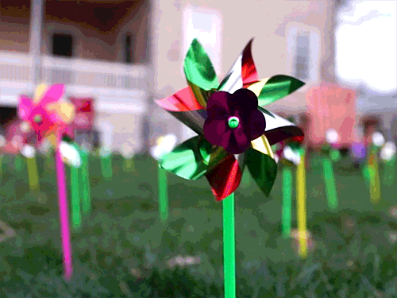
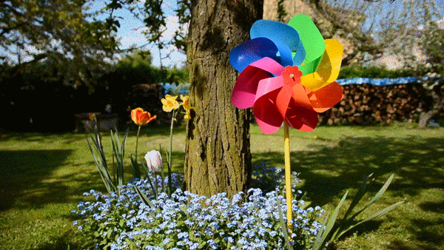
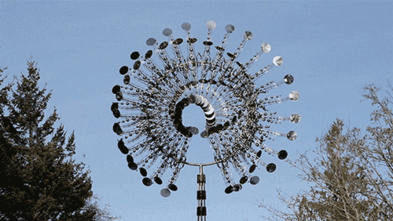
Activity 3 - Pinwheels
Move your pinwheel around. Can you get it to spin? Can you make it stop?
Make your own wind by blowing on it.
Capture the air by moving the pinwheel. (spin around)
Try a "figure 8" motion is perfect to create wind.
Fancy wind spinner

