Slide 1
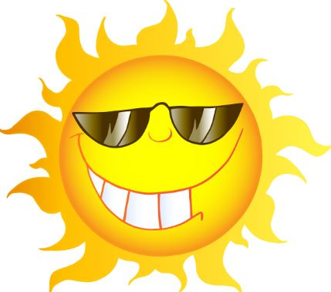
Mattos Science Magnet Docent Program
Kindergarten
Lesson 4. Heating and cooling Students learn that the sun heats up varying materials at different rates.
Math Science Nucleus © 2024

Slide 2
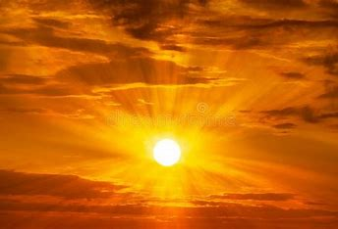
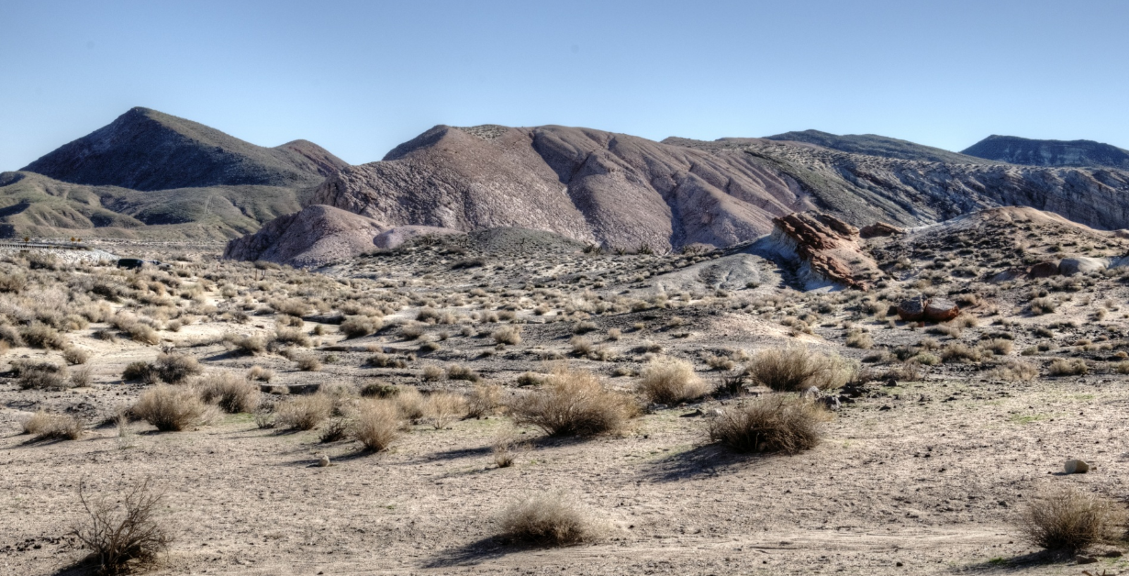
Sun gives us light and heat (thermal energy)
Sun shines down on earth surface.
It gives off light and radiant heat (warms things up)
Do all materials warm/cool at the same rate?
California desert
dark and light colors of sand and rock
Beach land, water, air

Slide 3
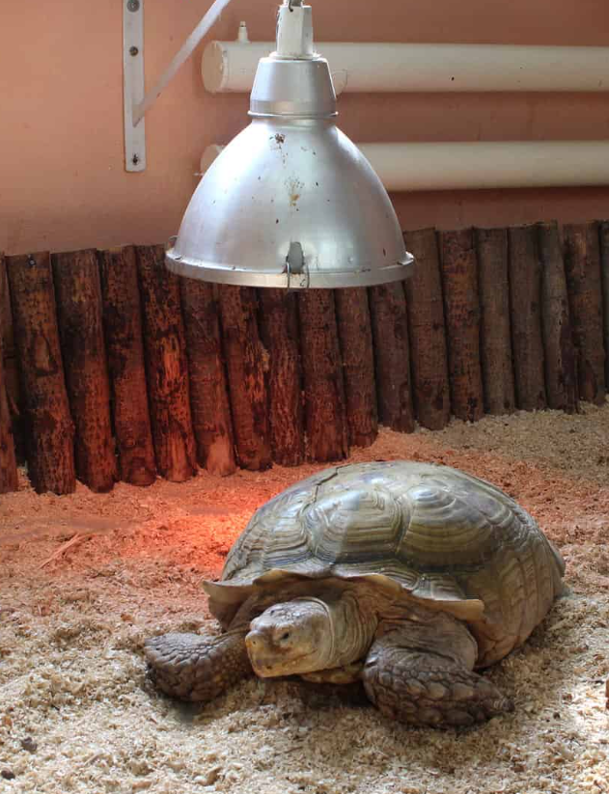
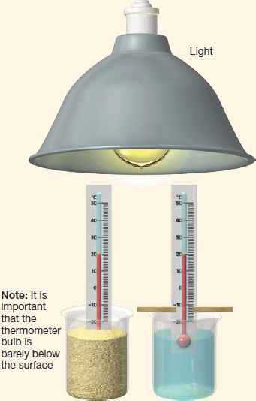
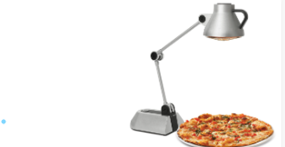
Light/lamp will be our Sun
It will provide light and heat
The bulb will get hot.
Do not touch!
Incandescent bulbs give off heat
LED and Fluorescent lights do not.

Slide 4
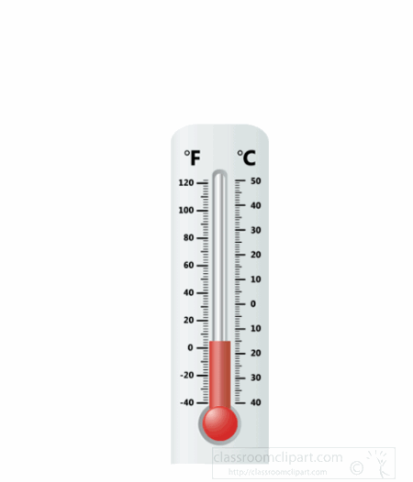
Activity 1 ( Action1) Thermometer measures temperature
We have been learning about temperature (hot/cold) and how to use a thermometer to measure temperature.
What happens when something is cold?
What happens when something is hot?
Give everyone a thermometer. Remind to be gentle.
What is the room air temperature?
Find 2 thermometers that read about the same. Place one in each container of sand. Extra thermometers can be used to practice later

Slide 5
Activity 1 (Action 2) What are the starting temperatures? Put thermometer into sand. (bulb of thermometer covered) Count to 30 or time 30 seconds. (thermometer will adjust to temperature of sand) With the thermometer in the sand, what is the starting temperature ? Slide tray around for all to agree Record this starting temperature (on student lab sheet)

Slide 6
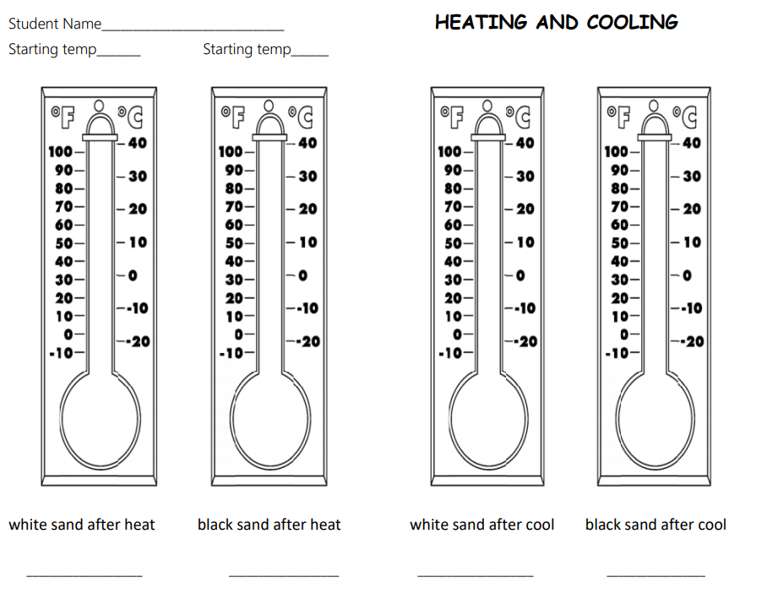

Slide 7
Activity 1 (Action 3)
Turn on the Sun
1.Place trays directly under the desk lamp (sun)
The bulb will generate light and heat like the Sun
2. Light should reach both trays of sand
3. Remind students not to touch lamp
4. Set timer for 10 minutes
5. While waiting, students can practice with
Thermometers. Practice recording temperature
numbers on lab sheet. Practice coloring thermometer
On lab sheet to match correct temperature.
What will happen to the
temperatures of the sand?
Replace with picture of our set up

Slide 8
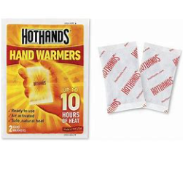
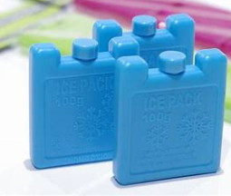
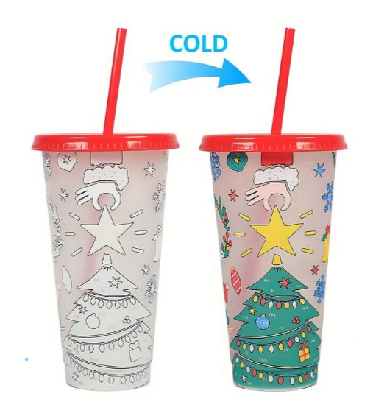
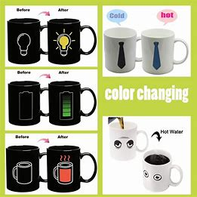
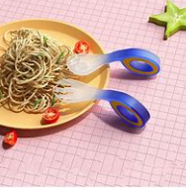
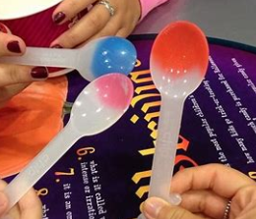
While waiting……
1. what do they think will happen?
2. Thermometer song
3. Is it hot or cold? Compare temperatures by touch
Put frozen ice pack in a mitten or sock, put activated hot hand in a sock
Let students touch at same time to compare and decide which temperature
is hot/cold
4. Explore Temperature/color change products –

Slide 9
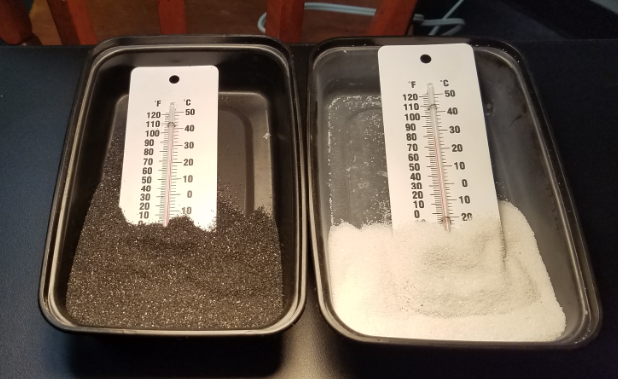
10 minutes later….. What are the temperatures after heating? Turn off lights. Pull trays away from light so easy to read thermometer. Everyone agree? Record on worksheet

Slide 11
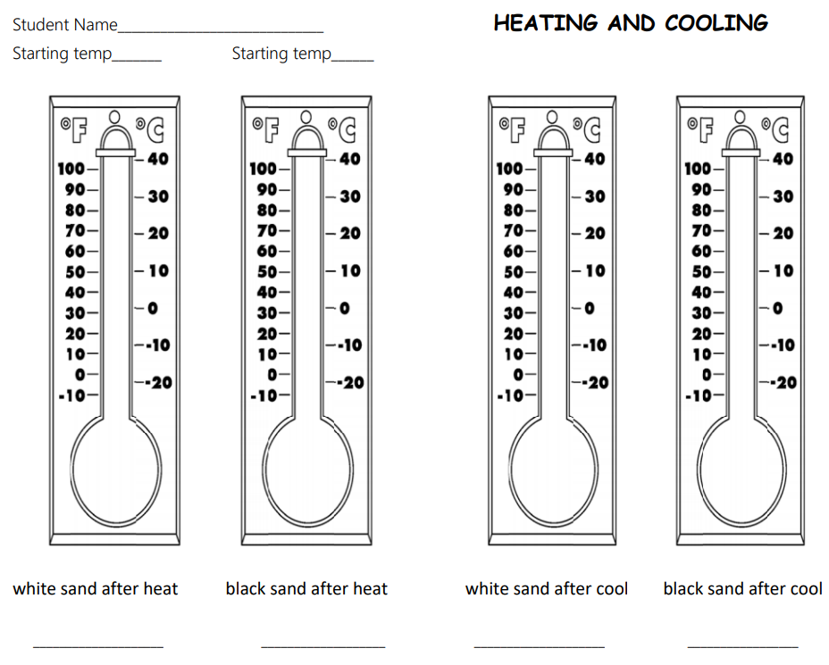
Activity 2 Start a timer for 10 minutes.
After 10 minutes of cooling, what are the temperatures?
Record on worksheet
Which sand heated up fast?
Which sand cooled down fast?
Dark colors absorb or soak up heat.
Light colors reflect the heat.
Different surfaces on earth (water, ice, soil, and rock) heat at different rates.

Slide 13
Actions to take when waiting
Help students record info in the correct place….put your finger here…
Takes time to write numbers correctly, and color in thermometer correcltly (they like to just color all in)
Other objects that are cool /hot (from previous labs…ice cube in a bag, ice pack, hot hands, heating pad, color/temperature changing products – spoons, straws, cups) Put object in a glove or bag, have them guess is it hot/cold
talk about objects outside dark asphalt vs light colored concrete heat absorbed?
Conclusion:
Different materials heat and cool differently.
Darker colors absorb more sunlight (heat)
Lighter colors reflect light (heat)
Picture hot summer day dark car light colored car

