Slide 1
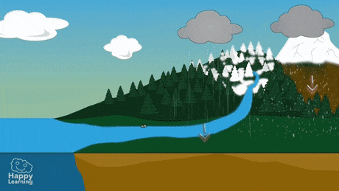
Mattos Science Magnet Docent Program
Kindergarten
Lesson 3. Exploring States of Matter of Water
Math Science Nucleus © 2024

Slide 2
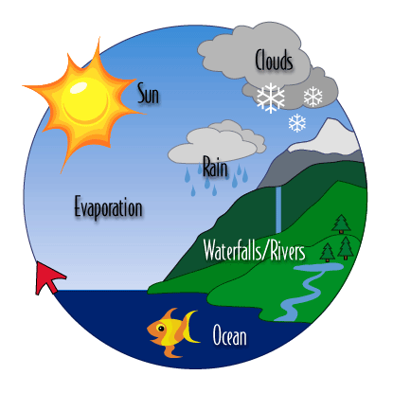
Without Water you would not have Weather
Water is an odd chemical made up of hydrogen and oxygen
It is solid, liquid and gas naturally on earth
Water cycle – miracle of life

Slide 3
Water Cycle
Rain-liquid
Snow-solid

Slide 4
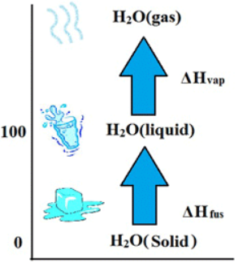
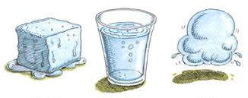
States of matter - Water

Slide 5
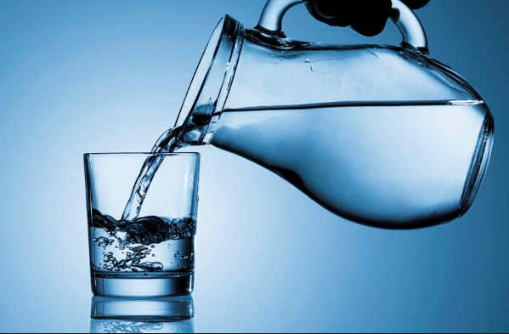
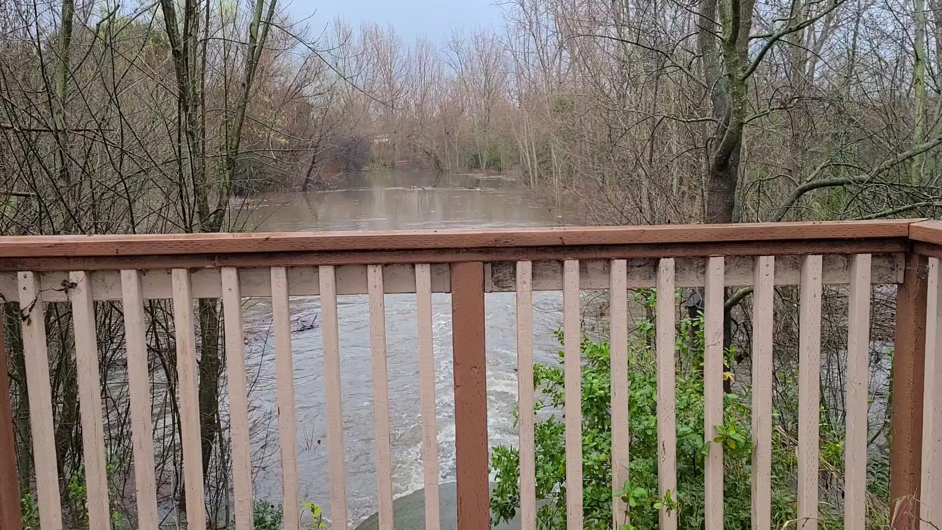
Water can be liquid and flows

Slide 6
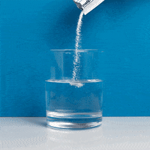
Activity: Pouring Water
Two beakers of water
Measure from another container 50 ml
Pour back and forth from beaker to another
Add a drop of food color in one beaker
Pour back and forth
Students are mixing liquid

Slide 7
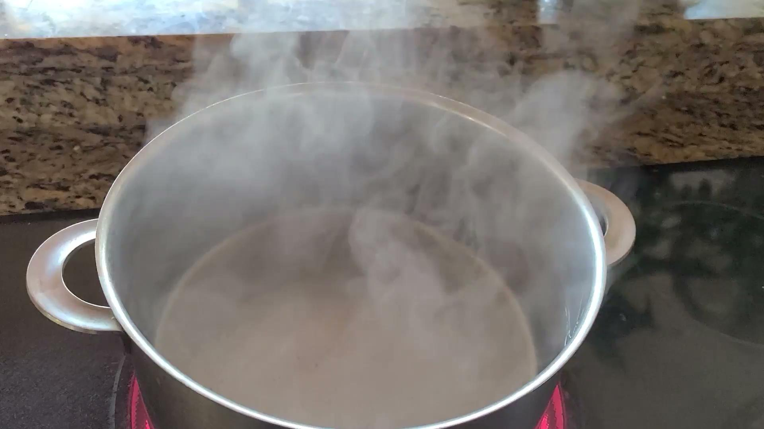
Water can be gas: boiling turns liquid to gas

Slide 8
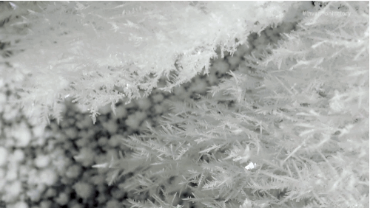
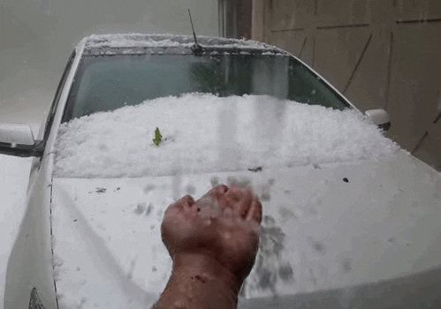
Water can be solid, under freezing conditions
What is this called?
HAIL

Slide 9
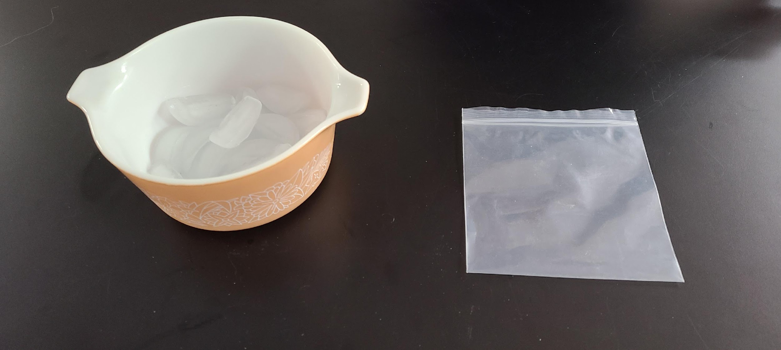
Activity: turn solid into liquid

Slide 10
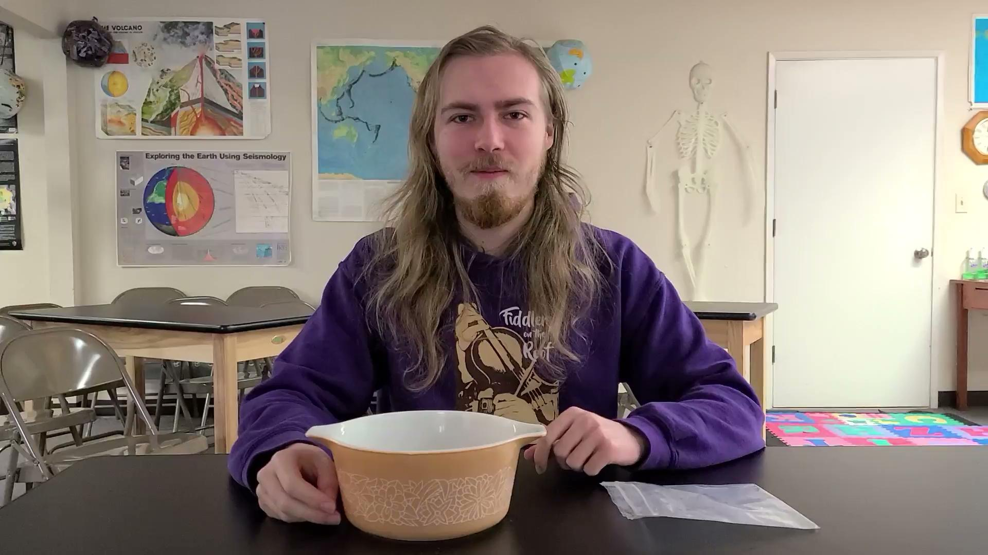
Exploring 2 states of matter

