Slide 1
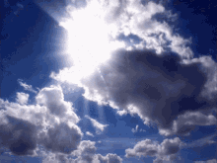
Mattos Science Magnet Docent Program
Kindergarten Lesson 2. Describing Clouds
Math Science Nucleus © 2024

Slide 2
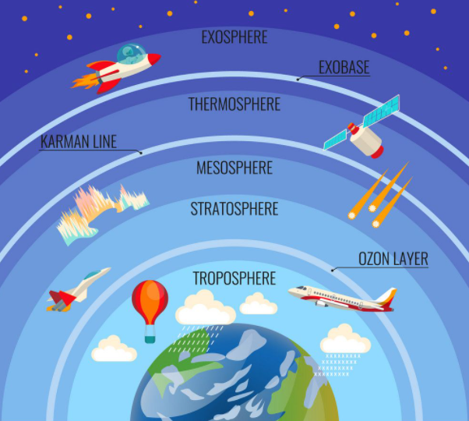
Where do you find clouds?
The atmosphere is an envelope of air around Earth
You only find clouds in the Troposphere
Notes:
Where do clouds live? Do you think the live in space?
No … they live in the layer of the atmosphere closest to the earth.
Clouds are really close!

Slide 3
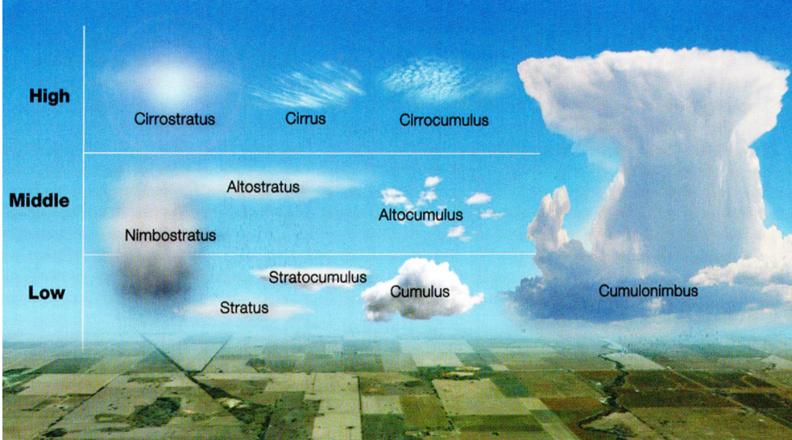
Clouds are in the Sky (Troposphere)
Notes:
Not too many cumulonimbus around us.

Slide 5
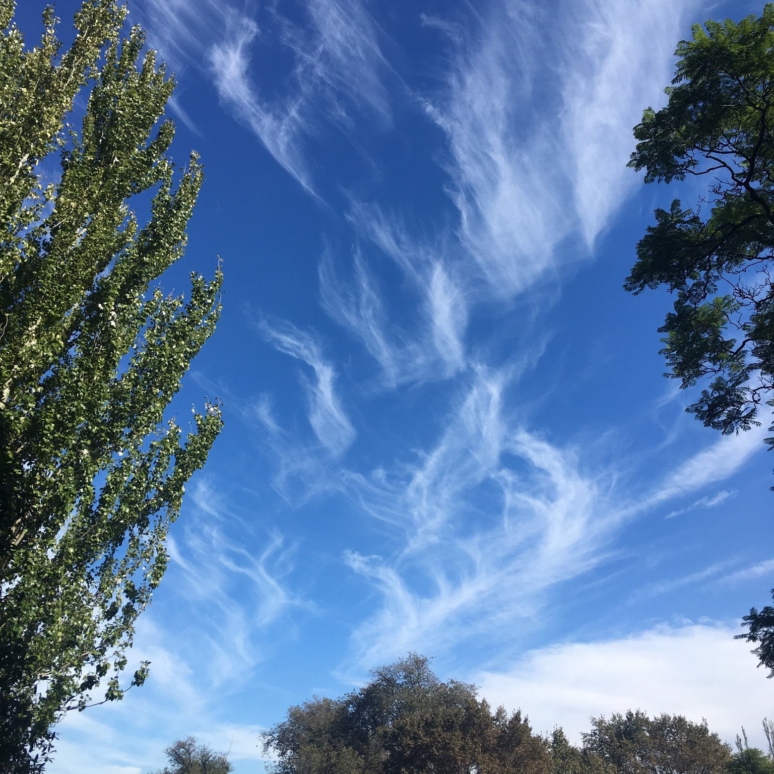
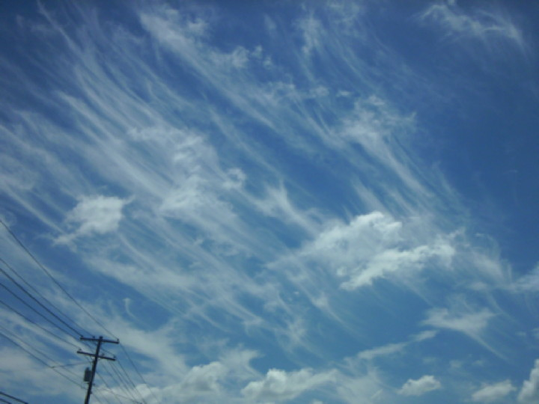
Cirrus Clouds
White, curly, and wispy. Thin feathery clouds float the highest.
Notes:
"Cirrus clouds” are white and curly. They float highest of all and mean the weather is changing

Slide 6
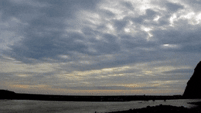
Stratus Clouds
Grey, low and flat. Like books stacked up. Rain or drizzle is coming!
Notes:
"Stratus clouds," are grey, and float low in the sky, flat as sheets and may bring rain or drizzle.

Slide 7
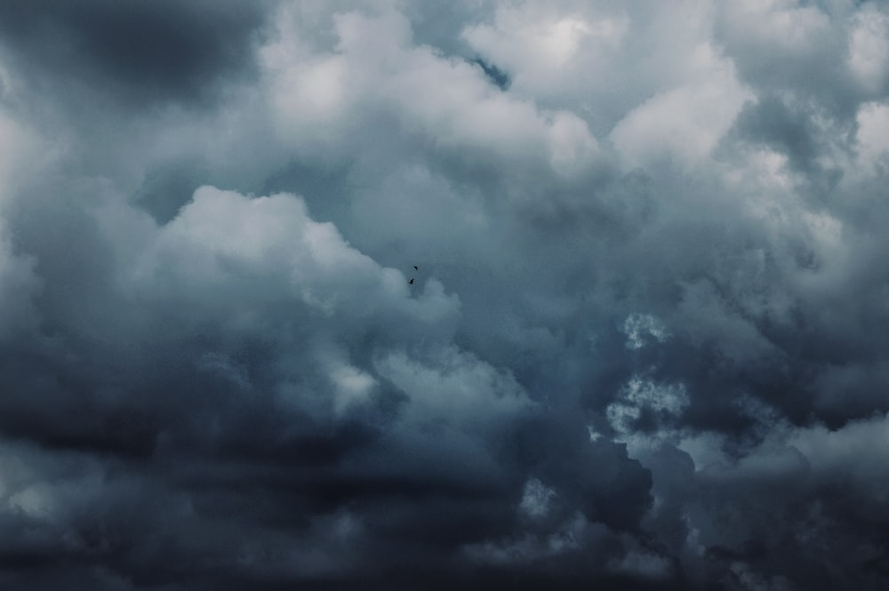
Nimbus Clouds
Dark clouds. Rain or snow is coming!
Notes:
"Nimbus” in a cloud name refers to clouds that are dark, which usually mean rain or snow. Cumulo-nimbus is a cumulus cloud that usually means rain in the forecast.

Slide 8
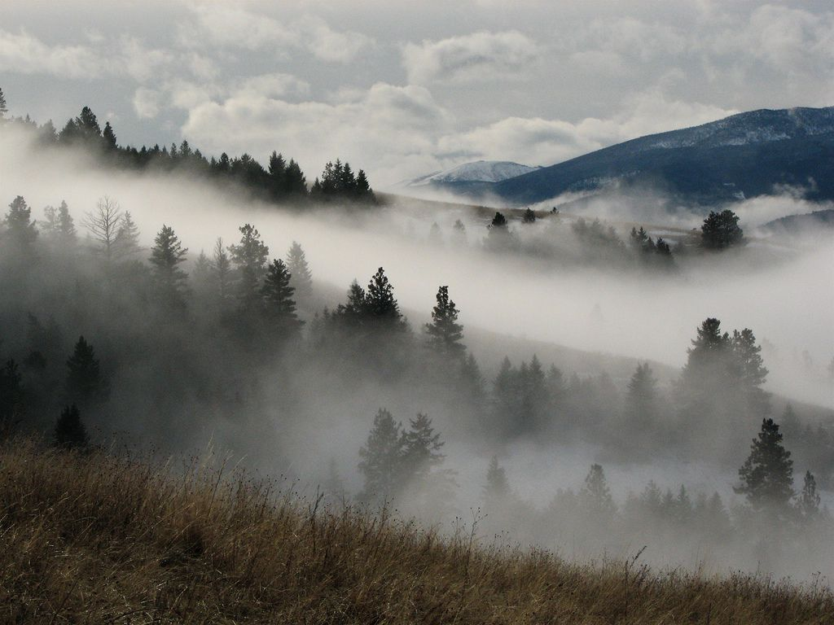
What about fog?
Notes:
Fog is a cloud that’s close to the ground.

Slide 9
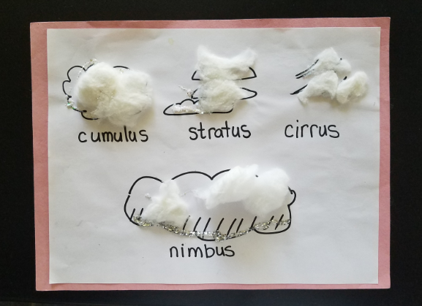
Activity - Making a Cloud Chart
Write your name!
Pull apart the cotton balls. Just need a little cotton for each.
Notes:
Write your name first!
Remember to tear apart your cotton balls!

Slide 10
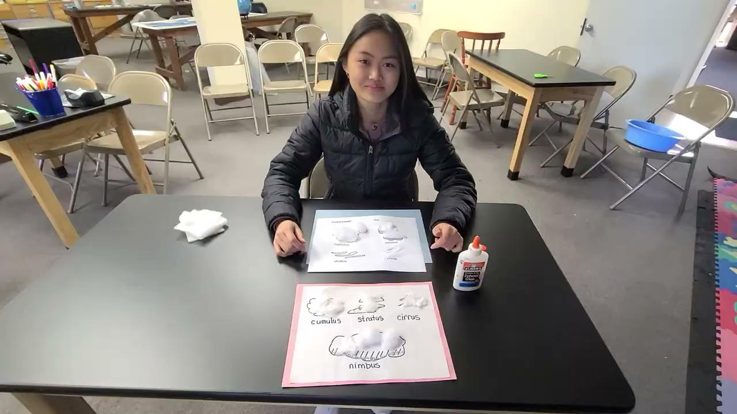

Slide 11
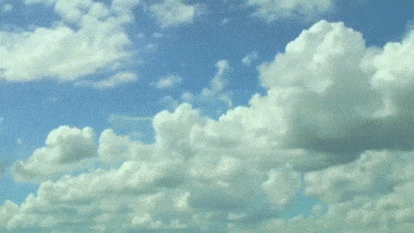
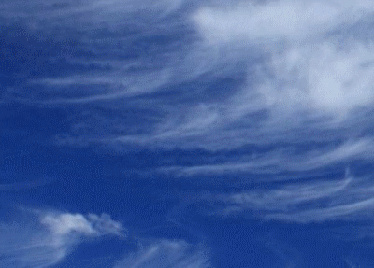
How can you use the Cloud Chart?
Go outside or to the window with your cloud chart.
Are there clouds in the sky?
Can you name the type of clouds in the sky using your cloud chart?

