Slide 1
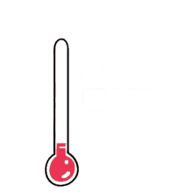
Mattos Science Magnet Docent Program
Kindergarten Lesson 1. Measuring Temperature with a thermometer
Math Science Nucleus © 2024

Slide 2
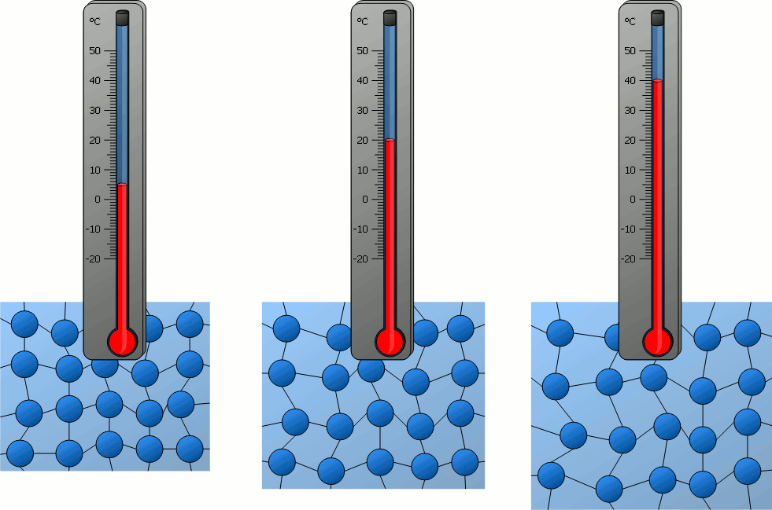
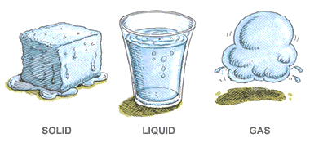
What is temperature?
Number that helps us compare hot and cold
A thermometer measures temperature
Collection of data over time provides information

Slide 3
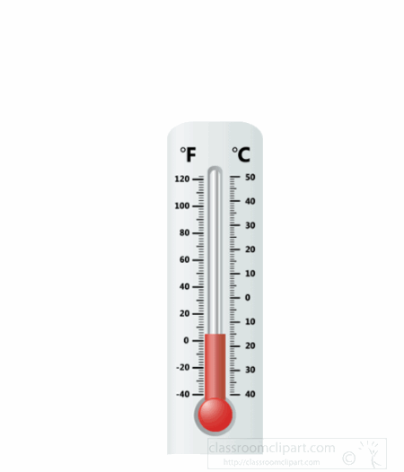
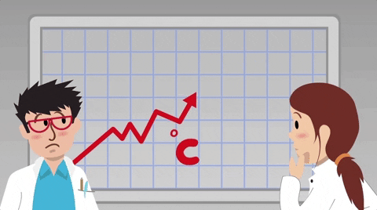
Thermometers measures temperature
Learn how to read a thermometer
Collect data on thermometer

Slide 4
A thermometer tells us if our body temperature is over 98.6 F or 37 C

Slide 5
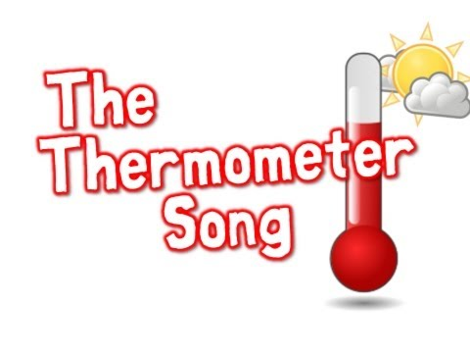
A thermometer tells us if our body temperature is over 98.6 F or 37 C

Slide 6
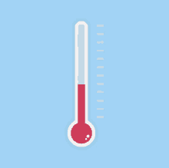
What does it mean when the liquid in the thermometer goes higher

Slide 7
Digital thermometer measures heat. You need to read numbers. Higher number is warmer.

Slide 8
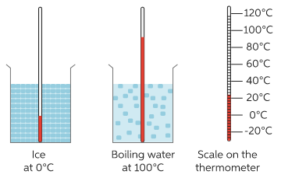
Let’s experiment.
Place a thermometer in a container.
Does the temperature go up or down?
Try a different container.
Warm water
Room temperature glass of water
Water with ice cube
Record 2 temperatures. Try writing the
Number and coloring up to the temperature.
Be careful with thermometers – they are made of glass.

Slide 9
Measuring temperature:
Materials

Slide 10
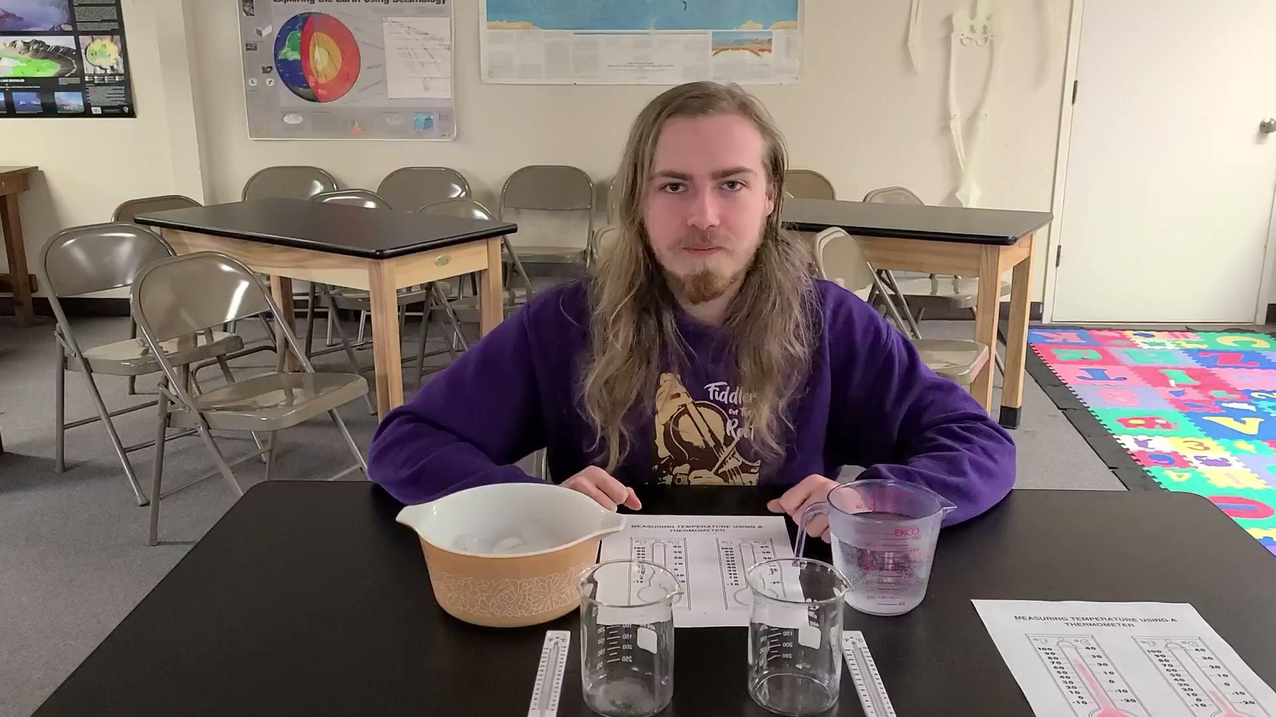
Measuring temperature

