Slide 1
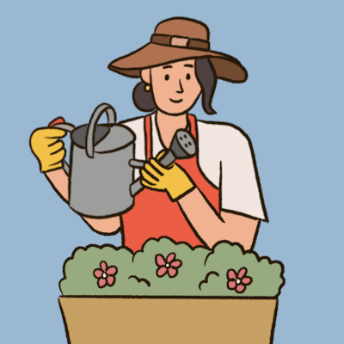
Mattos Science Magnet Docent Program
Fourth Grade Lesson 6. Enriching Soil with Compost
They use the compost they produced in the long-term project to fertilize plants at the school.
Math Science Nucleus © 2024

Slide 2
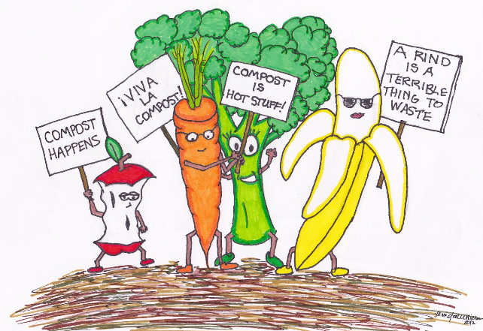
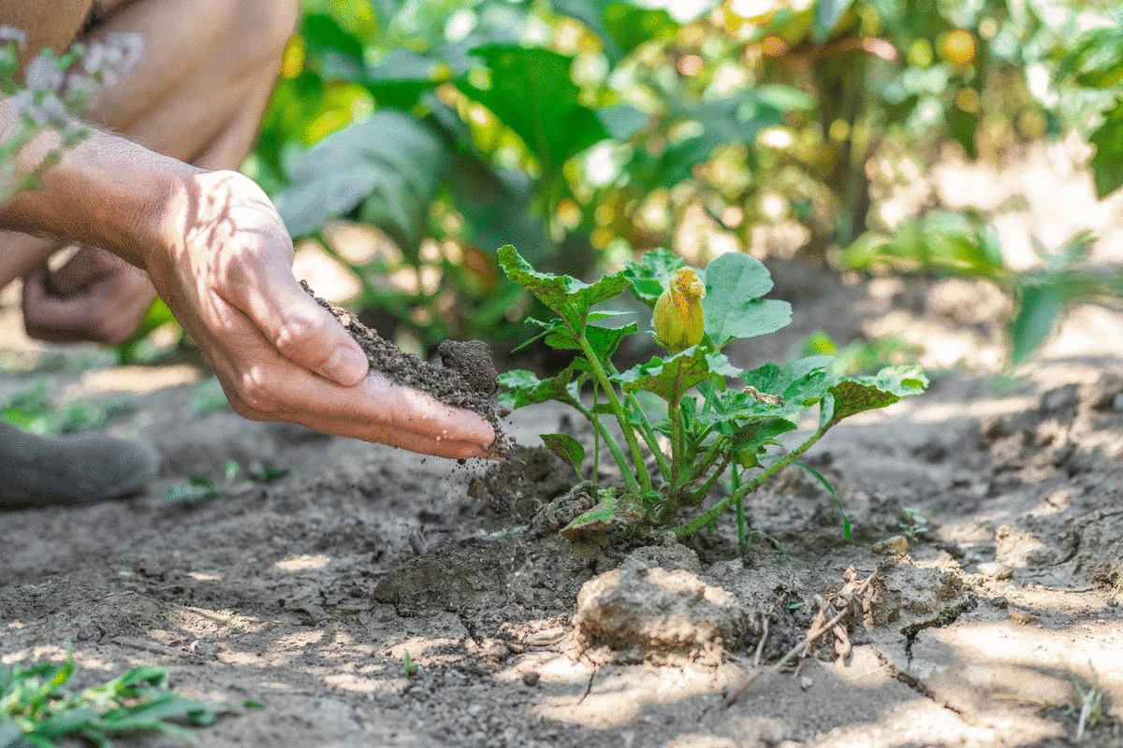
Why is compost important?
Composting helps the environment by
Reducing the waste volume
Produce compost that helps soil quality
Add nutrients to soil

Slide 3
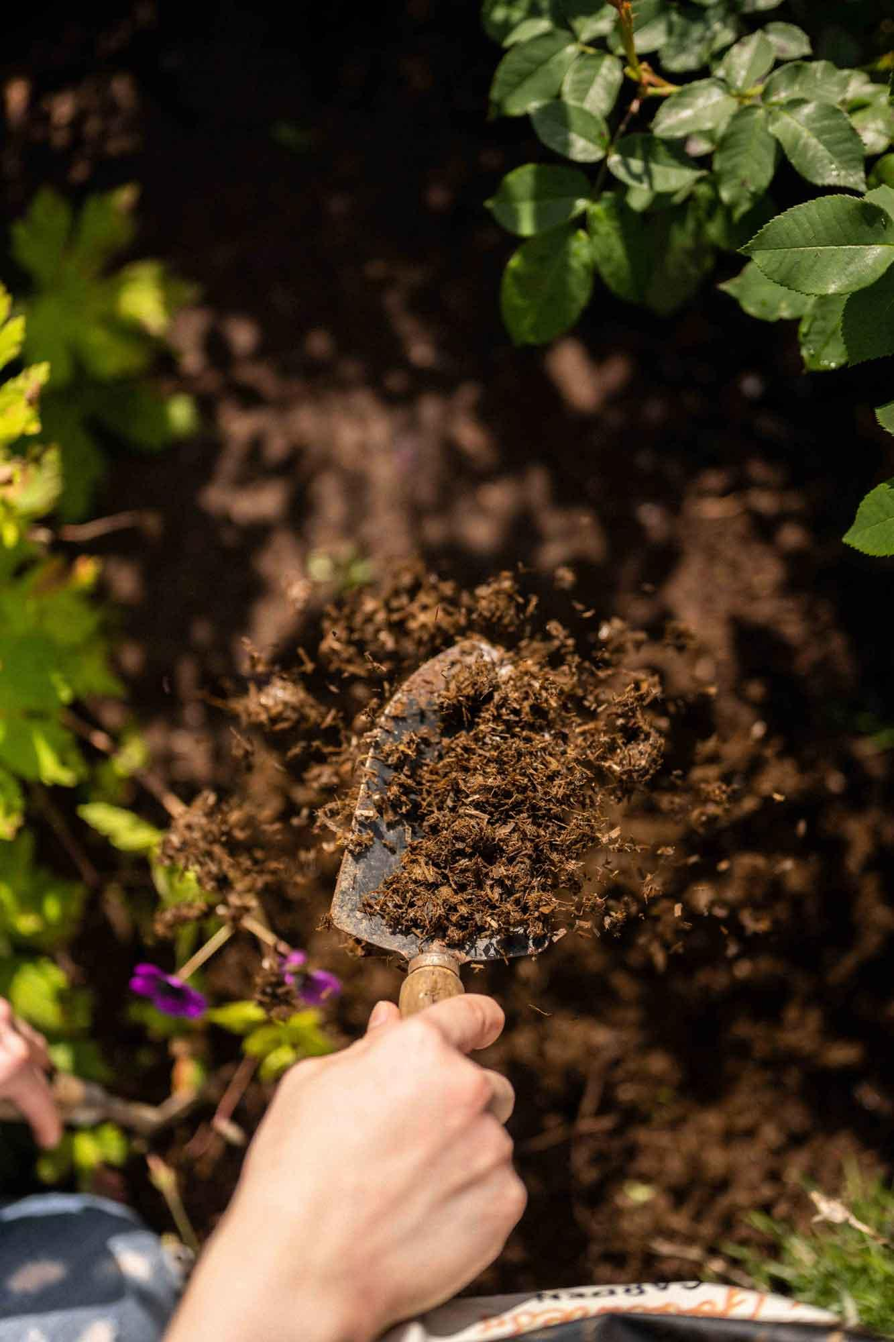
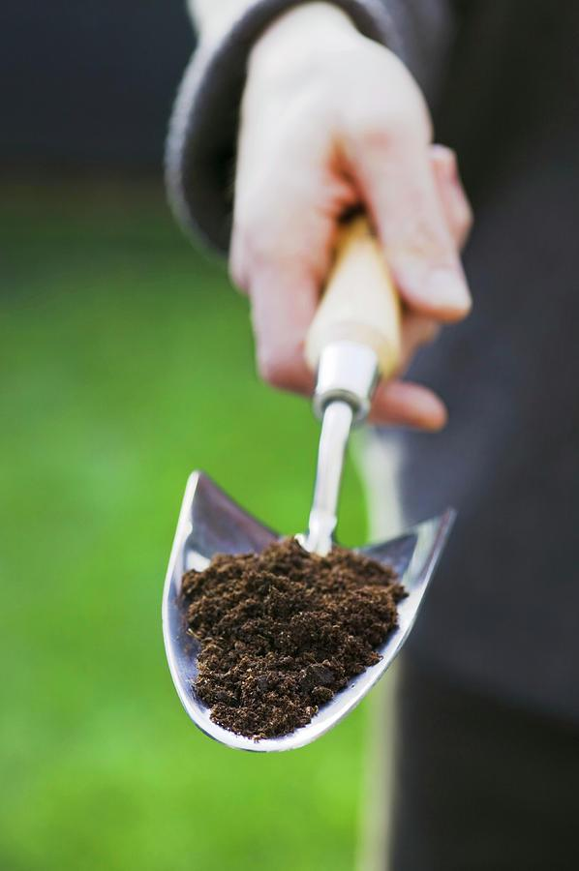
Review long term project… turning food waste into compost
Put in pictures from Compost parties, starting pictures of garden
School map what plants need help? Don’t look healthy
How to use tools
Sprinkle compost into beds
Equipment in shed:
Black low wheel barrow
White scoops
Hand trowel
Wheel barrow

Slide 4
Activity Spread out the Compost!
Sprinkle compost to areas of garden beds
Water if needed
Pull weeds (wiggle, wiggle, pull)
Look for invertebrates (pollinators, decomposers)
What can we do to enhance the habitat?
Clean Up
Video of spreading compost

Slide 5
Depending on how much compost is left….
We could make Compost tea (kids love to water) Paige may be able to help with this
Fill 5 gal bucket, let sit for 24 hrs to let chems disperse
Add small amount compost, stir, let sit for 24 hours.
Kids take small scoop to fill watering cans.

