Slide 1
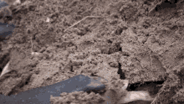
Mattos Science Magnet Docent Program
Fourth Grade Lesson 4. Sand
Math Science Nucleus © 2024

Slide 2
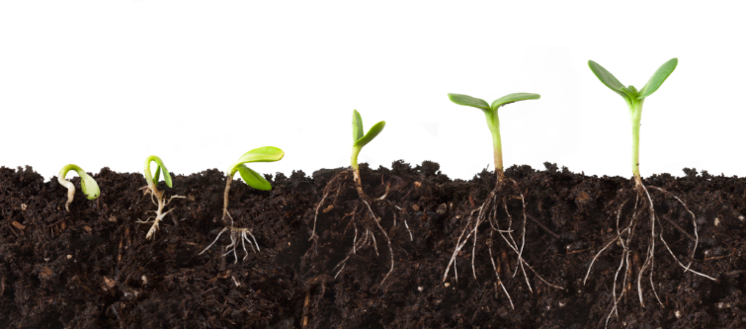
What makes up healthy soil?

Slide 3
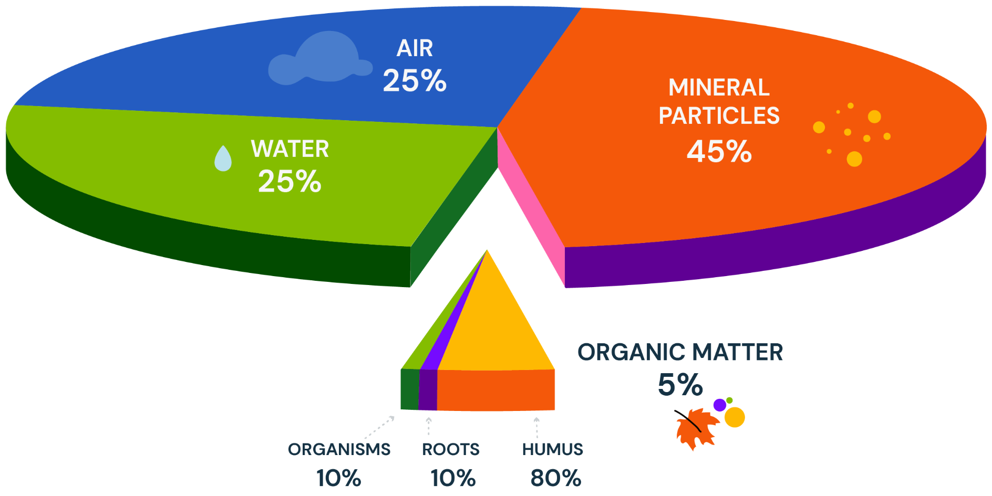
Healthy soil is a mix of minerals, air, water and organic material (compost)
Today’s
Lesson
Last
Lesson

Slide 4
Objectives
Sand composition tells the source
Roundness tells distance
To understand how the minerals get in our soil, let’s look at how sand forms

Slide 5
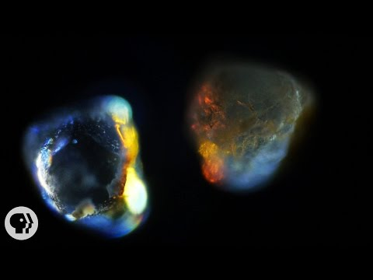

Slide 6
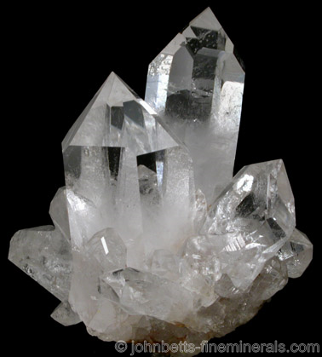
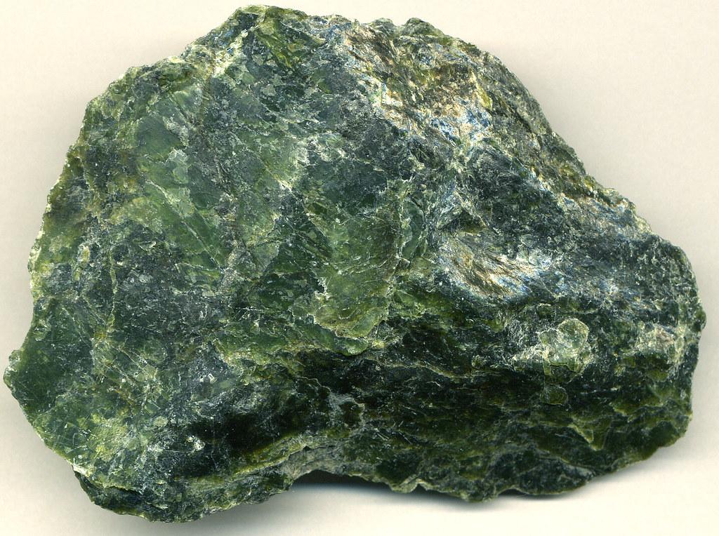
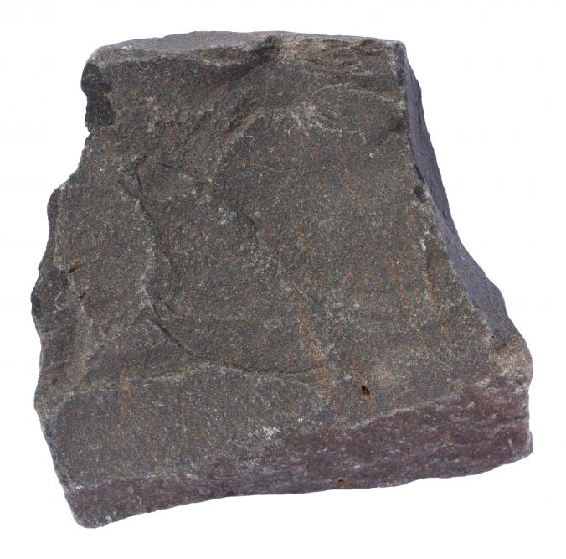
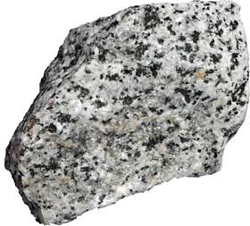
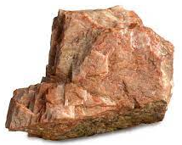
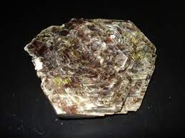
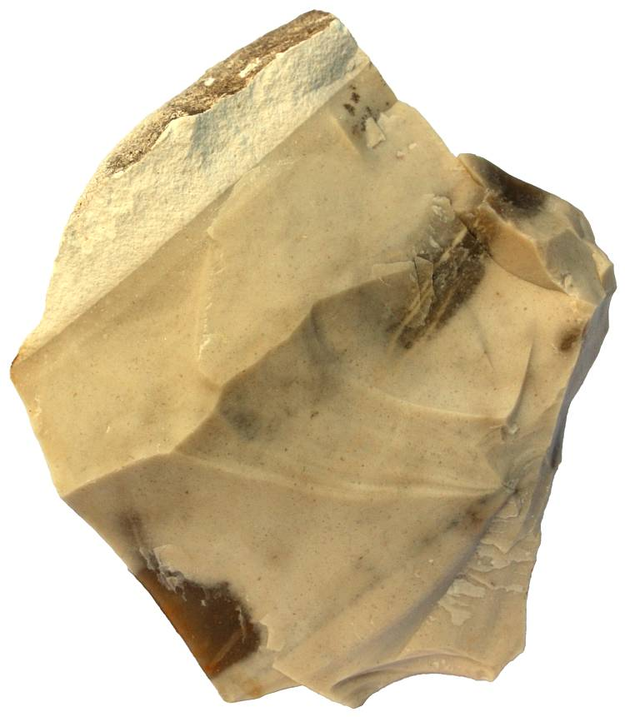
The minerals we find in soil (used by plants) come from breaking down the parent rocks. Here are some common rocks and minerals we find in California sands
Basalt
Quartz
Serpentinite (state rock of CA
Granite (mix of quartz and other rocks and minerals)
Feldspar
Chert
Mica

Slide 7
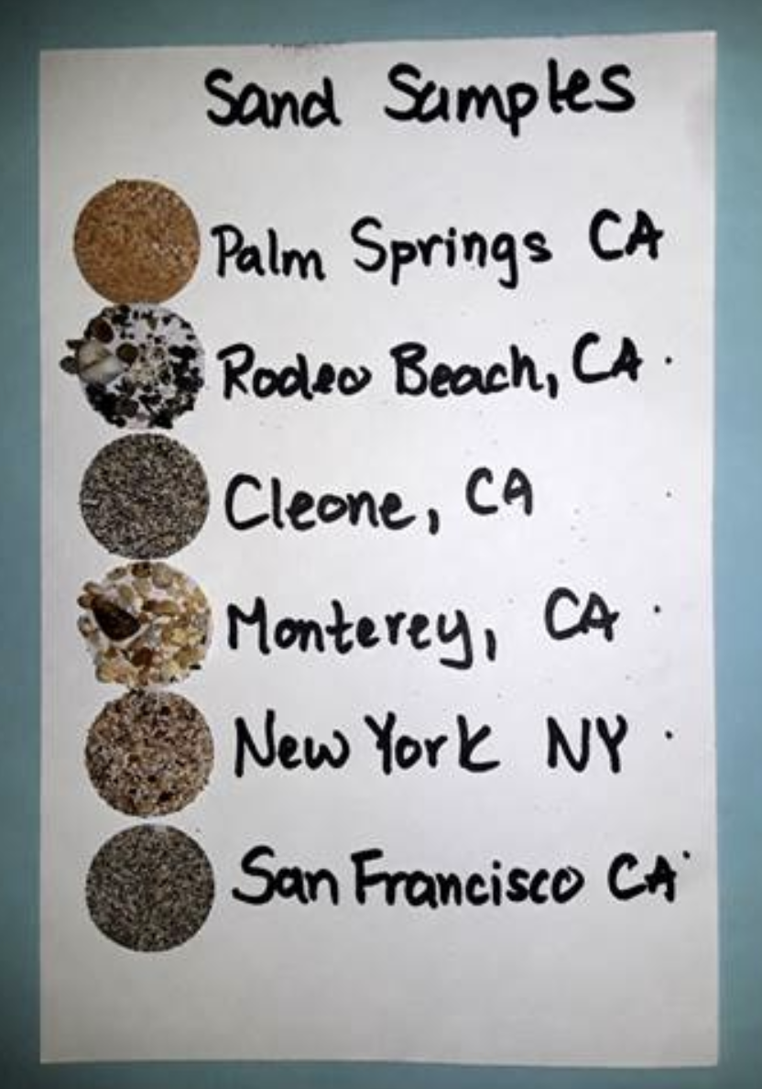
Activity Make sand cards with sand from 6 different beaches. Use a microscope to examine and compare. The rounder a sand grain is, the longer it has been eroding.
Maui

Slide 8
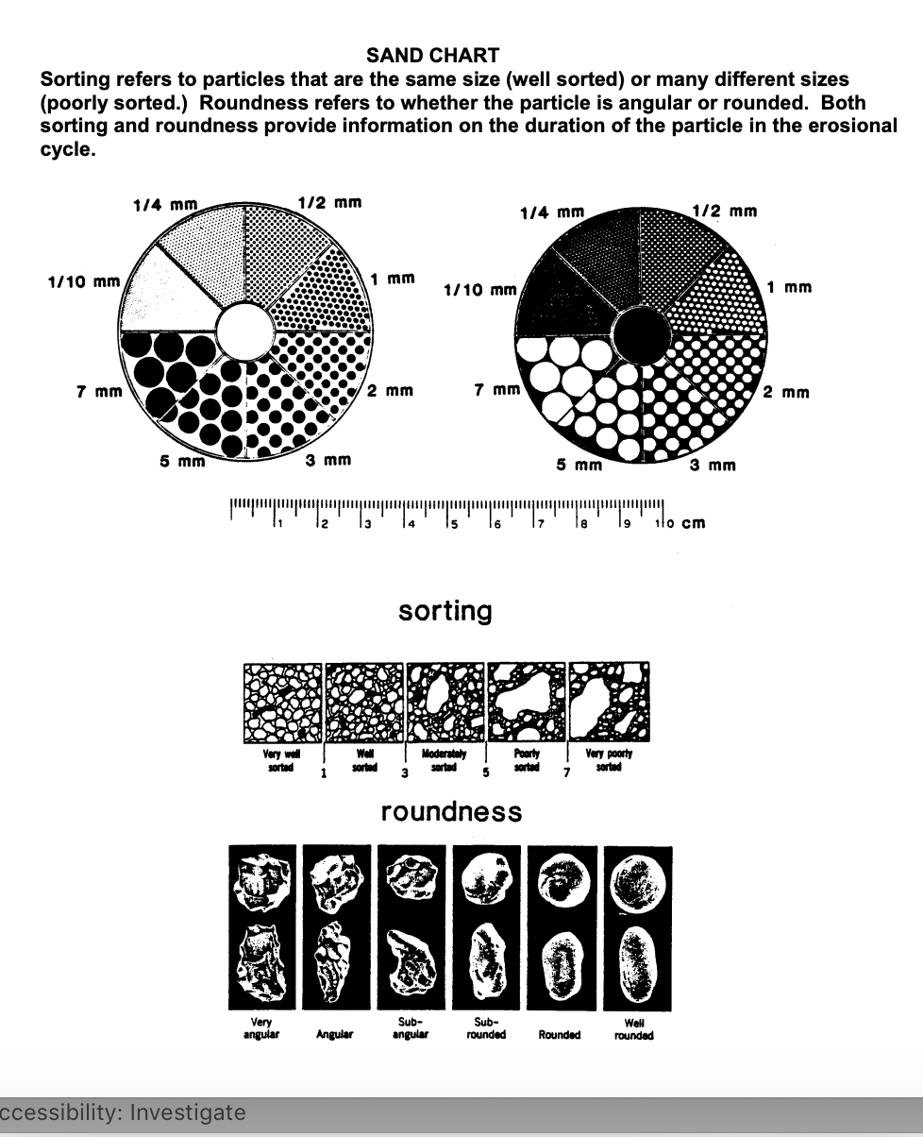
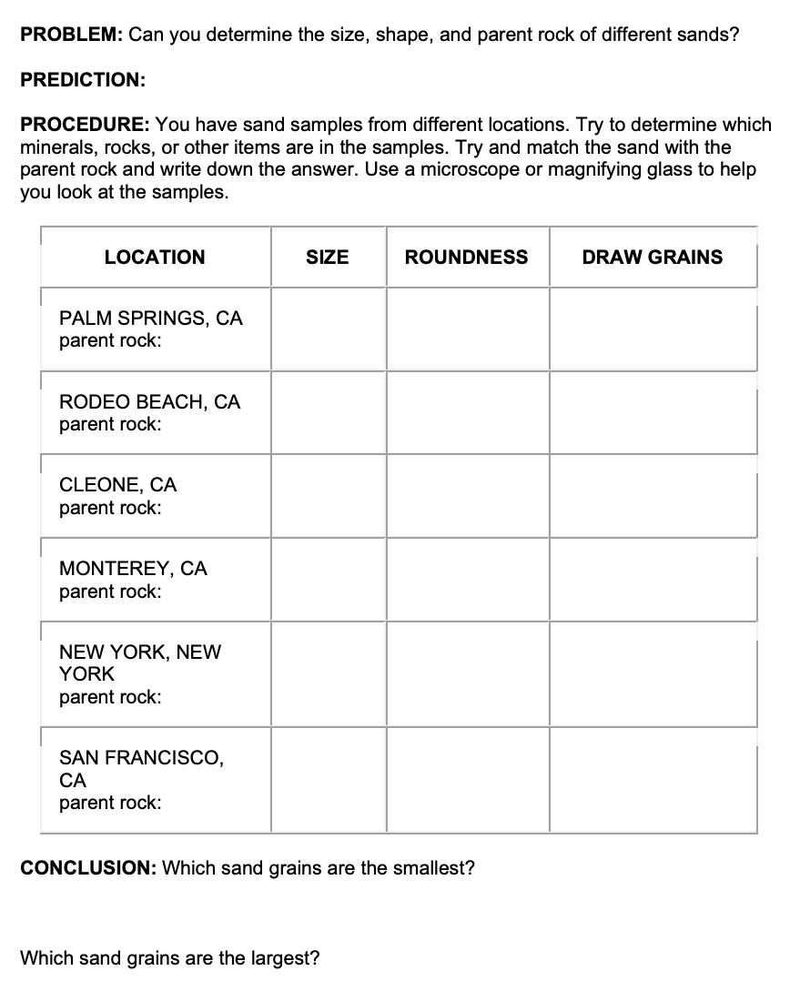
After you have made your sand card. Use the rocks, photos and sand chart to figure out the parent rocks, measure the size of grains and roundness
Maui
Parent Rock:

Slide 9
https://www.msnucleus.org/membership/ngss/fourth_ngss/04sand.html
Docent Notes

