Slide 1
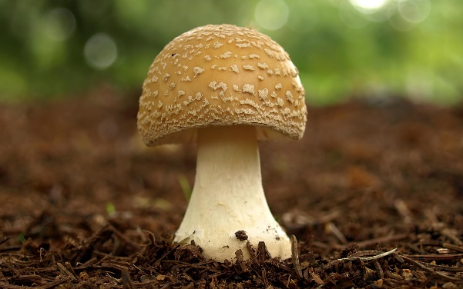
Mattos Science Magnet Docent Program
Fourth Grade Lesson 3. FUNGI IN THE ENVIRONMENT Students examine mold samples under a microscope.
Math Science Nucleus © 2024

Slide 2
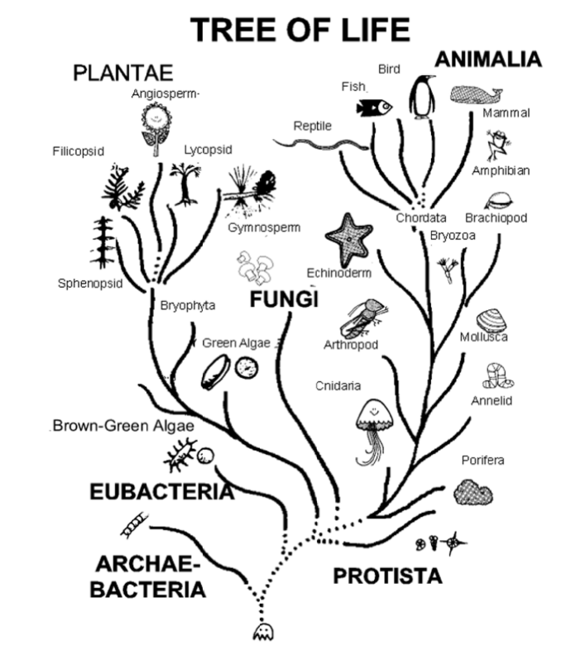
Fungi is a separate Kingdom
Notes:
Question for the young scientists: How do plants get their energy? How do animals get their energy? How do fungi (such as mushrooms) get their energy? It’s different, fungi is so different that they are their own category of life, known as fungi: Mushrooms, molds, yeast

Slide 3
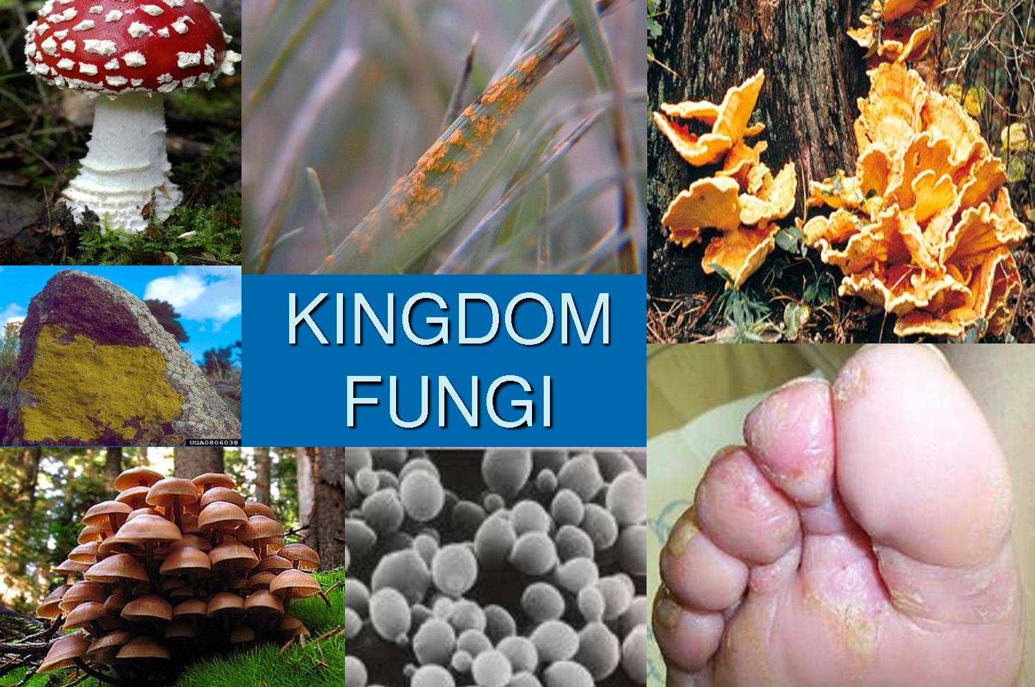
Rust
yeast
Mold, mushrooms and yeasts
Fungi are organisms that get food by breaking down organic matter and absorbing the nutrients, reproduce by means of spores, and have no means of movement. They are the most important decomposers on Earth.

Slide 4
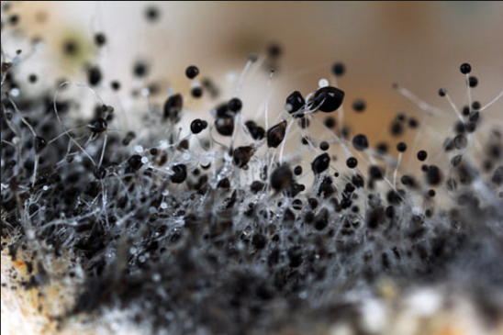
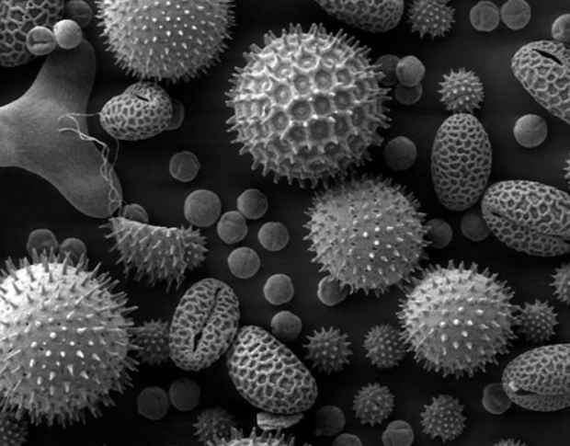
Spores
A spore is part of the life cycle of fungi; some bacteria and algae.
Mold spores are sometimes round balls at the end of the hairy filaments.
Spores are microscopic

Slide 5
Molds are a type of fungi

Slide 6
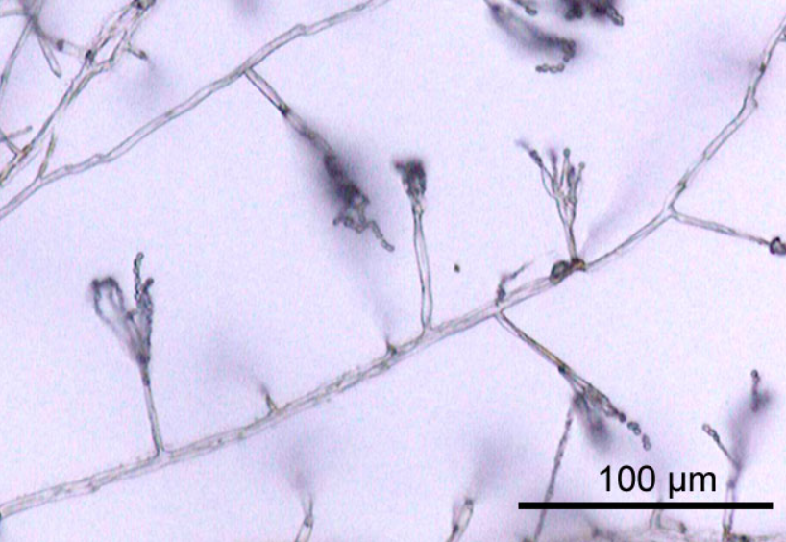
Penicillin is a Mold
Under a microscope hyphae of penicillin

Slide 7
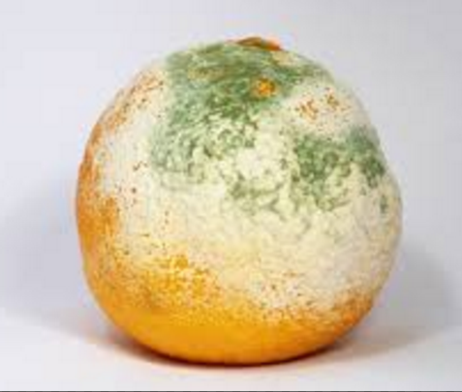
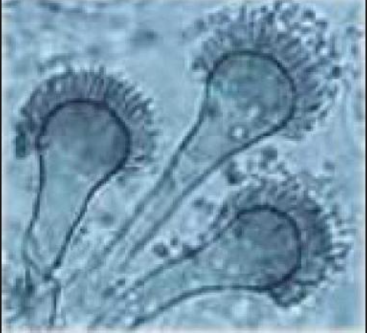
Molds – Fungi with a Hyphae
Multicellular Fungi, hyphae make mold look “fuzzy”

Slide 8
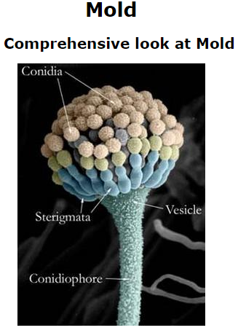
Molds
Molds are nature's super "recyclers", feeding on dead and decaying organic material such as trees and plants.
They put out spores to reproduce. Mold spores are in the air all around us.
When the conditions are right, the spores grow.
Molds like warm, moist conditions.

Slide 9
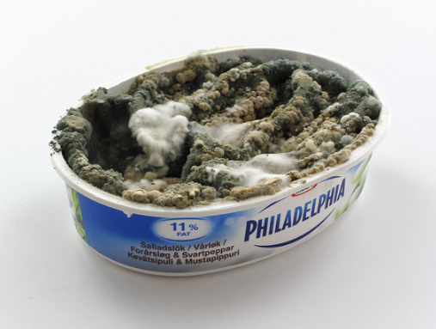
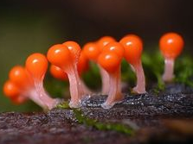
Mold have many colors, but like moist and warm areas to grow.

Slide 10
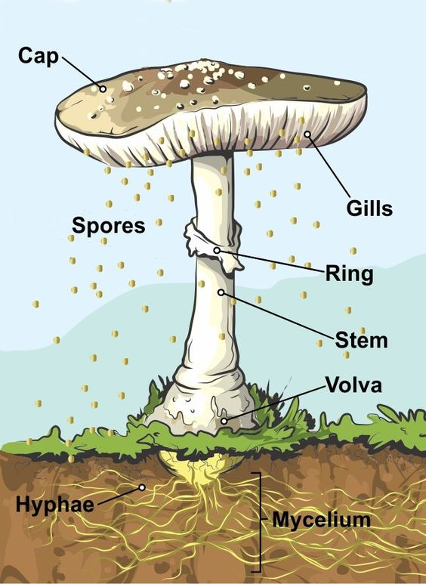
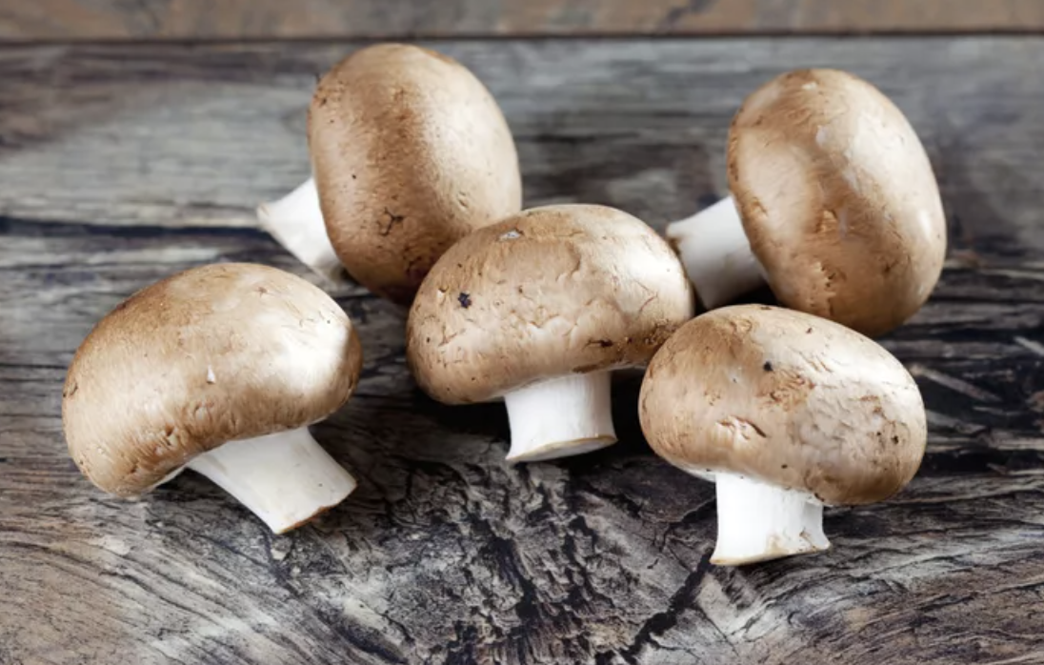
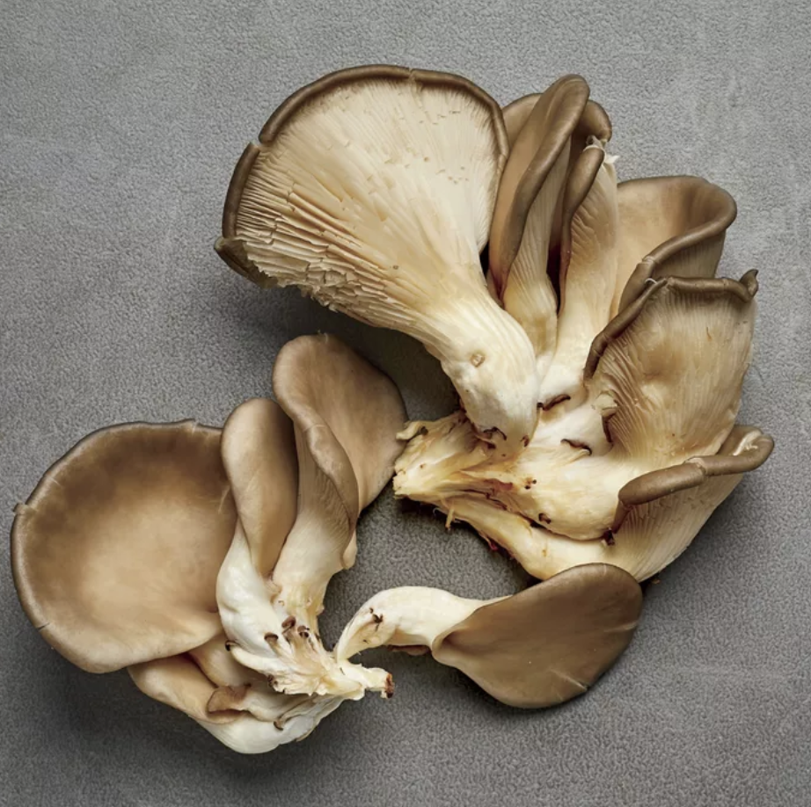
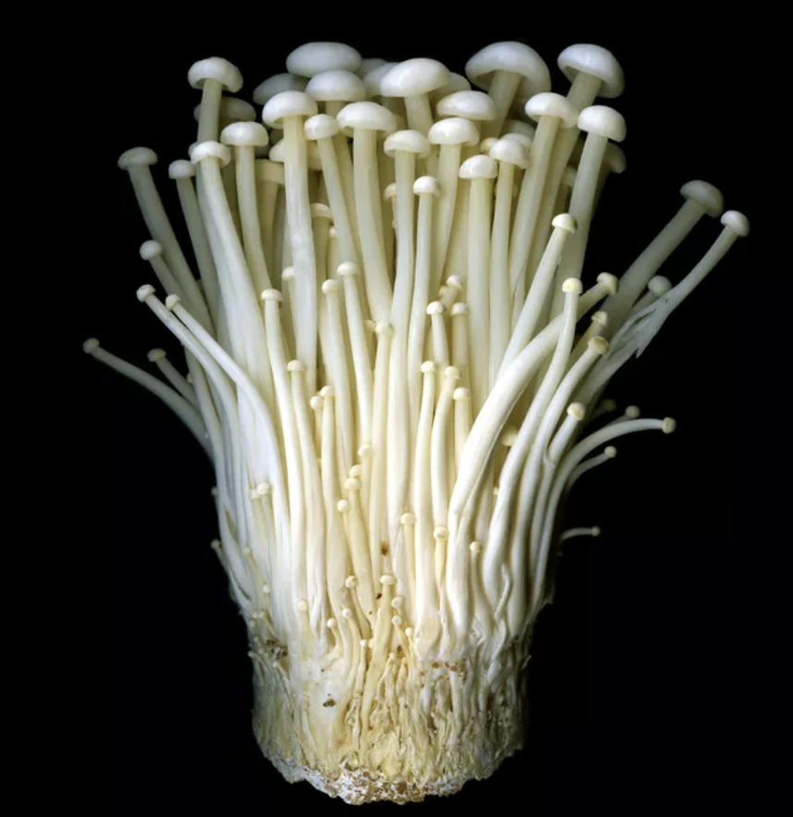
Activity 1: Observe a mushroom
NEVER EAT A MUSHROOM IN THE WILD!
MANY ARE VERY POISONOUS!
Cut the mushroom in half to see the parts. Identify the cap, gills, stem and spores. Use a microscope

Slide 11
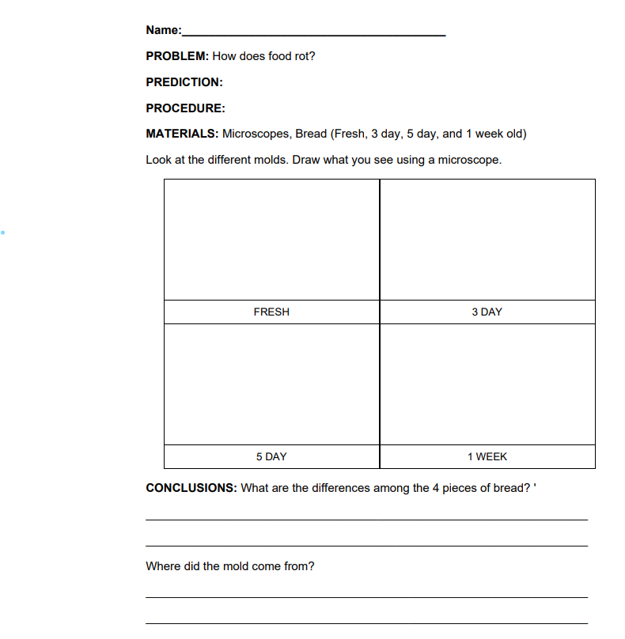
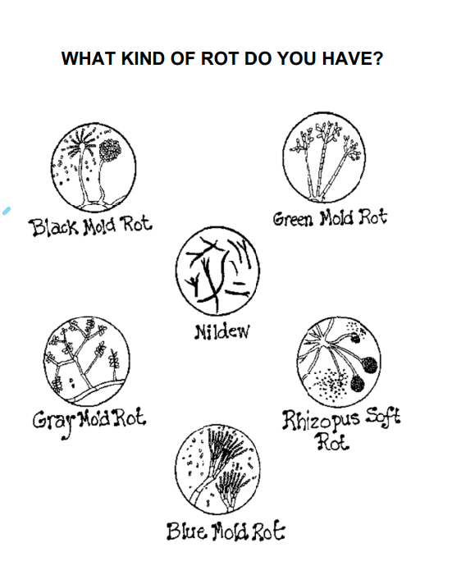
Activity 2 – Observe mold growth on bread
Look at examples of bread with fresh, 3 day old, 5 day old and 7 day old bread. Can you find mold? Is there more than one type? Look under the microscope and try to identify them using the chart and draw them on your worksheet.

Slide 12
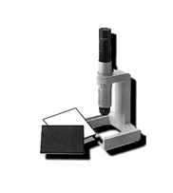
How to use a microscope
Review the microscope (remember with the Swift GH the objective needs to be 3 inches away from the specimen)
They are set to focus already.
Don’t lean on them or touch them.
Ask for help if they get out of focus.
Have a partner hold a flashlight on them so you can see better.

Slide 13
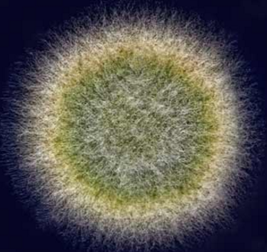
Molds can have different structures and often look hairy or fuzzy

