Slide 1
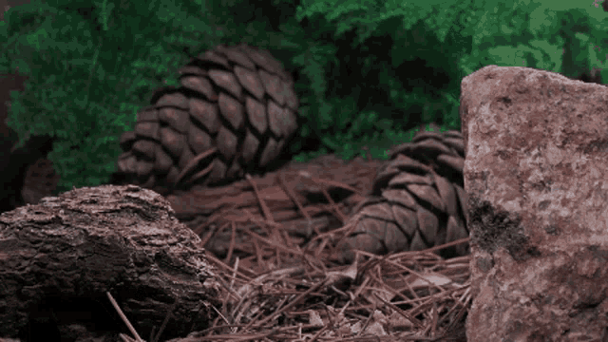
Mattos Science Magnet Docent Program
Fourth Grade
Lesson 1. Composting Organisms
Math Science Nucleus © 2024

Slide 2
Working on the food chain

Slide 3
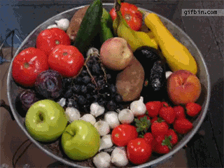
Today we focus on one part of the food chain, the decomposers
What is happening here?
Do some fruits and vegetables last longer than others?
What do you see?

Slide 4
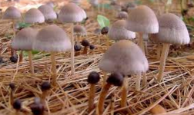
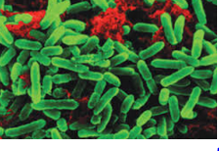
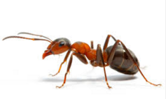
We need decomposers to convert organic matter; some are microscopic and others are larger

Slide 5
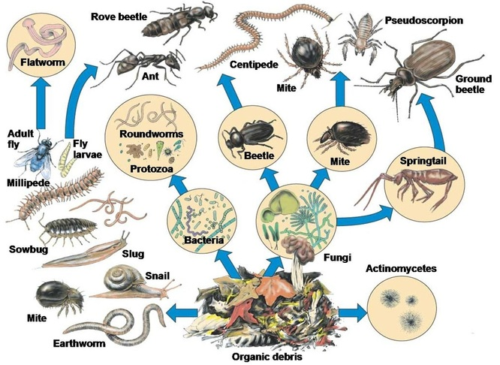
Decomposers – Cool vs Hot
Hot composters are the small ones—they can produce a lot of heat and can decompose rapidly if they are in a pile
Hot
Hot

Slide 6
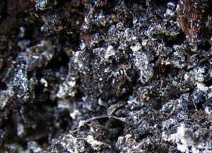
Actinomycetes—very small decomposer They are thermophilic (heat producing)

Slide 7
Experiment or Activity 1
Examine actinomycetes
Compare what you can see with your eye and then with a microscope. Can you see the little filaments (they look like little strings)

Slide 8
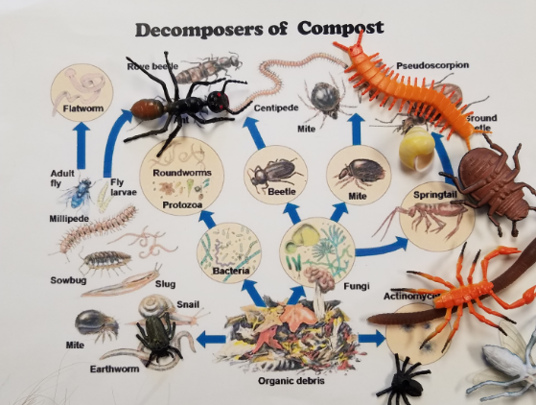
Use plastic models to study the decomposer food web Some decomposers eat the dead material while others are predators
Experiment or Activity 2

Slide 9
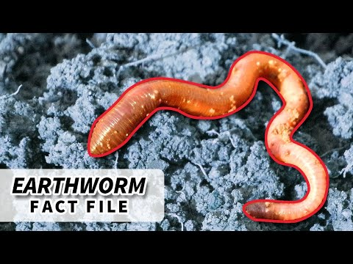
Let’s learn about one decomposer, an earthworm

Slide 10
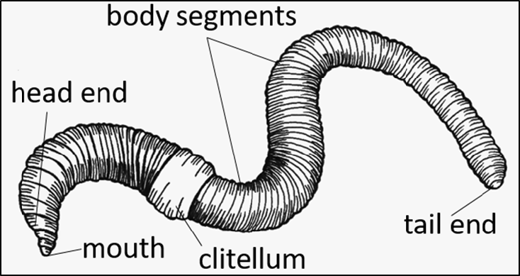
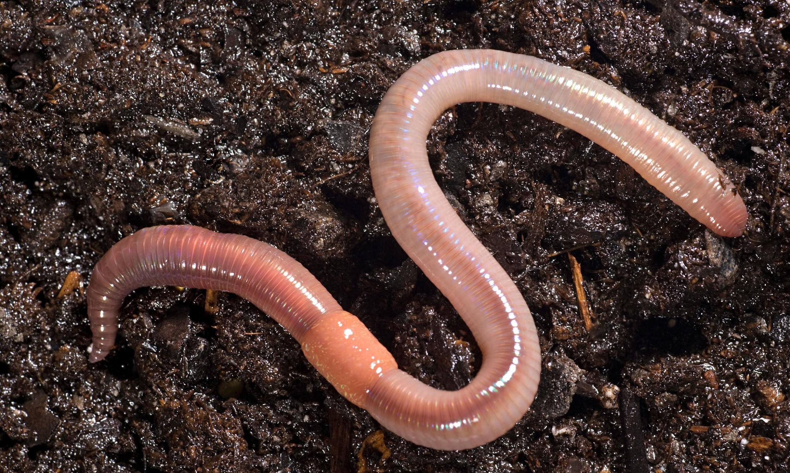
Experiment or Activity 3
Use a popsicle stick to dig out earthworms out of some dirt
Put it in a tray on damp paper towel and observe with a hand lens

