Slide 1
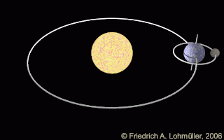
Mattos Science Magnet Docent Program
First grade
Lesson 5. Exploring night/day, the year and seasons
Comparing rotation and revolution and Earth’s tilt on its axis
Math Science Nucleus © 2024

Slide 2
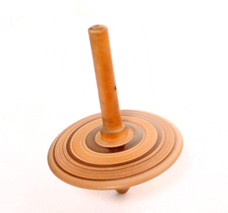
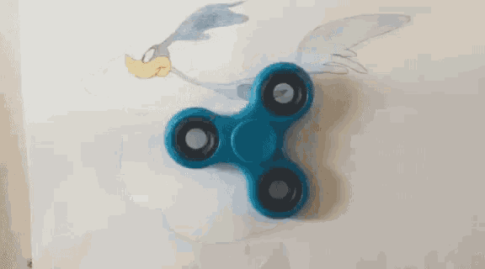
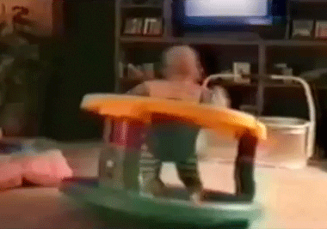
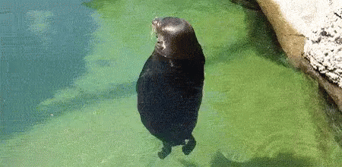
Rotation
To spin or turn on own axis

Slide 3
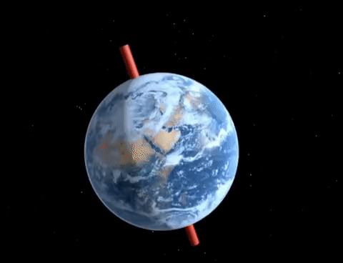
The Earth rotates on its axis
Activity 1: Stand up and rotate! Where is your axis?

Slide 4
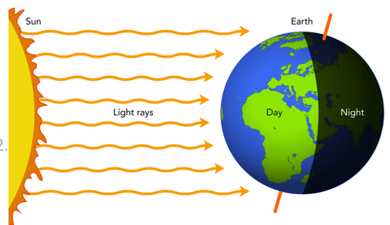
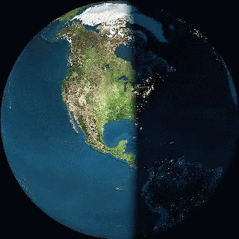
Rotation makes day and night
1 rotation = 24 hours

Slide 5
Rotation makes day and night
Activity 2
Demonstrate with light and globe
Make day/night with light and all students rotate.
Pairs of students make day/night with flashlight and earth ball (add sticker of where they are on Earth).

Slide 6
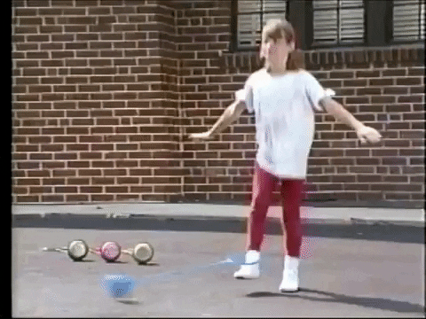
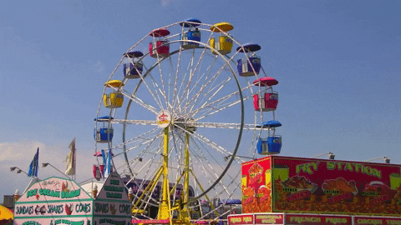
Revolution
To move or orbit around another object

Slide 7
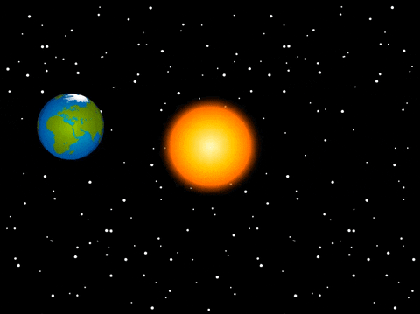
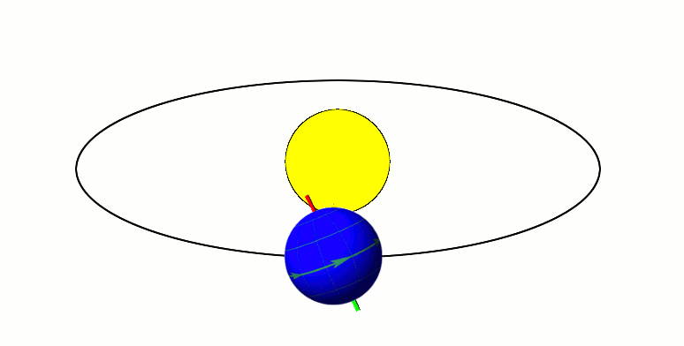
Revolution
The Earth revolves around the Sun. One full revolution is a year.
Activity 3: Stand up and revolve around your chair.
When you have gone around your chair once it is called a ____________?

Slide 8
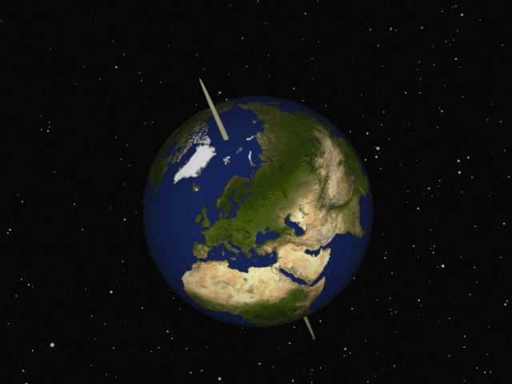
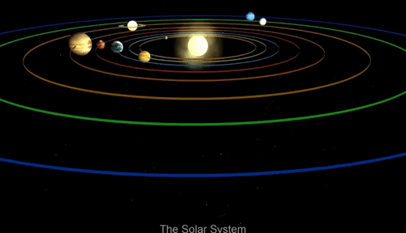
The Earth rotates and revolves!
Can you rotate and revolve at the same time?
Rotating Earth around its axis (spin)
Revolving around the Sun (orbit)

Slide 9
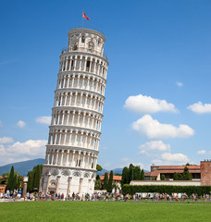
Look at a globe
Is the axis straight up and down?
Or is it on a tilt? “Tilted” means leaning over. Can you tilt a bit in your chair?

Slide 10
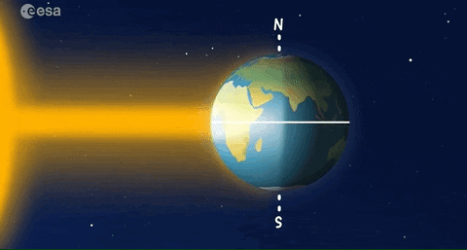
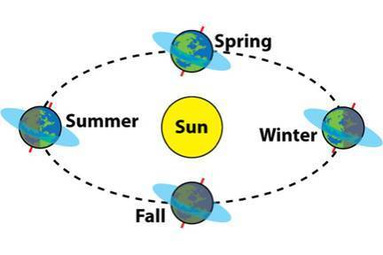
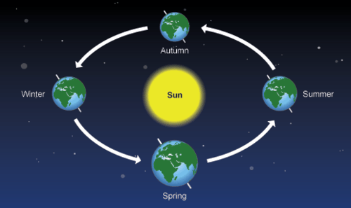
Seasons--The Earth’s tilt explains why we have seasons –
What are the 4 seasons?
Which is the coldest season?
Which is the hottest season?
Axis towards the Sun
Longer days of sunlight
Shorter shadows
Warmer weather
Axis away from Sun
Shorter days of sunlight
Longer shadows
Cooler weather

Slide 11
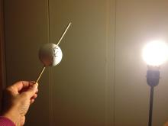
Activity 5 – Model the seasons
The light is more direct (hotter) when the axis faces the light like in summer and less direct (colder) when the axis faces away.
Use your flashlight on the earthball.

Slide 12
Activity 6
Look at the difference in the light when it is straight on or at a tilt.
Use your flashlight to practice making the sun straight up and down and on a tilt over an object.
When is the light brighter?
Which makes shorter shadows and which makes longer shadows?
Summer shadows are short and light is more direct and gets hotter
Winter shadows are long and the light is more spread out and feels weaker

Slide 13
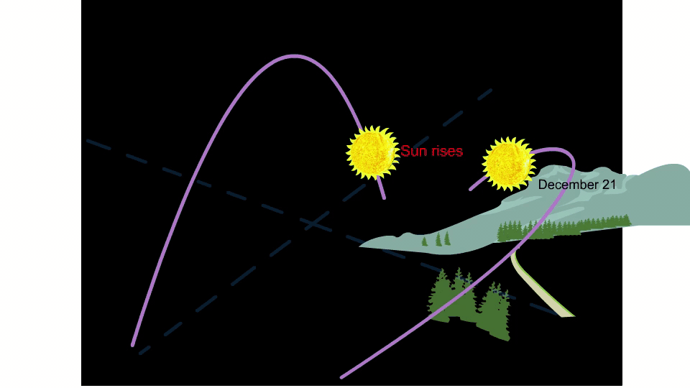
The Earth’s tilt explains changing shadow length during the year.
Summer solstice, Sun is high in sky
Winter solstice, Sun is lowest in sky
In your long term project you are seeing longer shadows in the winter and shorter shadows in the fall and spring.
Notes:
During the June solstice, the north pole is tipped directly toward the sun, causing the day in the Southern Hemisphere to be shorter. The sun reaches its northernmost position at the Tropic of Cancer, reversing direction towards the south from thereon.

Slide 14
REVIEW
1. The Earth’s rotation causes _______ and _______ .
2. The Earth’s revolution around the sun is a ___________.
3. The tilt of the earth
causes the __________.

Slide 15
REVIEW
1. The Earth’s rotation causes day and night.
2. The Earth’s revolution around the sun is a year.
3. The tilt of the earth
causes the seasons.

Slide 16
Docent Notes
Learn more at: https://www.msnucleus.org/membership/ngss/first_ngss/01day_night.html
Good background video on seasons: https://www.youtube.com/watch?v=vXjFJe5i-1o

