Slide 1
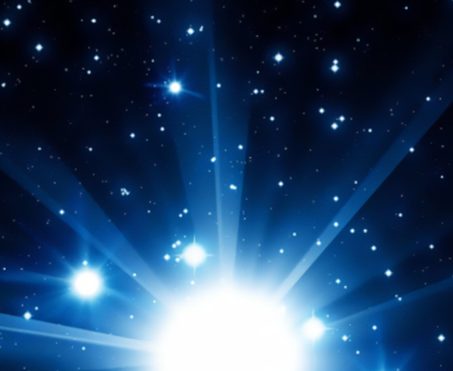
Mattos Science Magnet Docent Program
First grade
Lesson 4. Light in the Universe
Discovering the Sun is a star. It radiates light. Light reflects off other objects.
Math Science Nucleus © 2024

Slide 3
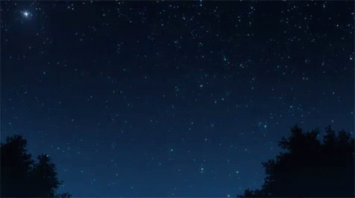
Shooting star—a rock burning up and produces light

Slide 5
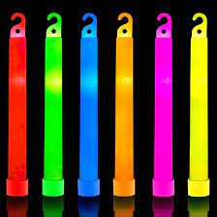
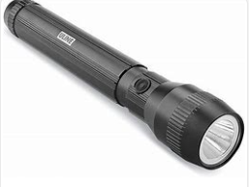
Observe things that produce light
What makes its own light in the classroom?
Explore how flashlight and alien ball produce their own light, like a star.
Demonstrate how a light stick produces light.
Notes:
In each case, show the students that the object can emit light. This is light the stars. They emit light.

Slide 6
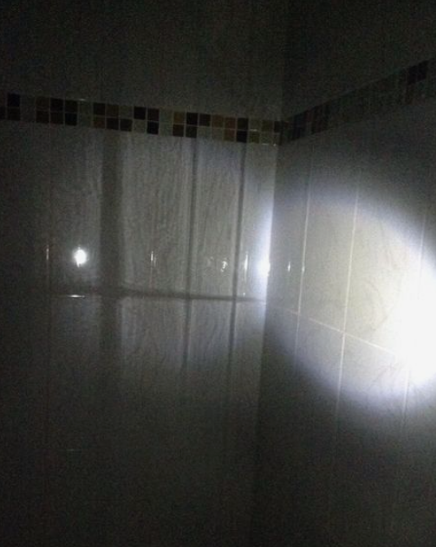
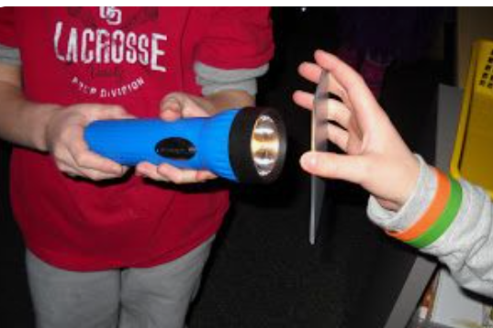
Activity 1 – Practice producing and reflecting light using a flashlight and a mirror
Moon
Notes:
Give each pair a flashlight and a mirror. Tell them not to turn it on yet.
Turn off the lights in the class.
Before turning on the flashlight, it the flashlight producing light ("no")
Ask is the ceiling producing light (no)
Turn on the flashlight, is it producing light now? Yes.
Shine the light onto the mirror. Can you reflect the light onto the ceiling? HINT: hold the flashlight like picture, do not move flashlight. Only move the mirror.
Can they see a light on the ceiling? Is the ceiling producing light or reflecting light (reflecting).
3. Now switch who holds mirror and flashlight. Can you reflect the light to the ceiling?

Slide 7
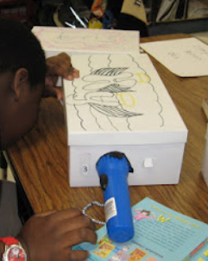
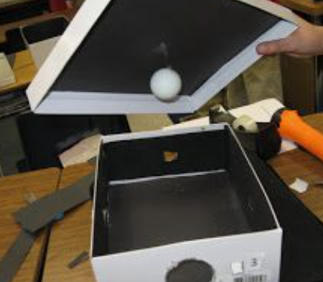
Activity 2 --Peek in the mystery box!
Can you see things if there is very little light?
Peek into the box.
How many items can you see?
Are any things emitting light?
Are any reflecting light?
Try again.
How many items can you see emitting light like a star?
How many items do you see reflecting light like the moon?
Can you see more things in the box now? Why?
Turn on the classroom lights and open the box lid.
Is there anything you can see now you didn’t see before?
Why is it easier to see everything now?

Slide 8
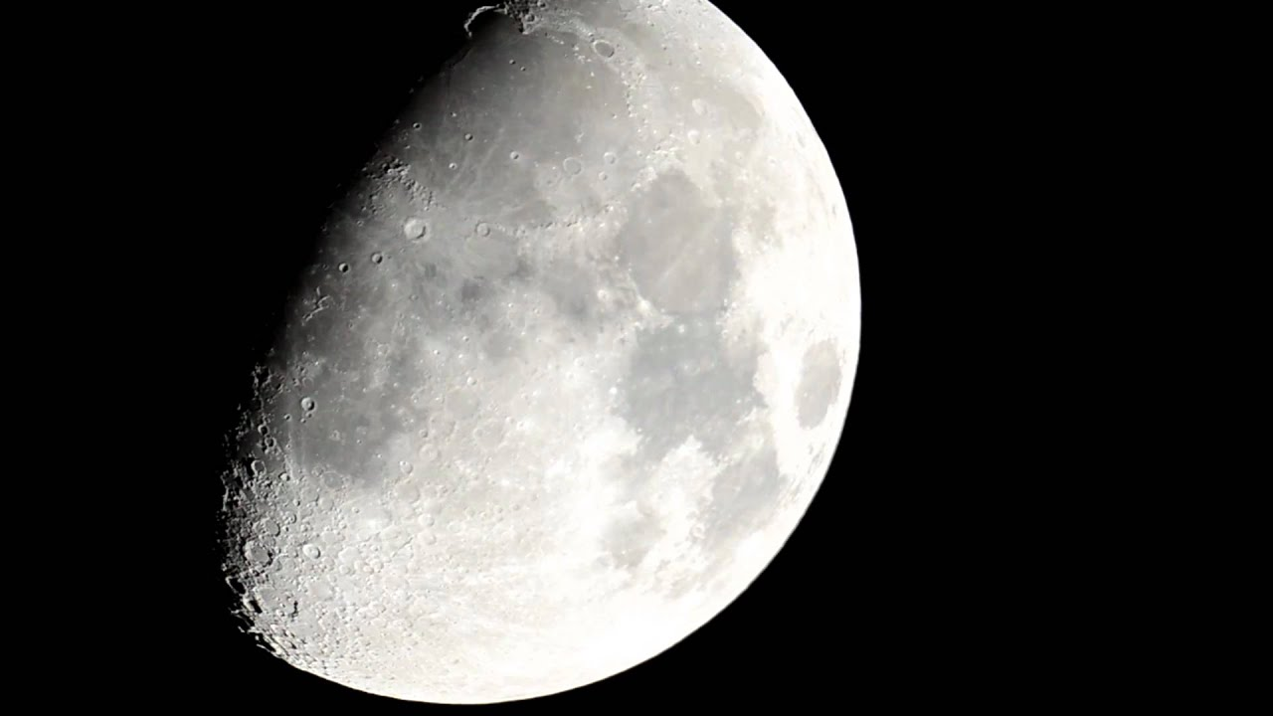
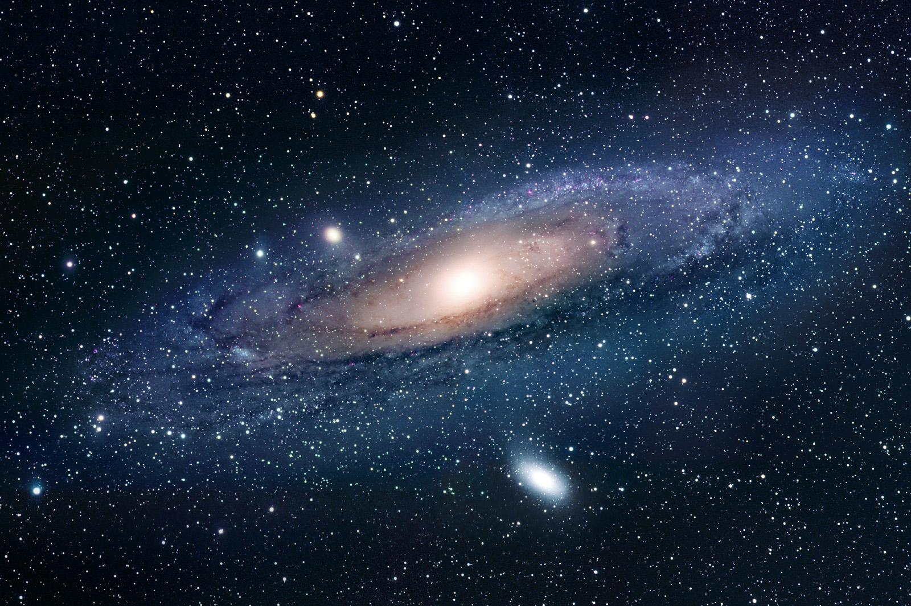
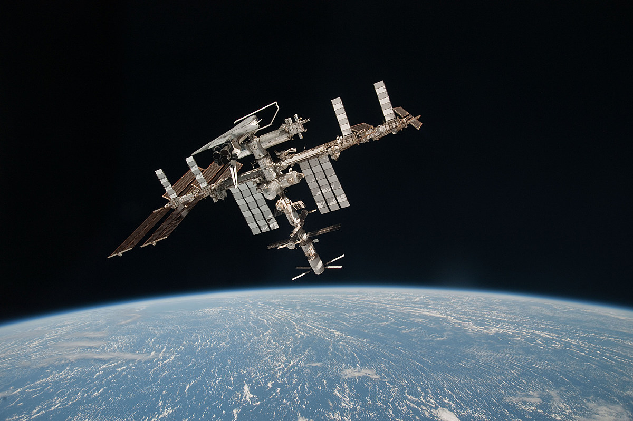
LESSON REVIEW
Which objects in the sky produce light and which reflect light?
Shooting star (meterior) reflects
Galaxy – group of stars
Satellites space station

Slide 9
LESSON REVIEW
Which objects in the sky produce light and which reflect light?
Shooting star (meterior) reflects
Galaxy – group of stars
Satellites space station

Slide 10
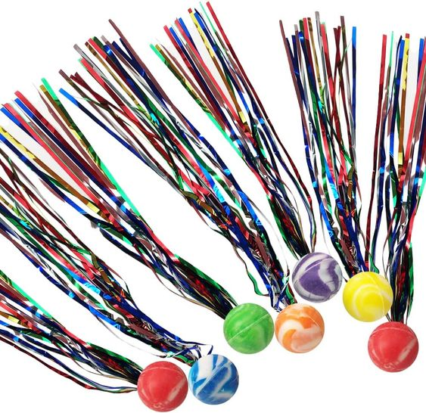
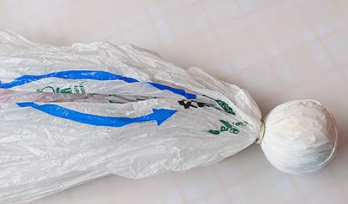
If you can darken a room…
ACTIVITY 3 Fly a comet!
Does it emit or reflect light?
A comet is an object that is made up of gases and rocks. When near the Sun, a “tail” of gas and dust particles point away from the Sun. Comets do not pass Earth very often.
Give each pair of students a comet ball (bouncy ball with reflective streamers)
Give several pairs of students flashlights and energy balls to act as shining stars. (4 flashlights to shine as students are tossing comets)
Students will throw the comet to their partner. Practice several times because when you turn the lights out you want them to catch the comets.
Turn off light. Toss comet to partner. Can you see the comets? (no if its darkened)
Turn on flashlights turned to comet pathway. Toss comets again. When can they see the comets? (Comets are visible when they contact light of flashlights. The comet is reflecting light, not producing light.

Slide 11
Docent Notes
Learn more at: https://www.msnucleus.org/membership/ngss/first_ngss/01light_universe.html
Mirrors may be in box from previous 1st grade lessons

