Slide 1
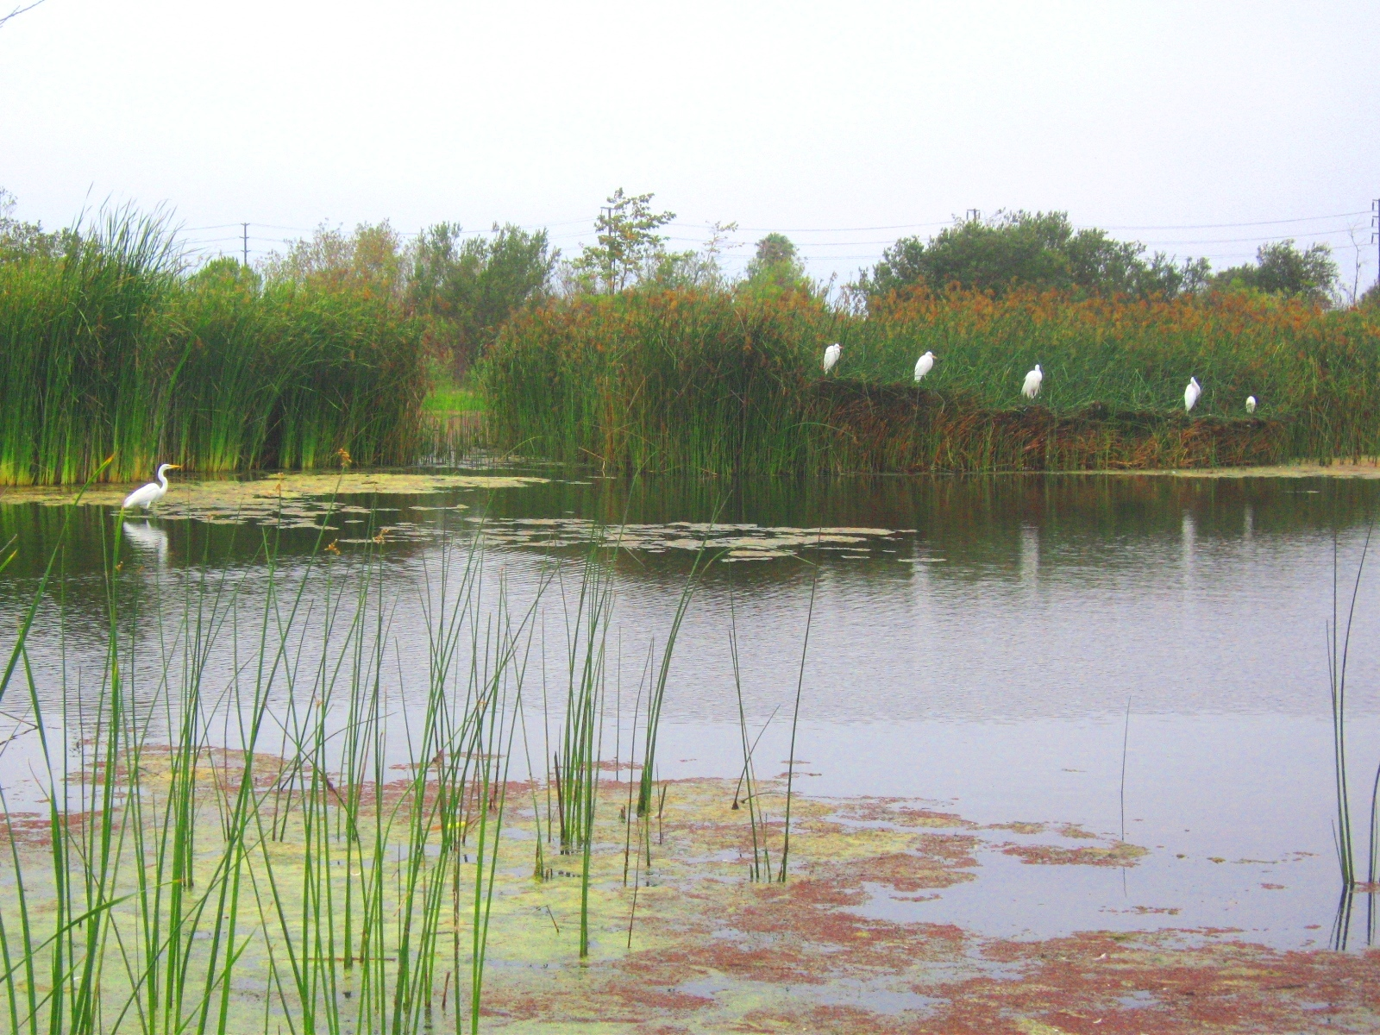
Mattos Science Magnet Docent Program
Fifth grade
Lesson 5. Constructed Wetlands Students learn about properties of wetlands and examine two wetland plants (tules and cattails) that can help clean the water and add dissolved oxygen. They compare soil samples from hydric soil (pond soil) with non-hydric soil (soil formed under drier conditions) and learn that hydric soil can help filter water through microbial action.
Math Science Nucleus © 2024

Slide 2
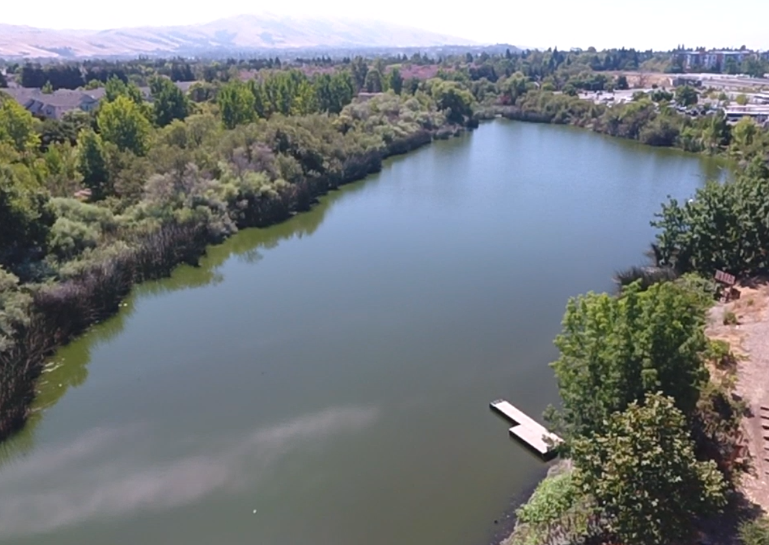
Wetland areas are essential to the balance of earth’s ecosystems. Wetlands help to control floods and prevent coastline erosion. They also act as carbon sinks that help to control global warming. Wetlands provide humans with many types of fish and shellfish that are used for food. Despite these benefits, wetlands are often threatened by development and pollution.
Tule Ponds at Tysons Lagoon
(bart station) upcoming fieldtrip

Slide 3
Insert Wetland in the city storybook

Slide 4
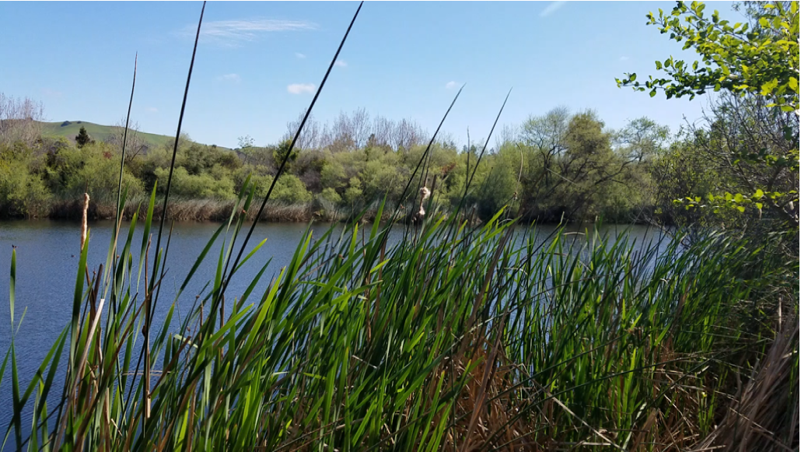
Tule Ponds at Tyson Lagoon

Slide 7
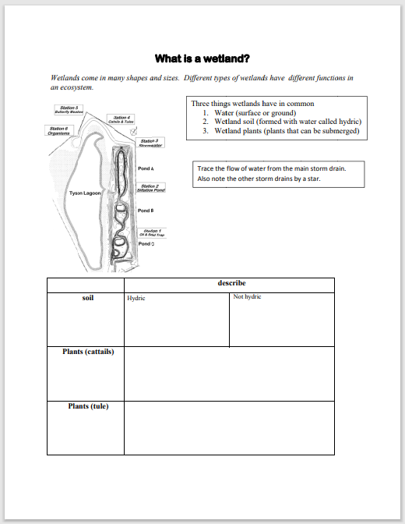
Student worksheet
Use blank for kids to color
Use blue master for ppt and docent
Soil anaerobic, decomposers working
Core sample
Texture
Odor
Color hydric dark
Put colored version of map

Slide 8
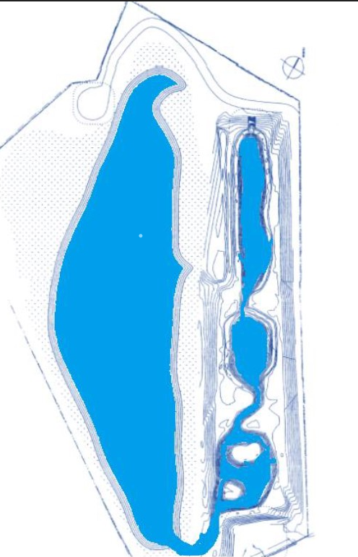
Master Tule Pond at Tysons Lagoon
Activity characteristics of Tule Pond Wetland
Color water blue
Edges near water are wetlands (green)
Arrow at top stream entry to Tyson lagoon (red)
Storm drains (black X)
Arrow water exit to SF Bay

Slide 9
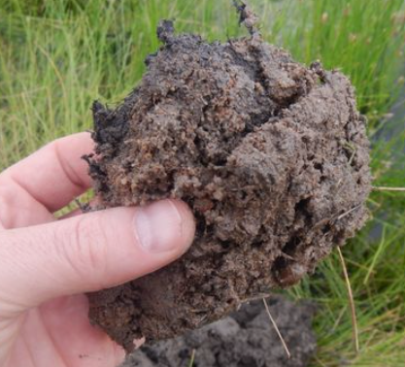
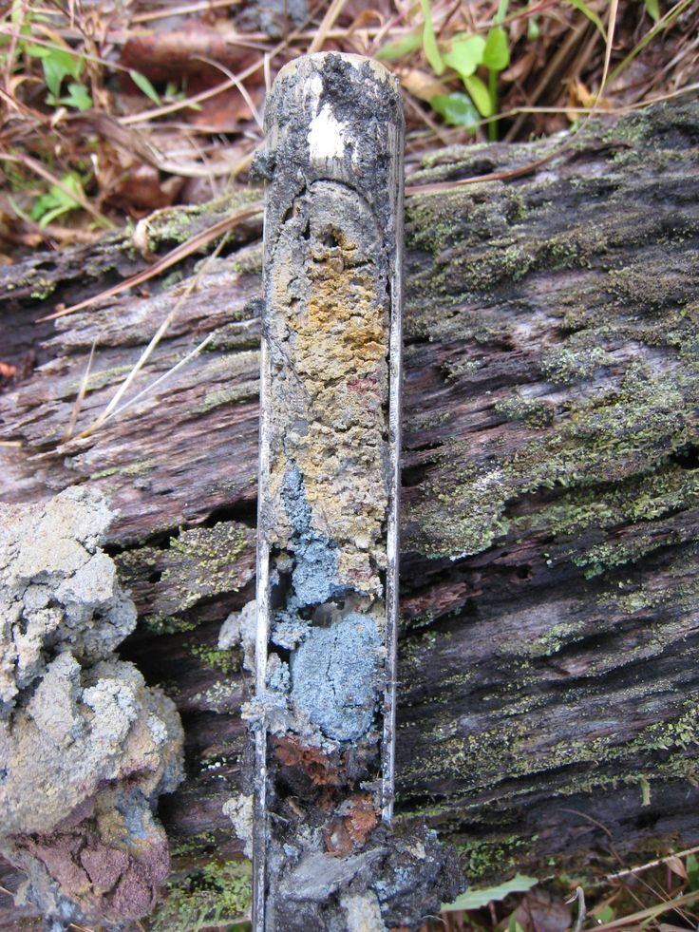
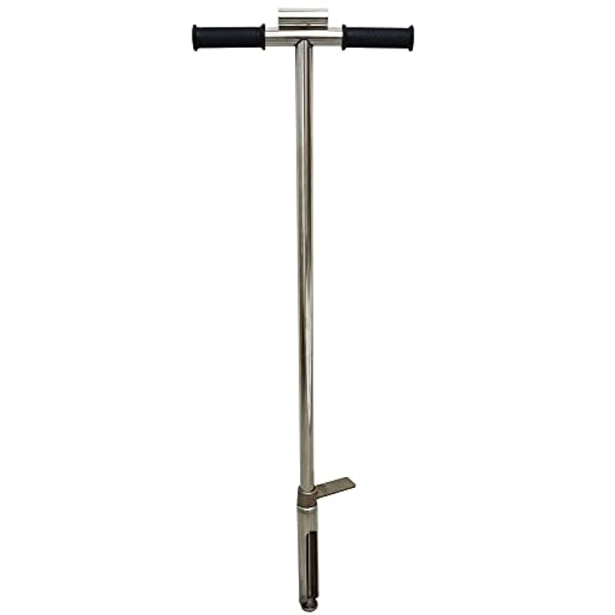
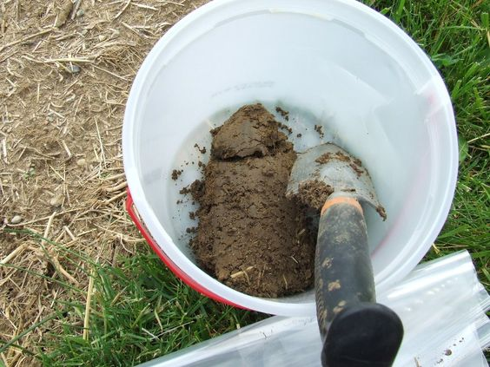
Activity Exploring Soils of a wetland
Hydric soils
Wet or moist
Dark color
Smelly (sulfur)
Soil probe
Core sample
Soil sample

Slide 10
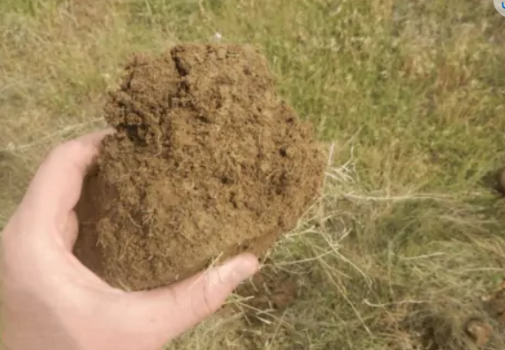
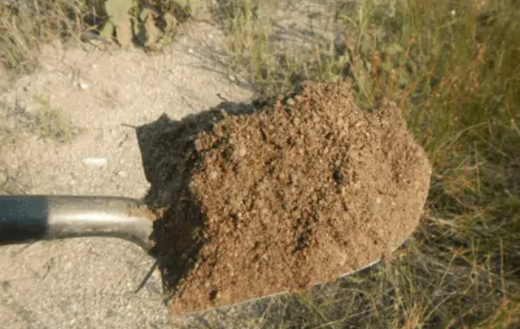
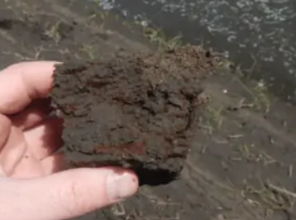
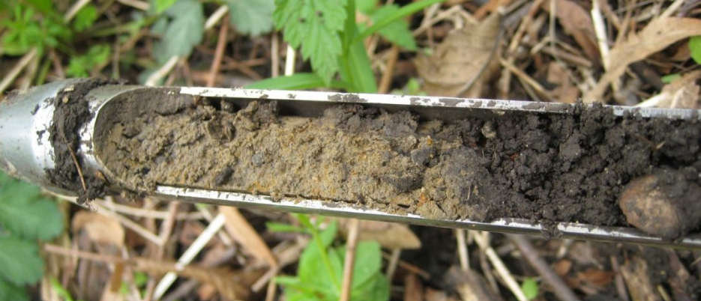

Slide 11
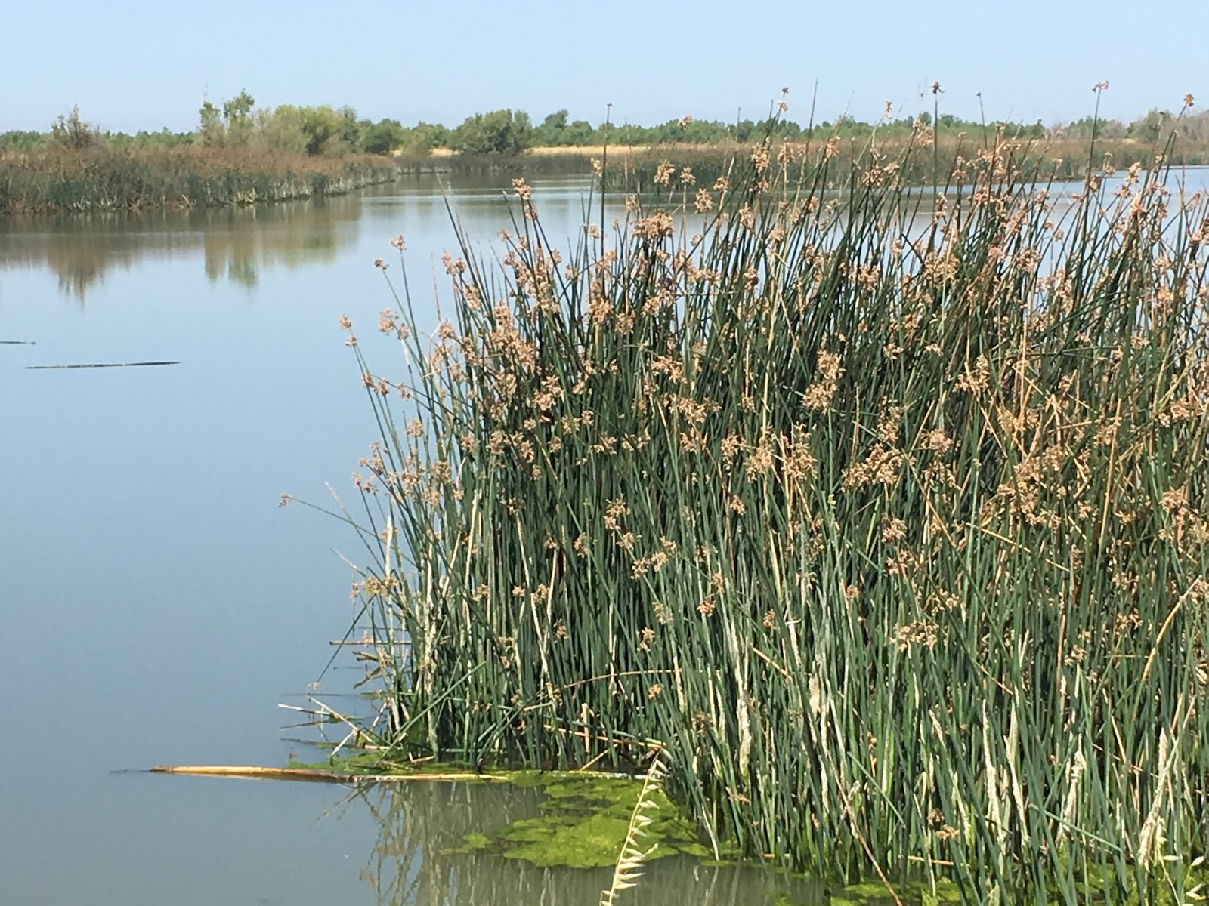
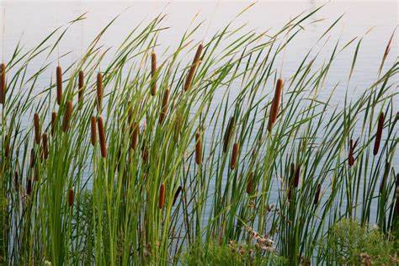
Activity Exploring plants of a wetland
Leaf
Stem
Seeds
Roots can be submerged in water
Just to remind docents… help guide students observations recod on lab sheet
Plop a bunch down they have to figure out which plant is which…

Slide 12
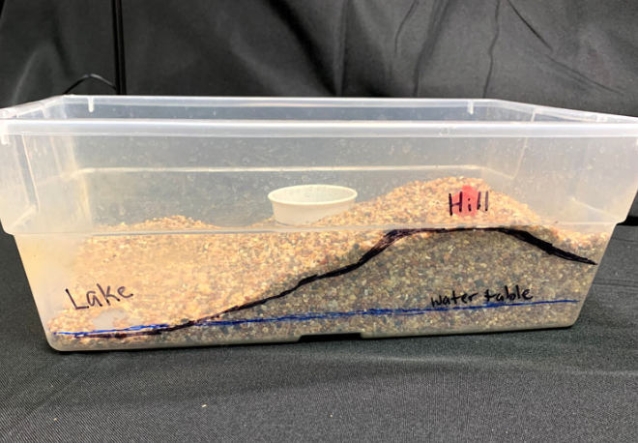
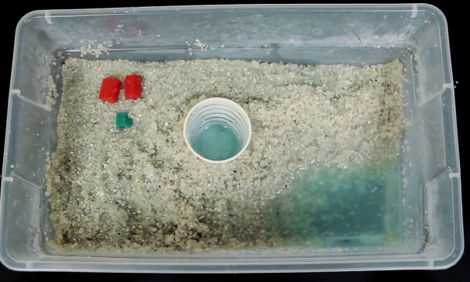
Activity How does water flow through a wetland?
Use materials to create a landform area that includes a taller hill, and a lower area.
Use colored water to rain on your landform. Notice where water settles or accumulates.
Record on the back of lab sheet, what is looks like from the side. (hill, lake)
Do you have water along the bottom? (water table)
4. Draw what it looks like from above.
5. Use a straw to “drill” a well to find your aquifer.

Slide 13
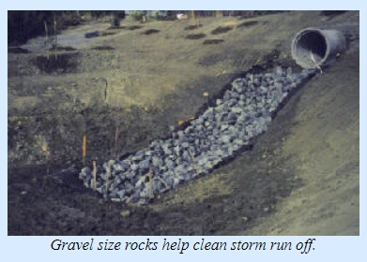
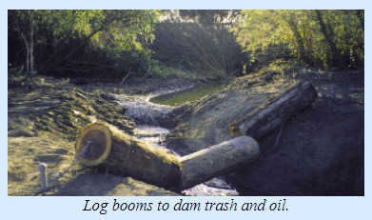
Roots of wetland plants …
Help hold soil from washing away with water current
Wetland plants protect shoreline from wind erosion
Help clean the water! Bioremediation plant roots hold onto heavy metals and other toxic materials.
Why Tule Ponds work to store and clean water?
Natural and man made ponds
Log booms slow water and collect trash
Layers of rock and soil filter water making it safe for organisms of Tule Pond

