Slide 1
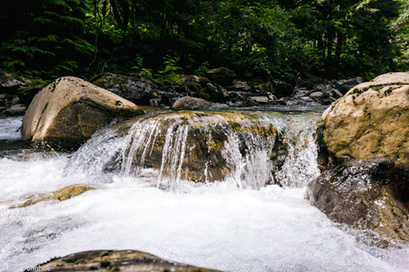
Mattos Science Magnet Docent Program
Fifth Grade Lesson 1. Watershed
Math Science Nucleus © 2024

Slide 2
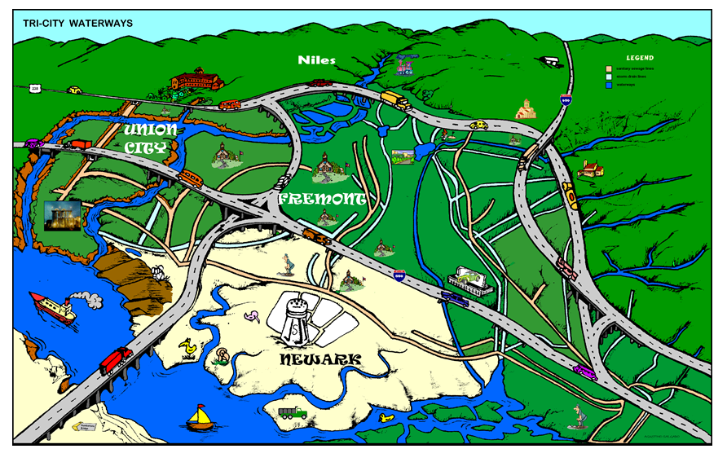
Activity 1 –Watershed Map of Area
a. Find the cities of Newark, Fremont, Union City b. what is the difference between the brown, light blue and dark blue lines on the map (make sure they see the legend). c. Find East, West, North, South (east is where the East Bay Hills are, Mission Peak) d. how does the water flow e. locate: Tule Ponds and Lake Elizabeth

Slide 3
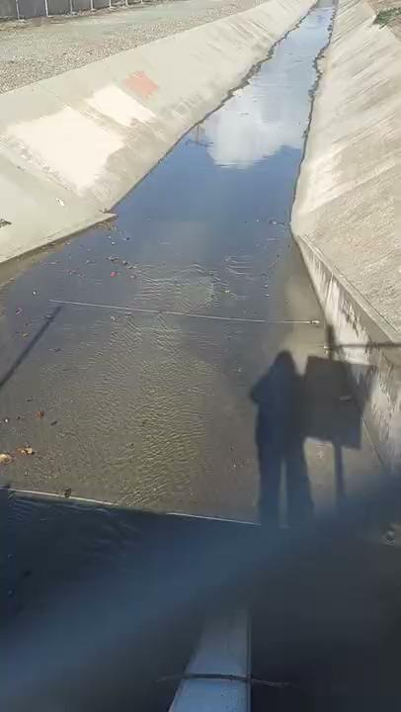
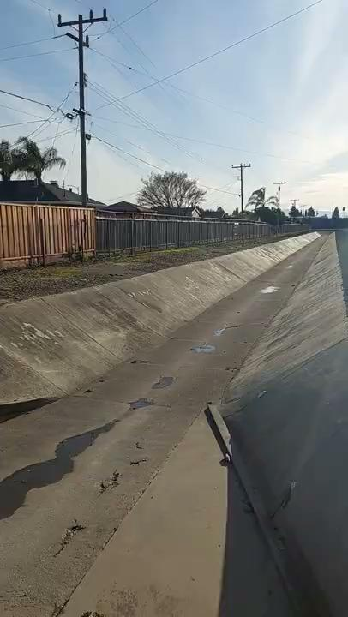
Storm drains (light blue on the map)
after a rain
almost dry

Slide 4
What is a Watershed?
A watershed is the area of land where all of the water that falls in it and drains off of it goes to a common outlet.

Slide 5
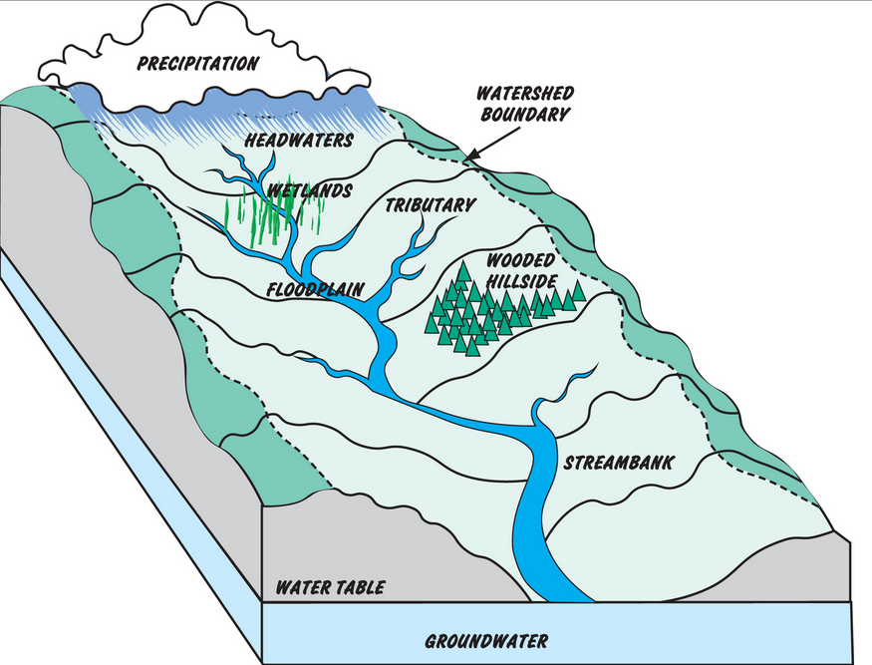
Components of Watershed
All streams drain to common main stream
Flows by gravity
Goes into another body of water

Slide 6
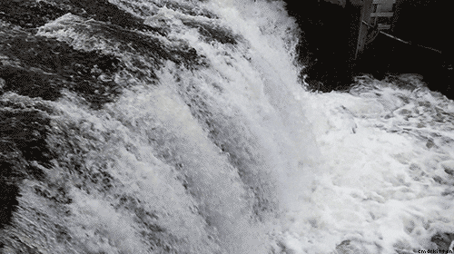
Components of Watershed
Based on the principle of gravity
Water always flows from higher to lower

Slide 7
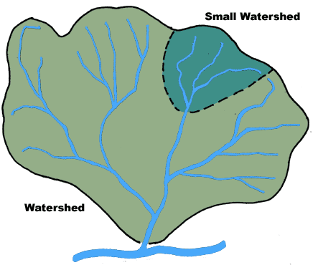
Size of watersheds varies depending on scale

Slide 8
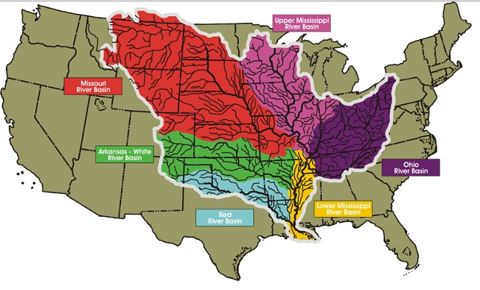
If we are looking at the health of our water, why does knowing the extent of the watershed help you understand pollutants?

Slide 9
River basins are collections of smaller watersheds

Slide 10
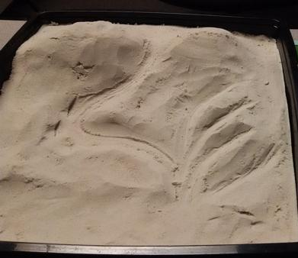
Activity 2 – Make a watershed
Now you get to make a watershed!
Needs to show how the water moves and where does it end up. Use marbles to use in place of water
You need to be able to show the boundaries of your watershed.

